Slide 1
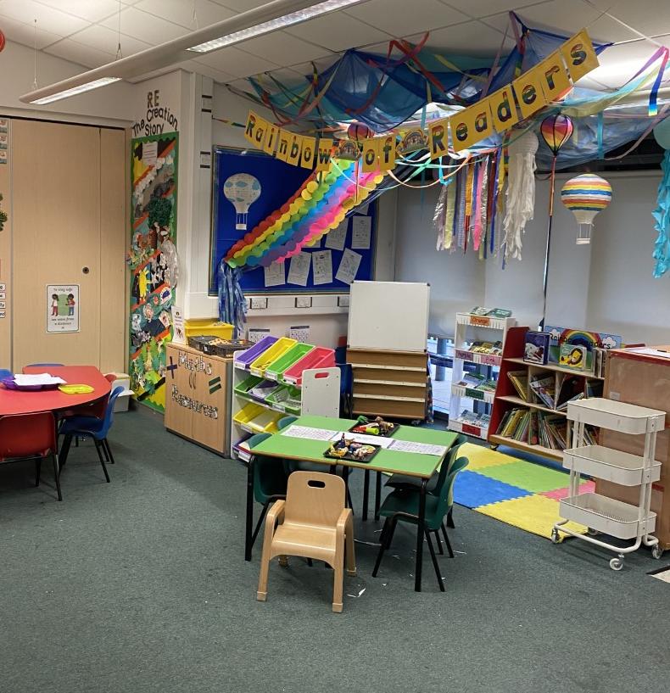

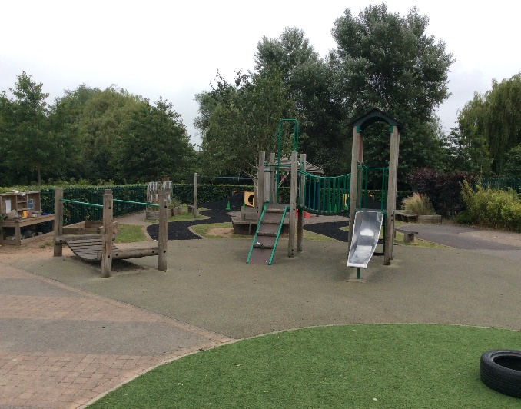


Slide 2



Slide 3

We belong to Our Lady and All Saints MAC
This is our MAC Children’s Charter

Slide 4
Attendance
Regular school attendance is essential if children are to enjoy their education and make good progress.
At St. Anne’s Catholic Primary School, we believe that regular school attendance is the key to enabling children to maximise the educational opportunities available to them and become emotionally resilient, confident and competent adults who are able to realise their full potential and make a positive contribution to their community.
Expected levels of attendance:
98-100% | Excellent. Accessing all learning opportunities
96-97% | Good. Very few learning opportunities missed
94-95% | Risk of under achievement up to 50 missed lessons Up to 10 school days absent in an academic year
92-93% | Risk of under achievement Up to 75 missed lessons Up to 15 school days absent in an academic year.
90-92 | Severe risk of under achievement Up to 100 missed lessons Up to 19 school days absent in an academic year
90% and below | Extreme risk of underachievement over 100 missed lessons Pupil is persistently absent upwards of 22 school days absent in an academic year
50% and below | Extreme risk of underachievement Pupil is severely absent At least half of all lesson and days missed
School Day and Punctuality
It is important that pupils are punctual so that they do not miss out on the beginning of each school day. Children must attend on time to be given a present mark for the session.
If a pupil arrives late to school every day, their learning begins to suffer. Below is a graph showing how being late to school every-day over a school year adds up to lost learning time

Slide 5
Leave of absence
Unauthorised leave of absence of 10 or more sessions
Local authority will issue a fine per parent per child. If paid within 28 days this is £160. If paid within 21 days it is reduced to £80.
If the threshold is met a 2nd time in three years and a 2nd Penalty notice is issued to the same parent in relation to the same child – this will a flat rate of £160 if paid within 28 days.
A third penalty notice cannot be issued to the same parent in respect of the same child within 3 years of the date of issue of the first. In a case where the national threshold is met for a third time (or subsequent times) within those 3 years, alternative action should be taken instead. This will often include considering prosecution.
Please note:
A leave of absence form will need to be completed at least 2 weeks before the absence.

Slide 6
School Dinners
Please apply and register for free school meals as soon as your child enters Reception.
To order your child’s dinner, please login through our online ordering system weblink: https://olaas.myschoolmealorders.com/login
Meals can be ordered until 9.30am on the given day. Essentially, you should register without delay to activate your accounts and get ordering for the following week
All Free school dinners i.e. Free-School meals and Universal Free School meals (Reception to Y2) will still need to be ordered online.
There is more guidance on our website for ordering your child’s dinners and there is also a family information pack, produced by Aspens for you all to look at.
If you are not able to access your child's Blue Runner account or you encounter any issues, please contact school to speak to a member of the office team on 0121 779 8060. Alternatively, email parentmail@st-annes.solihull.sch.uk. The school office staff will help with any queries that you may have.

Slide 7

Solihull Family Hubs
New Family Hubs have opened in Solihull. Our local one is the Riverside Hub, which is in the building outside the school gates on Bosworth Drive.
Services within the family hub:
Health visitors
Midwives
SOLAR
SENDIAS
Urban Heard (Youth Group)
Stay and Play (including a sensory room, which you book via the Hubs)
Solihull College
Solihull Housing
Women’s Community Drop in
Coffee mornings
And many more
The hubs have clothing banks and Evergreen and Elmwood have a community pantry for all to use.
Scan the QR code to download the app, and you will see all of the upcoming events.

Slide 8
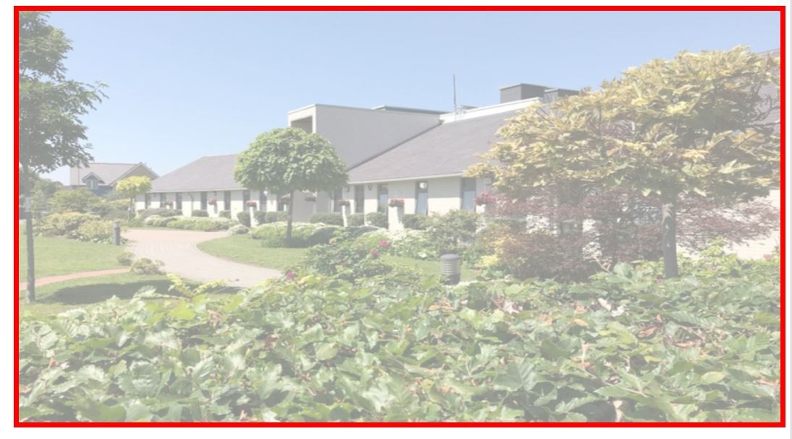
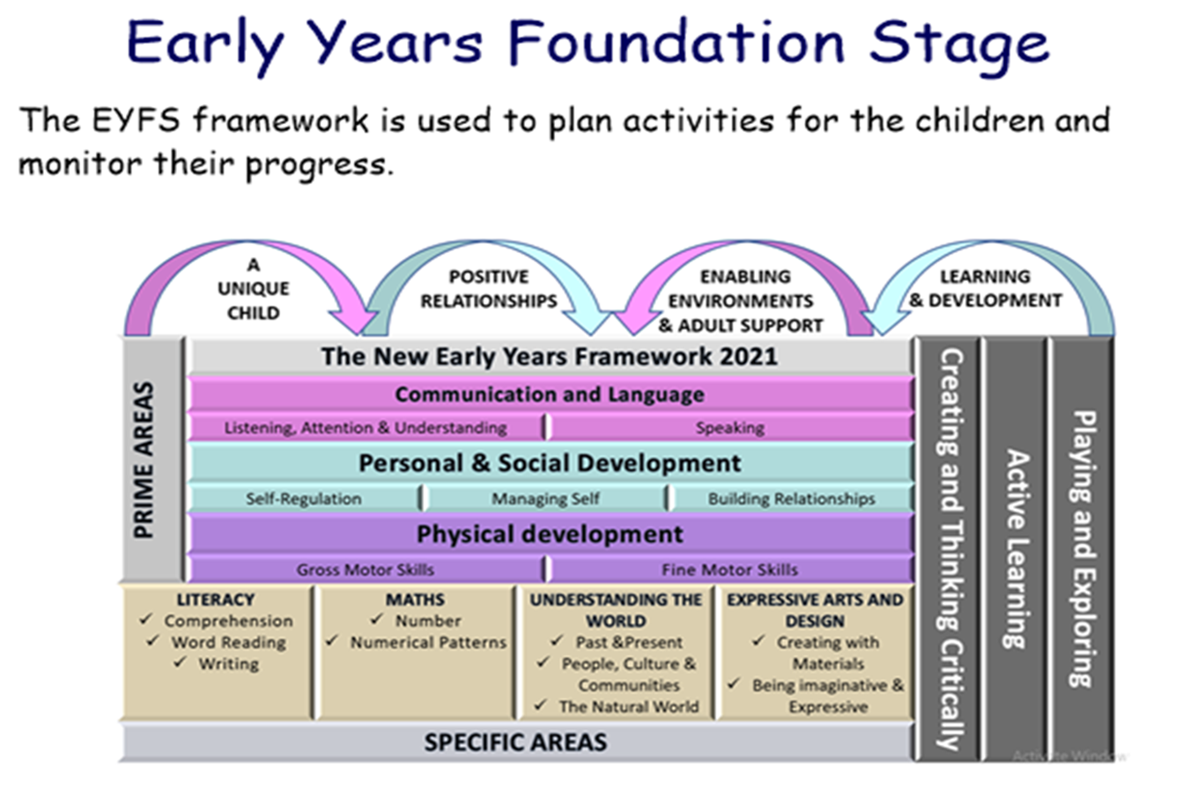
The EYFS
To lay the foundations for learning through a fun play based curriculum. We nurture the children’s growth in many ways across the seven areas of learning.

Slide 9

Prayer to Saint Anne
Saint Anne
Since Mary was your daughter
and Jesus your grandson,
look lovingly upon our families
in the same way that you looked upon the
Holy Family in Nazareth,
and intercede for us in heaven
where we all hope to meet one day
as members of the one, splendid family of God,
our sins forgiven,
our problems solved
and our hearts filled with love
Amen

Slide 10
Catholic Life and Celebration of the Word
As a Catholic School we practise our faith every day.
All children take part in Prayer and Liturgy and children say daily prayers. All children receive a prayer booklet at the beginning of the new academic year. Please practise these prayers with your children at home.
The Sign of the Cross (Children will make the sign of the cross using the words below until the Spring Term)
From my head, to my heart.
From this shoulder, to this shoulder.
I belong to God.

Slide 11
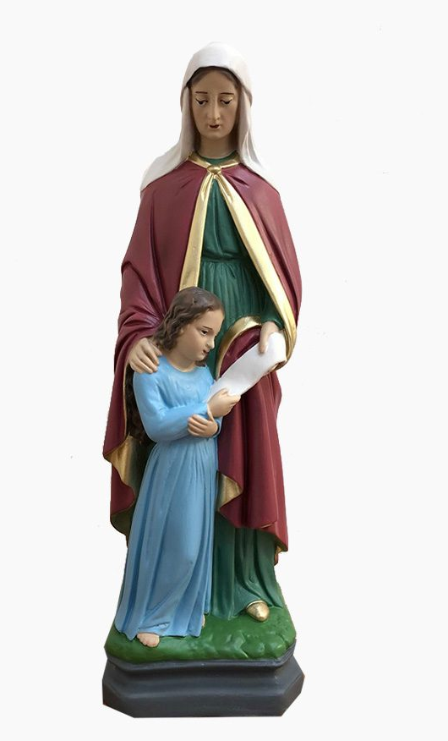
Reception Class Saint: Saint Anne
Feast Day: 26th July
Patron Saint of: Grandmothers and Educators

Slide 12

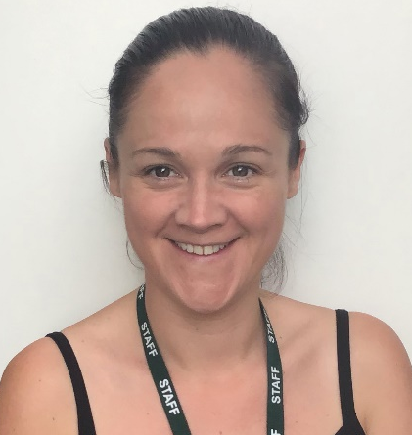
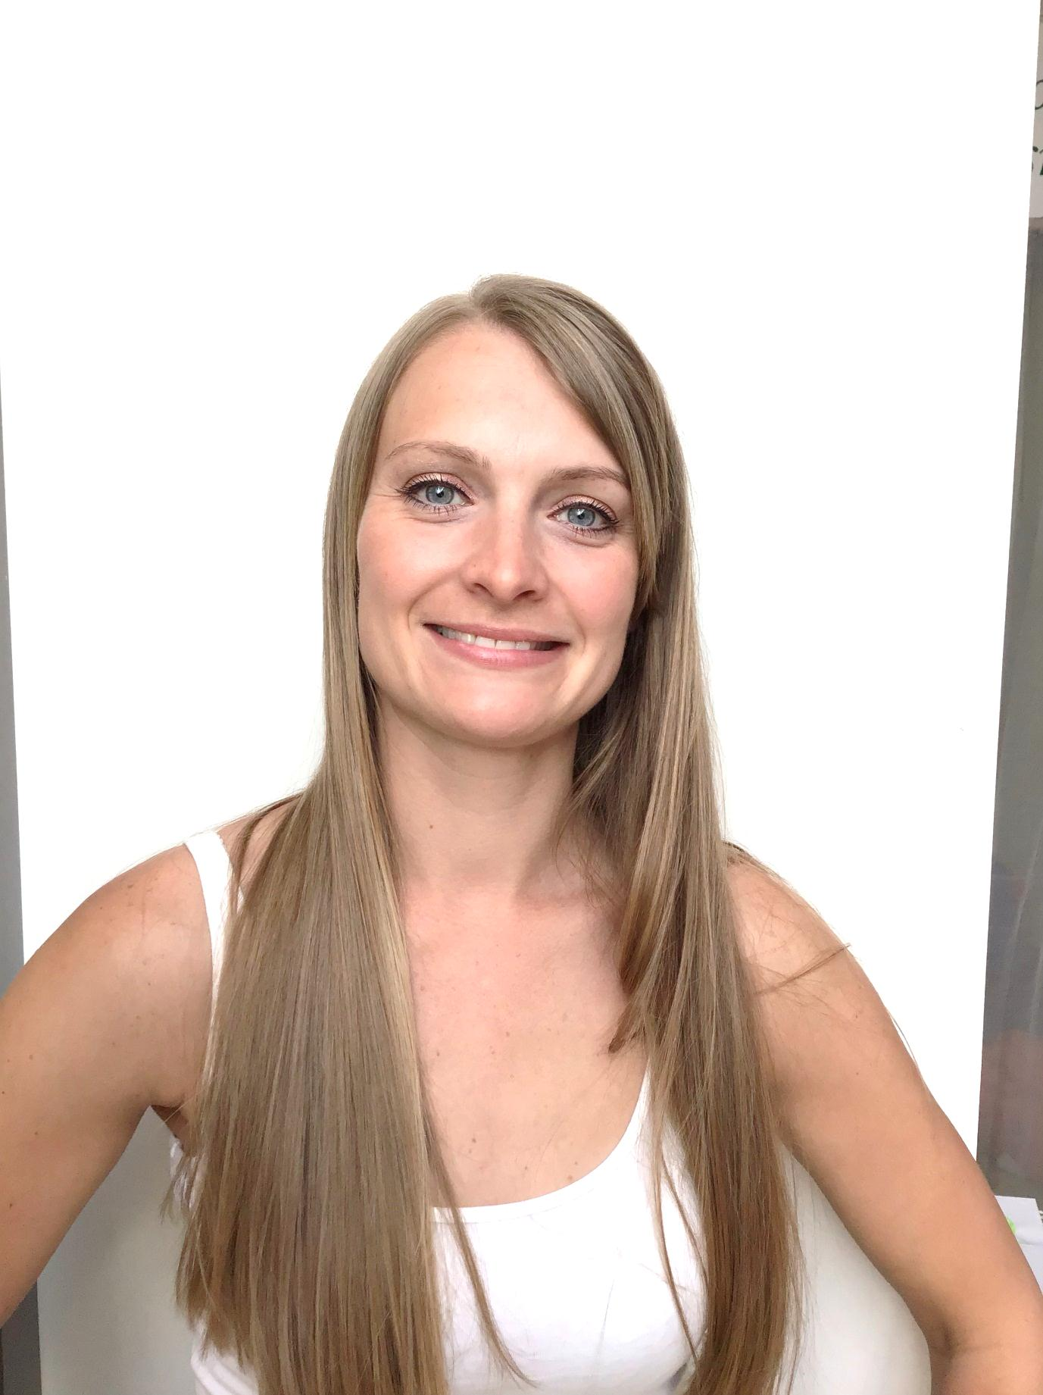
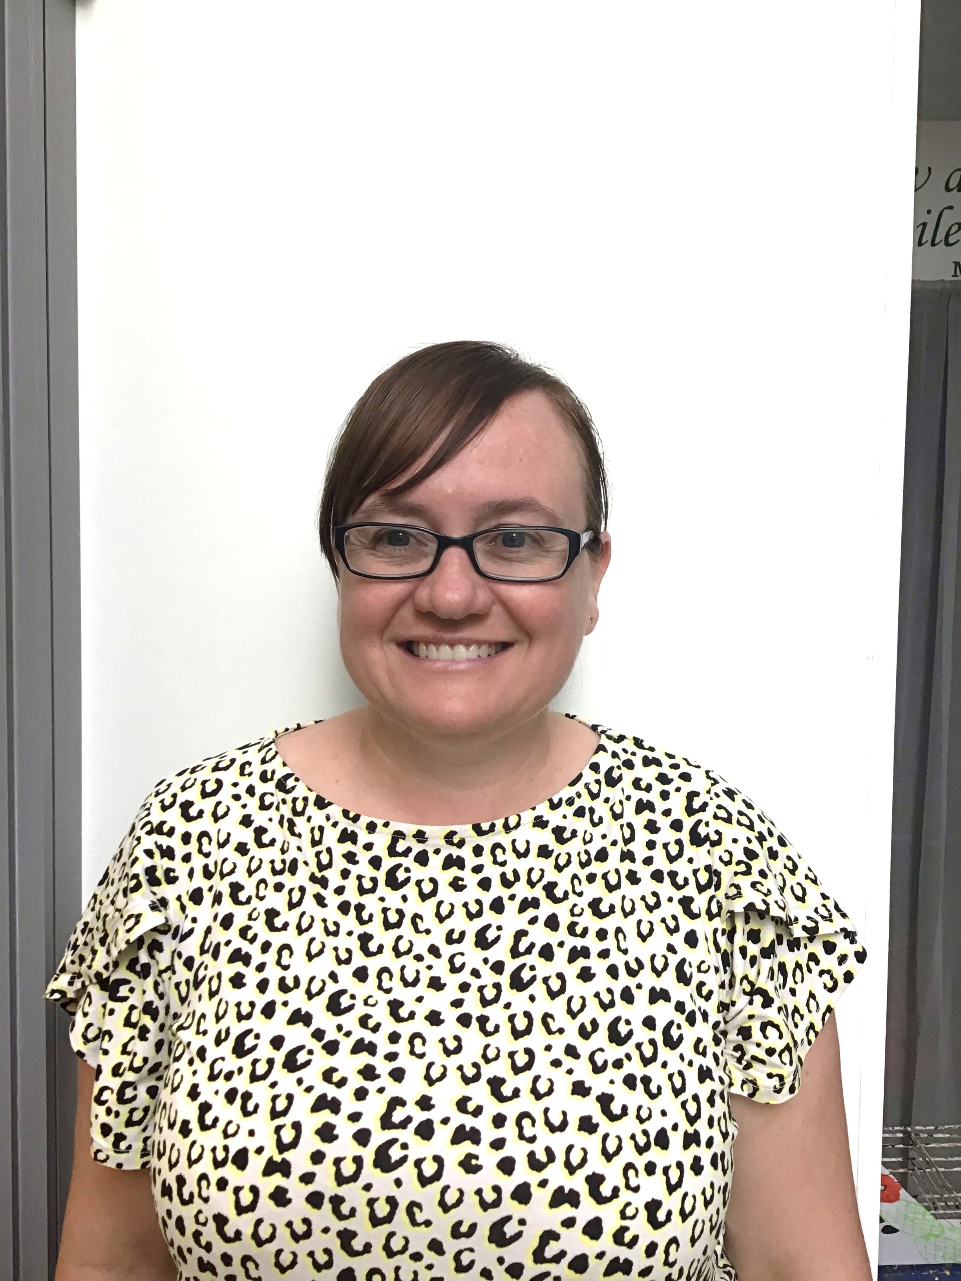
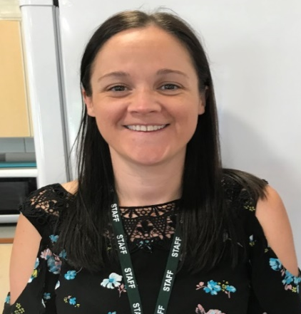
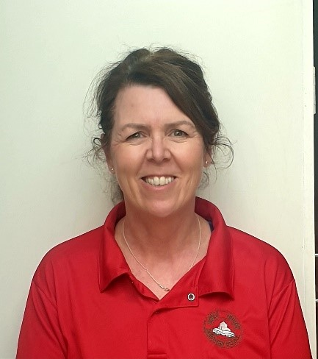
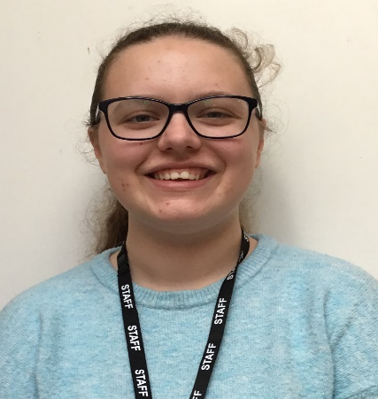
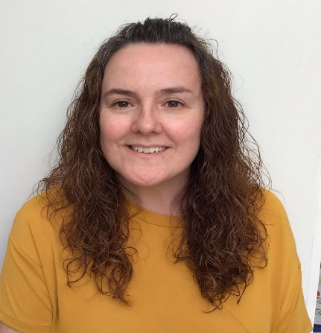
Meet the Reception Team
Mrs Lewis
Miss Holyland
Mrs Elliott
Mrs Hunter
Miss Mason
Mrs Handley
EYFS Lead

Slide 13
Parent Reminders
The school gates open for the start of the day a few minutes before 8.30am each
morning.
School begins at 8.30am.
Registration finishes at 8.40am.
Children who arrive after 8.40am need to go to the main office to be registered. They will receive a late mark.
Children who arrive at school after 9.10 receive an Unauthorised mark that morning.
(10 or more unauthorised absences may require the involvement of external agencies)
The children at Saint Anne’s work very hard every single day.
They continue their learning until 3.15pm. It takes several minutes to get coats , belongings etc
before children leave. With 30 children to dismiss it can take 5 or so minutes after 3.15 to dismiss
all children. Please be patient.
Friday finish - gates open at 2.05pm and children need to be collected by 2.10pm.
All children must be collected by an authorised adult. If another adult is going to collect your child please inform your class teacher with advance notice.
If you have any queries wherever possible please send these into our
parent email: parentmail@st-annes.solihull.sch.uk

Slide 14
Homework1
Homework
Homework will be sent each half term and the children will have several weeks to complete this homework.
Words
When your child is ready they will be sent home a set of words. These are to kept at home and used for further practise. Staff will test these words weekly and a new set will be sent home.
Spellings
Children will receive spellings when they are ready. Spellings will be tested weekly.
If you have any questions about home work please don’t hesitate to ask!

Slide 15
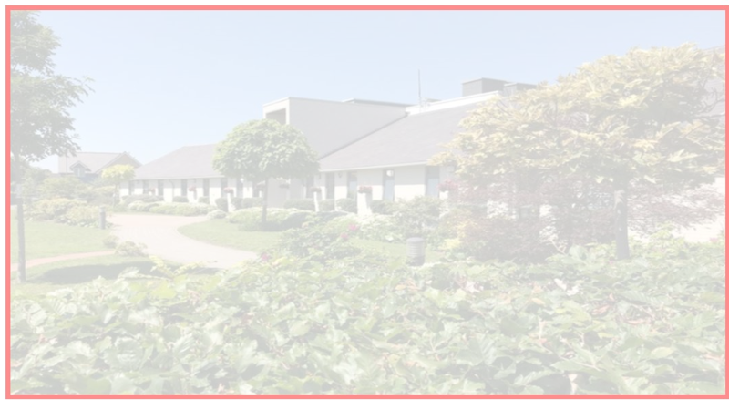


Building the Kingdom
Building the Kingdom is a faith-based initiative that weaves Catholic values throughout our curriculum. By engaging with big questions, children are encouraged to explore themes of faith, justice, and their role in the world. This approach supports our mission to guide young people into becoming compassionate, responsible individuals who live the Gospel and understand their place in God’s plan.
Alongside its central place in our school curriculum, we will also be introducing monthly BTK homework for you to enjoy with your child at home. Each month, you’ll receive a BTK question to respond to in any way you choose, whether through writing, art, or another creative form. We warmly invite you to take part in this journey together.

Slide 16

Reading
The expectation is for children to read for at least 10 minutes each day.
Please sign their reading journal when you have listened to your child read each day.
Children’s reading books will be checked and changed daily. All children are expected to bring their book bag and reading diary with them into school every day as it is part of their uniform.
It’s incredibly important that you listen to your children read every night to help us develop your child’s reading ability.
Children will also bring home a bedtime story for you to read to your child. This will be changed each day. This does not need to be recorded in reading diaries.

Slide 17


Phonics
Phonics is a way of teaching children the skills of reading and writing.
Phonics is taught every day in a discreet 20 minute session.
Phonics is differentiated in each class and children are grouped based on their phonics needs.
Phonics is reinforced throughout all lessons and learning, to embed the skills and knowledge.

Slide 18

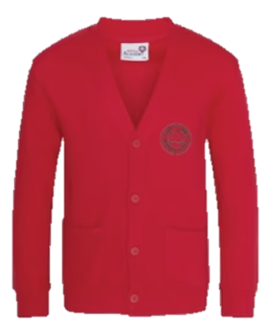
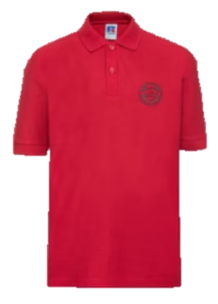

Uniform
Winter Uniform
White collared shirt
Green tie (available through Parent Pay)
Red jumper or cardigan
Girls – Grey school skirt
Boys – Grey school trousers
Black school shoes
Summer Uniform
Girls
Red gingham summer dress
Red cardigan
White socks
Black school shoes
Boys
Red polo
Red jumper
Grey school shorts
Dark socks
Black school shoes
Children are expected to bring their book bags every day as part of their uniform.
Trainers should only be worn on PE days.

Slide 19

P.E
On our P.E day we ask children to come to school wearing their PE kit.
PE day: RL and RH - Thursday
A reminder that P.E kit consists of red polo shirt, black jogging bottoms and trainers. Children must come in wearing their school jumper/cardigan.
In addition to their school jumper /cardigan children may come to school with a plain black sweatshirt/hoodie on top of their school jumper/cardigan. Wearing a black hoodie should not replace a school red cardigan/jumper.
In school they take their black hoodie off with their coat and keep it for the PE lesson.

Slide 20
P.E
The wearing of any jewellery is not encouraged, watches are the only exception. We only allow analogue watches that support children to learn to tell the time - no digital/smart watches are permitted.
Children must not wear rings, chains, necklaces or earrings that hang below the ear e.g. sleepers. If parents still wish children to wear earrings, despite the risks of injury, only the small plain tiny stud type are allowed (maximum number of one per ear in the centre of the lobe). Staff cannot be held responsible for looking after items of jewellery such as watches or studs.
Children are also expected to take their own earrings out for P.E lessons as required.
Therefore, we discourage any jewellery on P.E days.

Slide 21
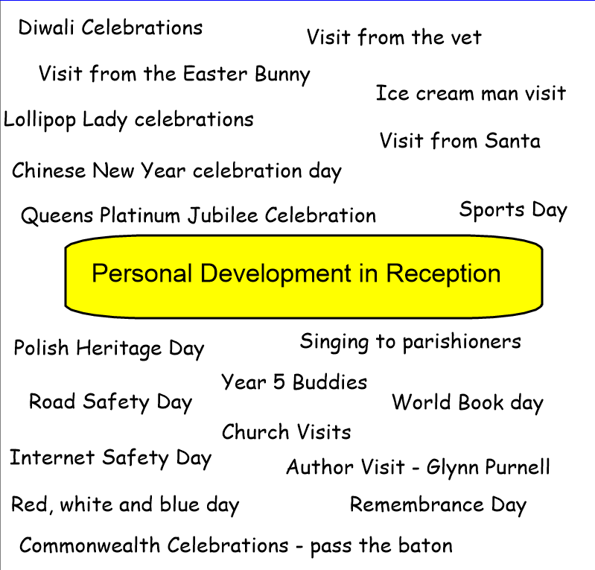
Personal Development Opportunities
We also believe that children’s personal development is just as important as their academic progress.
Here are some ways in which we enrich and encourage children’s personal development in Reception

Slide 22

Relationships Education
Children follow a diocesan programme TEN TEN.
Partnership work with families.
Parent access to materials and website:
https://www.tentenresources.co.uk/life-to-the-full-primary/

Slide 23


Online Safety
We support parents and families and aim to work
together with you to keep children safe online.
How to set up parental controls
Talking to your child about staying safe online
Individual guidance for the sites, apps and games that
your child uses
Important to understand and consider the parental responsibilities linked to e-safety with the support of school.
https://www.internetmatters.org/wp-content/uploads/2015/05/ncro3p-Internet-Matters_E-safety_Primary_1.pdf
https://www.nspcc.org.uk/preventing-abuse/keeping-children- safe/online-safety/

Slide 24

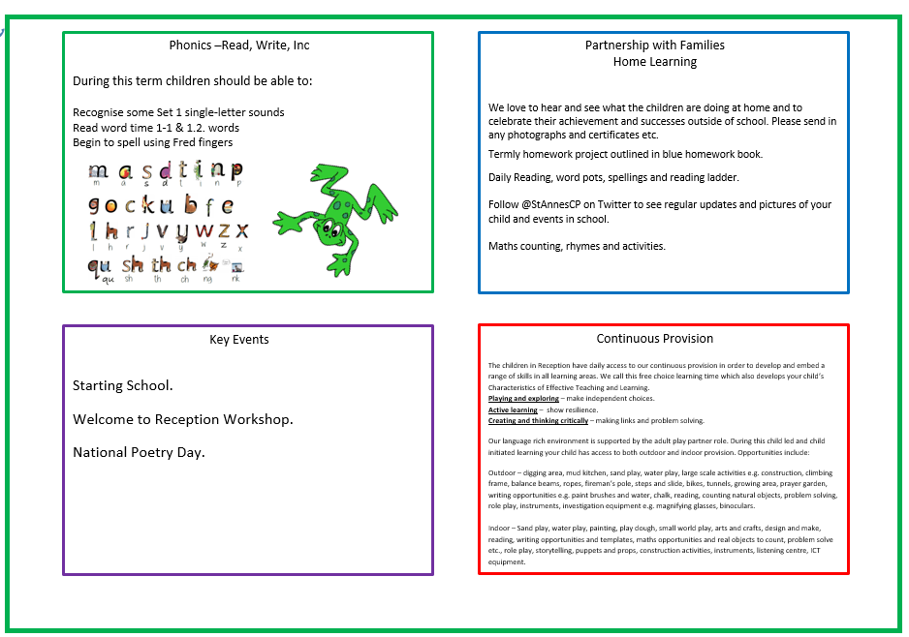
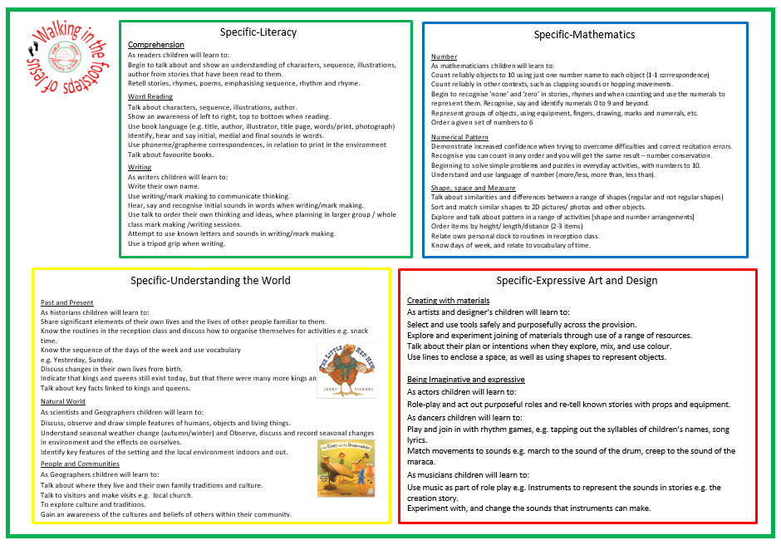
Half Term Curriculum Overview
Each half term your child will bring home an overview of the curriculum for the upcoming weeks. Please have a look at these with your children and talk about some of the language and things we will be looking at in preparation. Curriculum overviews are good for consolidating learning at home.

Slide 25
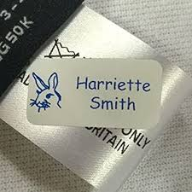

Please ensure all items of your child’s uniform have their names in them.
Please send them to school with a named water bottle every day.
A medical form is needed for any new creams/gels/soaps that have been prescribed by a doctor. Please ask us for one of these.
We hope all of the children have a fantastic year in Reception!
And Finally …

Slide 26
If you have any questions please phone the school office or send your class teacher an email.
parentmail@st-annes.solihull.sch.uk
In the event of an urgent response,
please contact the school office 0121 779 8060
We will not hesitate to help!
Thank you for all your support and cooperation!

