Slide 1



Slide 2


Slide 3

Prayer to Saint Anne
Saint Anne
Since Mary was your daughter
and Jesus your grandson,
look lovingly upon our families
in the same way that you looked upon the
Holy Family in Nazareth,
and intercede for us in heaven
where we all hope to meet one day
as members of the one, splendid family of God,
our sins forgiven,
our problems solved
and our hearts filled with love
Amen

Slide 4
Catholic Life and Collective Worship/Liturgy and Prayer
As a Catholic School we practise our faith every day.
All children take part in Collective Worship each day.
Children also take part in school assemblies and also go to Church.
Children say daily prayers. All children receive a prayer booklet at the beginning of the new academic year. Please practise these prayers with your children at home.

Slide 5

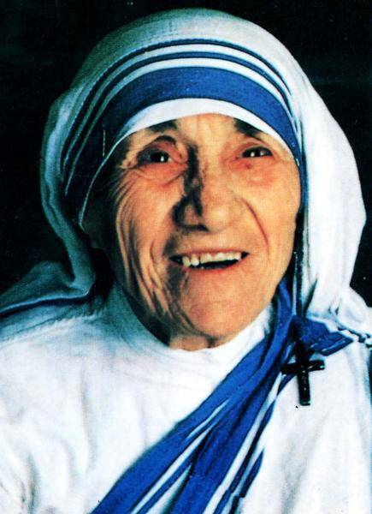
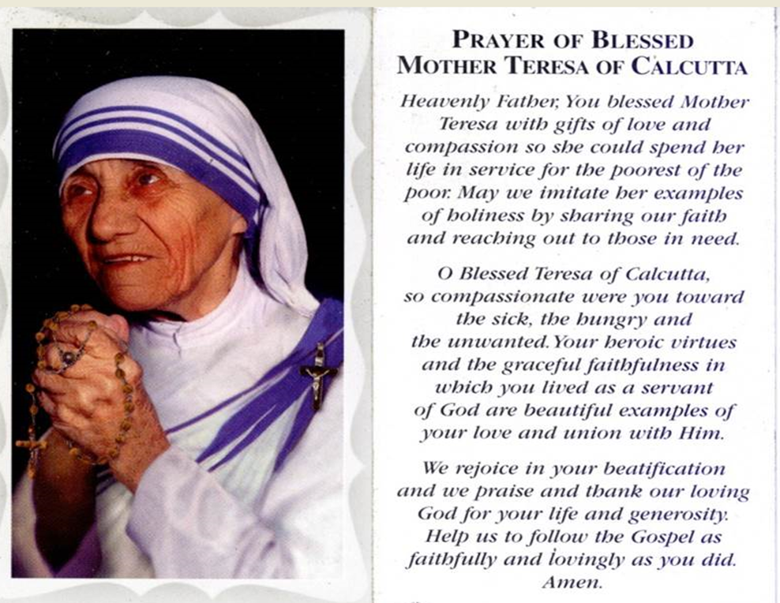

Year 2 Class Saint
Mother Teresa
Feast Day: September 5th
Birth: August 26th 1910
Death: September 5th 1997
Beatified: October 19th 2003 by Pope John Paul II
Canonized: September 4th 2016 by Pope Francis

Slide 6


Slide 7
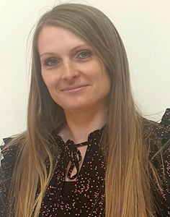
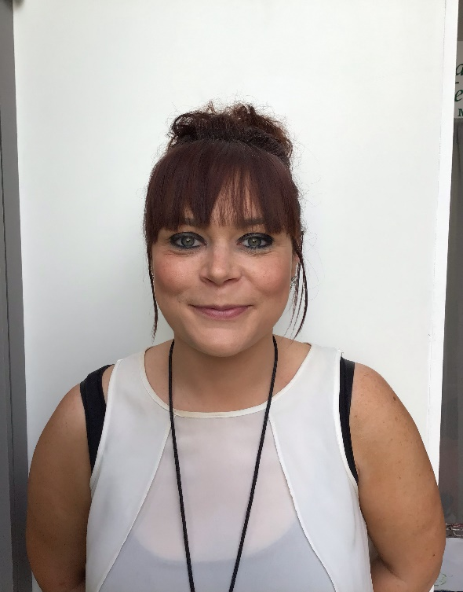
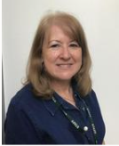
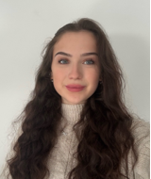
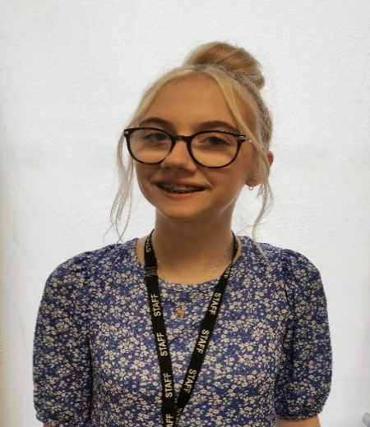
Meet the Year 2 Team!
In Class 2B we have …
Mrs Bathurst
Miss Sherlock
Mrs Ratheram
In Class 2M we have …
Please note as well as the Year 2 team there will be other school staff including inclusion staff, staff who cover part time hours, senior leaders, dinner supervisors and staff who cover absences who will also work in this year group as required linked to school organisation.
Miss Molyneux
Miss Cruise

Slide 8
Parent Reminders
The school gates open for the start of the day a few minutes before 8.30am each
morning.
School begins at 8.30am.
Registration finishes at 8.40am.
Children who arrive after 8.40am need to go to the main office to be registered. They will receive a late mark.
Children who arrive at school after 9.10 receive an Unauthorised mark that morning.
(10 or more unauthorised absences may require the involvement of external agencies)
The children at Saint Anne’s work very hard every single day.
They continue their learning until 3.15pm. It takes several minutes to get coats , belongings etc
before children leave. With 30 children to dismiss it can take 5 or so minutes after 3.15 to dismiss
all children. Please be patient.
Friday finish - gates open at 2.05pm and children need to be collected by 2.10pm.
All children must be collected by an authorised adult. If another adult is going to collect your child please inform your class teacher/ school office with advance notice.
If you have any queries wherever possible please send these into our
parent email: parentmail@st-annes.solihull.sch.uk

Slide 9
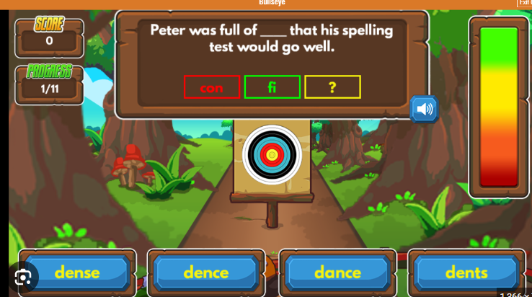

Homework
Maths
Each week your child will receive maths homework. This will link either to key skills that your child is expected to know by the end of year 2 or their weeks learning in class.
Spelling Frame
Please log on to Spelling Frame to access the list of words for this week. You will also receive a printed list of the words every Monday. Ideally, children who have access to the online resource should take the test on Spelling Frame (as many times as they wish) and they will also be assessed in school each Friday.
Building the Kingdom homework
Alongside its central place in our school curriculum, we will also be introducing monthly BTK homework for you to enjoy with your child at home. Each month, you’ll receive a BTK question to respond to in any way you choose, whether through writing, art, or another creative form. We warmly invite you to take part in this journey together.

Slide 10



Reading
The expectation is for children to read for at least 10 minutes each day.
Please sign their reading journal when you have listened to your child read each day.
Children’s reading books will be checked and changed daily. All children are expected to bring their book bag and reading diary with them into school every day as it is part of their uniform.
It’s incredibly important that you listen to your children read every night to help us develop your child’s reading ability. On a Friday they will also bring home a ‘bedtime storybook’ to share with an adult over the weekend.

Slide 11

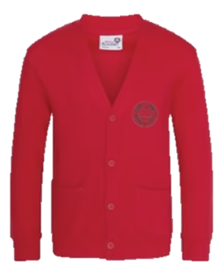


Uniform
Winter Uniform
White collared shirt
Green tie (available through Parent Pay)
Red jumper or cardigan
Girls – Grey school skirt
Boys – Grey school trousers
Black school shoes
Summer Uniform
Girls
Red gingham summer dress
Red cardigan
White socks
Black school shoes
Boys
Red polo
Red jumper
Grey school shorts
Dark socks
Black school shoes
Children are expected to bring their book bags every day as part of their uniform.
Trainers should only be worn on PE days.
Smart watches with cameras or voice recording functions are not permitted.

Slide 12

P.E
We are continuing to request all children to come to school wearing their PE kit on their PE day.
Year 2 P.E days are Monday and Wednesday.
A reminder that P.E kit consists of red polo shirt, black jogging bottoms and trainers. Children must come in wearing their school jumper/cardigan.
In addition to their school jumper /cardigan children may come to school with a plain black sweatshirt/hoodie on top of their school jumper/cardigan. Wearing a black hoodie should not replace a school red cardigan/jumper.
In school they take their black hoodie off with their coat and keep it for the PE lesson.

Slide 13
P.E
The wearing of any jewellery is not encouraged, watches are the only exception. We only allow analogue watches that support children to learn to tell the time - no digital/smart watches are permitted.
Children must not wear rings, chains, necklaces or earrings that hang below the ear e.g. sleepers. If parents still wish children to wear earrings, despite the risks of injury, only the small plain tiny stud type are allowed (maximum number of one per ear in the centre of the lobe). Staff cannot be held responsible for looking after items of jewellery such as watches or studs.
Children are also expected to take their own earrings out for P.E lessons as required. Children must NOT wear earrings of any type for swimming.
Therefore, we discourage any jewellery on P.E days.

Slide 14
Online Safety
We support parents and families, and aim to work together with you to keep children safe online
We can advise you on:
How to set up parental controls
Talking to your child about staying safe online
Individual guidance for the sites, apps and games that
your child uses
Important to understand and consider the parental responsibilities linked to e-safety with the support of school.
Online Safety tips are shared each week via our Newsletter.

Slide 15
Attendance
Regular school attendance is essential if children are to enjoy their education and make good progress.
At St. Anne’s Catholic Primary School, we believe that regular school attendance is the key to enabling children to maximise the educational opportunities available to them and become emotionally resilient, confident and competent adults who are able to realise their full potential and make a positive contribution to their community.
Expected levels of attendance:
98-100% | Excellent. Accessing all learning opportunities
96-97% | Good. Very few learning opportunities missed
94-95% | Risk of under achievement up to 50 missed lessons Up to 10 school days absent in an academic year
92-93% | Risk of under achievement Up to 75 missed lessons Up to 15 school days absent in an academic year.
90-92 | Severe risk of under achievement Up to 100 missed lessons Up to 19 school days absent in an academic year
90% and below | Extreme risk of underachievement over 100 missed lessons Pupil is persistently absent upwards of 22 school days absent in an academic year
50% and below | Extreme risk of underachievement Pupil is severely absent At least half of all lesson and days missed
School Day and Punctuality
It is important that pupils are punctual so that they do not miss out on the beginning of each school day. Children must attend on time to be given a present mark for the session.
If a pupil arrives late to school every day, their learning begins to suffer. Below is a graph showing how being late to school every-day over a school year adds up to lost learning time

Slide 16
Leave of absence
Unauthorised leave of absence of 10 or more sessions
Local authority will issue a fine per parent per child. If paid within 28 days this is £160. If paid within 21 days it is reduced to £80.
If the threshold is met a 2nd time in three years and a 2nd Penalty notice is issued to the same parent in relation to the same child – this will a flat rate of £160 if paid within 28 days.
A third penalty notice cannot be issued to the same parent in respect of the same child within 3 years of the date of issue of the first. In a case where the national threshold is met for a third time (or subsequent times) within those 3 years, alternative action should be taken instead. This will often include considering prosecution.
Please note:
A leave of absence form will need to be completed at least 2 weeks before the absence.

Slide 17
School Dinners
To order your child’s dinner, please order this via BlueRunner.
We need you to order their dinners for a week ahead before your child comes into school on a Monday .
Your ParentPay account will need to be in credit as all meals have to be paid for in advance.
There is more guidance on our website for ordering your child’s dinners.
There is also a family information pack, produced by Aspens for you all to look at.
Please remember, there are no options for baguettes or wraps, however a varied, hot and nutritious dinner is available every day, including a jacket potato or pasta pot or sandwiches.
If you are not able to access your ParentPay account, please contact the school office via Parent mail.
Please apply for Free School Meals if you think you may be entitled to these via Solihull Council.

Slide 18

Solihull Family Hubs
New Family Hubs have opened in Solihull. Our local one is the Riverside Hub, which is in the building outside the school gates on Bosworth Drive.
Services within the family hub:
Health visitors
Midwives
SOLAR
SENDIAS
Urban Heard (Youth Group)
Stay and Play (including a sensory room, which you book via the Hubs)
Solihull College
Solihull Housing
Women’s Community Drop in
Coffee mornings
And many more
The hubs have clothing banks and Evergreen and Elmwood have a community pantry for all to use.
Scan the QR code to download the app, and you will see all of the upcoming events.

Slide 19
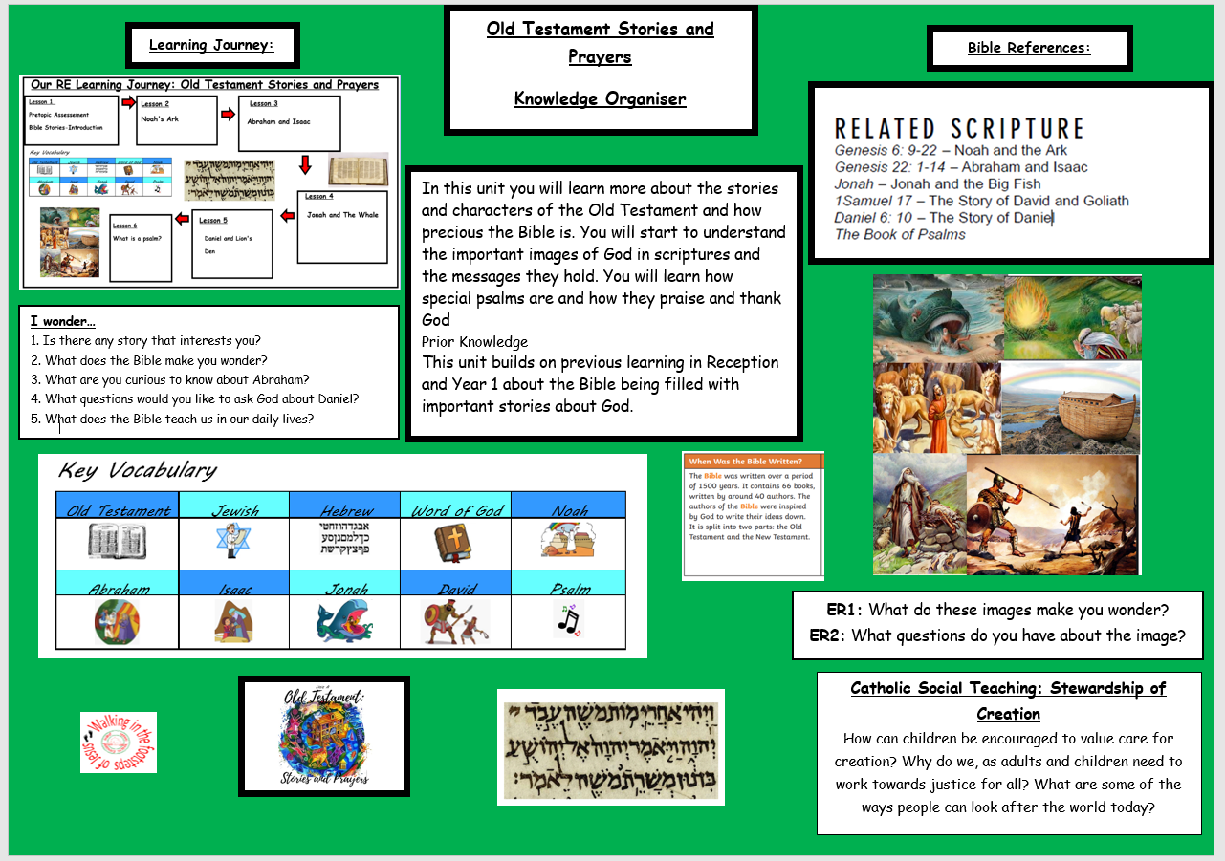
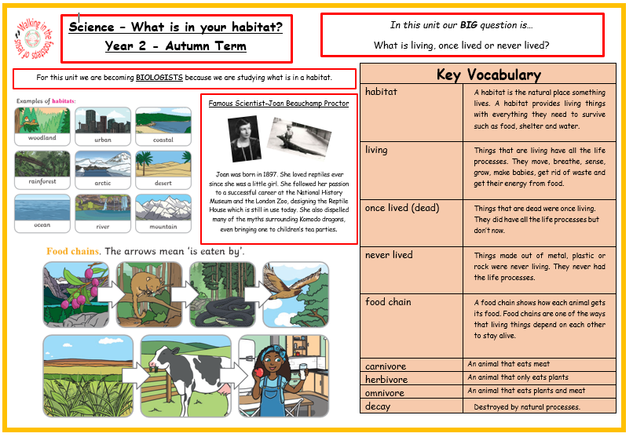
Knowledge Organisers
Each half term your child will bring home an overview of the curriculum for the upcoming weeks paired with the appropriate Knowledge Organisers.
Please have a look at these with your children and talk about some of the language and things we will be looking at in preparation. Knowledge organisers are also a fantastic resource for consolidating learning at home.

Slide 20
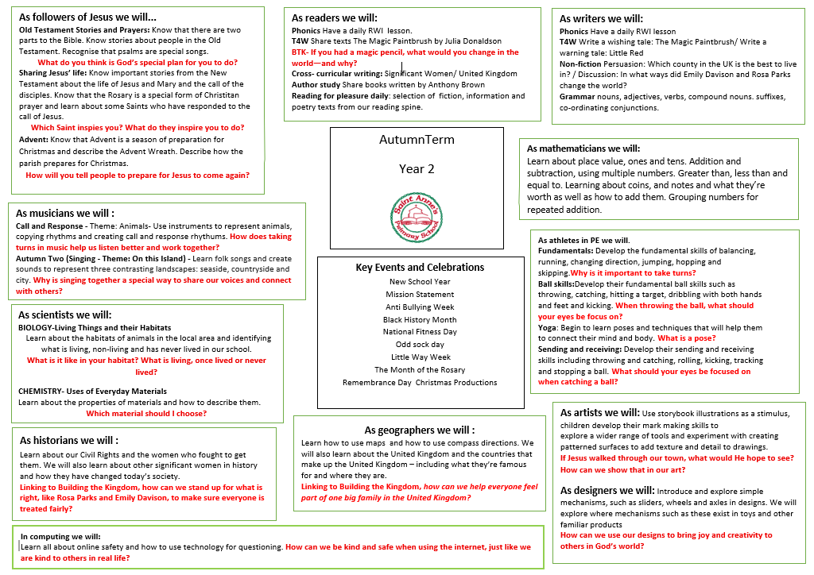
Curriculum Overview

Slide 21


Personal Development Opportunities
We also believe that children’s development is just as important as their academic progress.
Here are some ways in which enrich and encourage children’s personal development in Year 2.

Slide 22

Relationships Education
Children follow a diocesan programme TEN TEN.
Partnership work with families.
Parent access to materials and website:
https://www.tentenresources.co.uk/life-to-the-full-primary/

Slide 23
Please ensure all items of your child’s uniform have their names in them.
Please send them to school with a named water bottle every day-WATER ONLY.
A medical form is needed for any new creams/gels/soaps that have been prescribed by a doctor. Please ask us for one of these.
We hope all of the children have a fantastic year in Year 2!
And Finally …

Slide 24
If you have any questions please phone the school office or send your class teacher an email.
parentmail@st-annes.solihull.sch.uk
In the event of an urgent response,
please contact the school office 0121 779 8060
We will not hesitate to help!
Thank you for all your support and cooperation!

