Slide 1




Slide 2
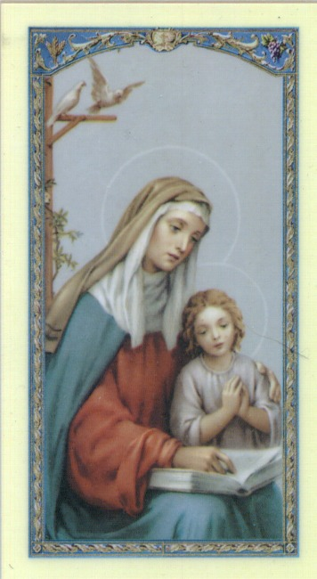
Prayer to St. Anne
Saint Anne
Since Mary was your daughter
and Jesus your grandson,
look lovingly upon our families
in the same way that you looked upon the
Holy Family in Nazareth,
and intercede for us in heaven
where we all hope to meet one day
as members of the one, splendid family of God, our sins forgiven, our problems solved and our hearts filled with love
Amen

Slide 3
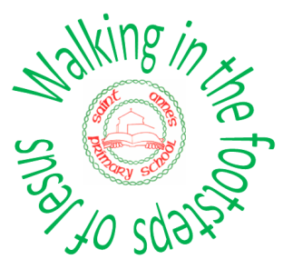

St. Anne's Mission

Slide 4

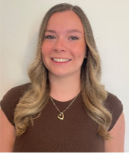
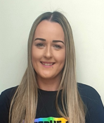
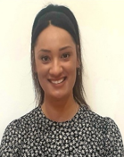
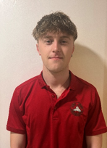
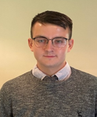
Meet the Year 5 Team!
In 5S we have …
Miss Showell
Miss Bell
In 5T we have …
Other school staff including inclusion staff, staff who cover part time hours senior leaders, dinner supervisors do also work cross school, as required, linked to school organisation
Mr Tregonning
Mrs Boulton
Mr McGuire

Slide 5
CATHOLIC LIFE AND COLLECTIVE WORSHIP
As a Catholic School we practise our faith every day.
All children take part in Prayer and Liturgy each day.
Children also take part in whole school assemblies and also go to Church.
Children say daily prayers. All children will receive a prayer booklet at the beginning of the new academic year. Please practise these prayers with your children at home.

Slide 6
The school gates open for the start of the day a few minutes before 8.30am each
morning.
School opens at 8.30am.
Registration finishes at 8.40am.
Children who arrive after 8.40am need to go to the main office to be registered. They will receive a late mark.
Children who arrive at school after 9.10 receive an unauthorised mark that morning.
(10 or more unauthorised absences may require the involvement of external agencies)
The children at Saint Anne’s work very hard every single day.
They continue their learning until 3.15pm. It takes several minutes to get coats , belongings etc
before children leave. With 30 children to dismiss it can take 5 or so minutes after 3.15 to dismiss
all children. Please be patient.
Friday finish - gates open at 2.05pm and children need to be collected by 2.10pm.
All children must be collected by an authorised adult. If another adult is going to collect your child please inform your class teacher with advance notice.
Parent Reminders

Slide 7
Craft Aprons
Please can your child bring to school a painting overall for Art and Design & Technology lessons as soon as possible.
This will protect their clothing during painting, gluing or other art and design activities.
From our experience, we know that an ideal painting overall is an old adult shirt with sleeves, which the child should wear back to front or an old adult t-shirt. Each child should have his/her own overall or apron, which will be kept at school.

Slide 8

Homework
Daily:
Reading
Weekly:
Spellings (spelling frame)
Maths activity
SPAG activity
Monthly:
BTK Homework

Slide 9

Reading
The expectation is for children to read for at least 10 minutes each day.
Please sign their reading journal when you have listened to your child read each day.
Children’s reading books will be checked and changed daily. All children are expected to bring their book bag and reading diary with them into school every day as it is part of their uniform.
It’s incredibly important that you listen to your children read every night to help us develop your child’s reading ability.

Slide 10

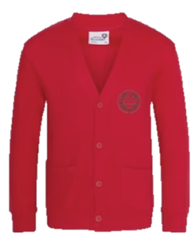
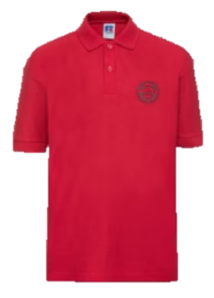
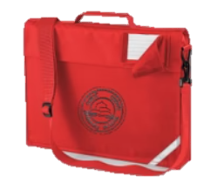
Uniform
Winter Uniform
White collared shirt
Green tie (available through Parent Pay)
Red jumper or cardigan
Girls – Grey school skirt
Boys – Grey school trousers
Black school shoes
Summer Uniform
Girls
Red gingham summer dress
Red cardigan
White socks
Black school shoes
Boys
Red polo
Red jumper
Grey school shorts
Dark socks
Black school shoes
Children are expected to bring their book bags every day as part of their uniform.
Trainers should only be worn on PE days.
Smart watches with cameras or voice recording functions are not permitted.

Slide 11
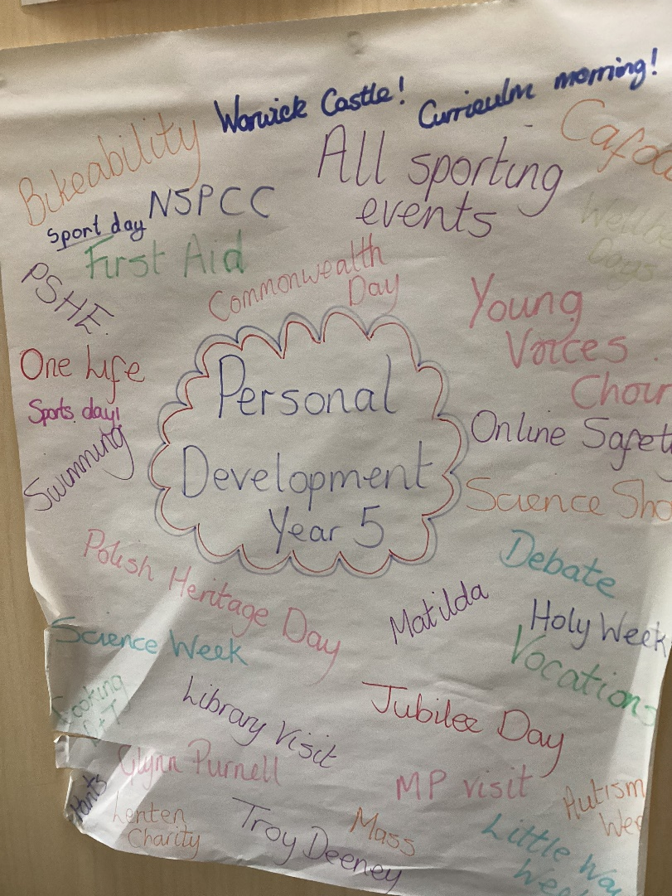
Personal Development Opportunities
Children follow a programme called JIGSAWS to support their Personal Development.
There is a strong focus on British Values.
Throughout the year, children will receive a range of personal development opportunities such as:
First Aid Training
Bikeability
NSPCC Assemblies and Lessons
Various Visitors
Online Safety Week
Sporting Events
Local Library Visit
Themed Days – Polish Heritage Day, Bastille Day
Lenten Charities
Visits to JHNCC

Slide 12

Relationships Education
Children follow a programme approved by the diocese, this is called TEN TEN.
Partnership work with families.
Parent access to materials and website:
https://www.tentenresources.co.uk/life-to-the-full-primary/

Slide 13

Please remember that the expectation is to wear a red
jumper/cardigan on P.E days as well as other days (5 days
a week)
P.E days are as follows:
Wednesday and Thursday
As the weather gets colder the children can wear as
an additional layer a plain, black, sweatshirt /hoodie
on PE days.(no logos)
However the sweatshirt/hoodie does not replace the
school jumper/cardigan.
P.E

Slide 14
PE and Jewellery
The wearing of any jewellery is not encouraged, watches are the only exception. We only allow analogue watches that support children to learn to tell the time - no digital/smart watches are permitted.
Children must not wear rings, chains, necklaces or earrings that hang below the ear e.g. sleepers. If parents still wish children to wear earrings, despite the risks of injury, only the small plain tiny stud type are allowed (maximum number of one per ear in the centre of the lobe). Staff cannot be held responsible for looking after items of jewellery such as watches or studs.
Children are also expected to take their own earrings out for P.E lessons as required.
Therefore, we discourage any jewellery on P.E days.
P.E

Slide 15
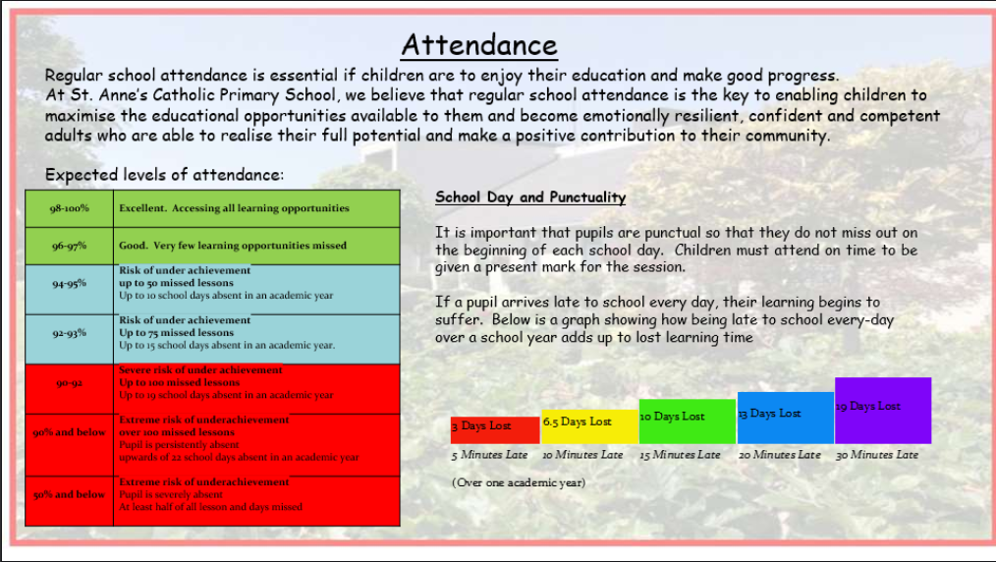

Slide 16
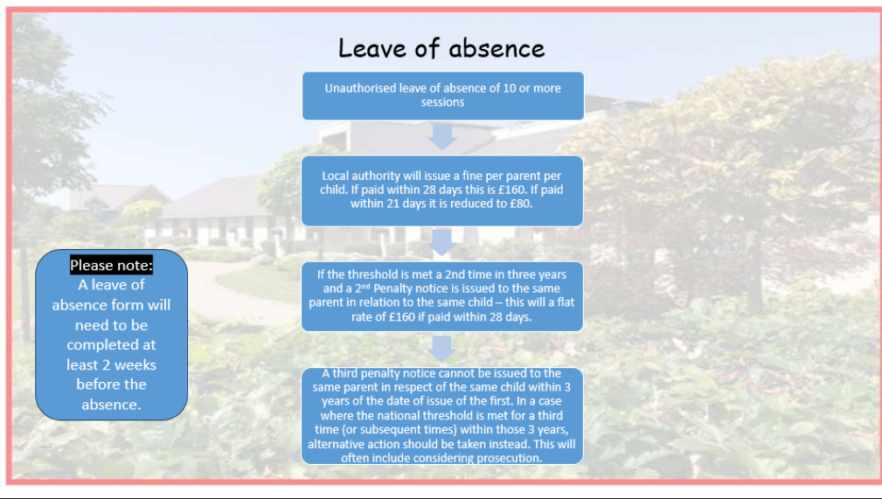

Slide 17
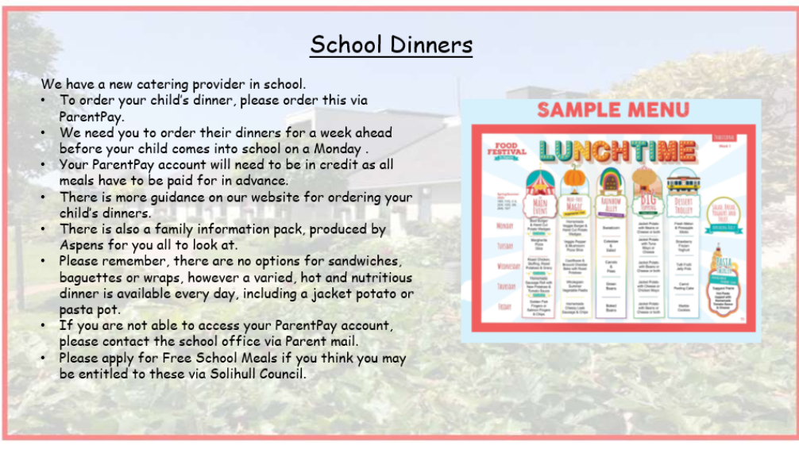

Slide 18
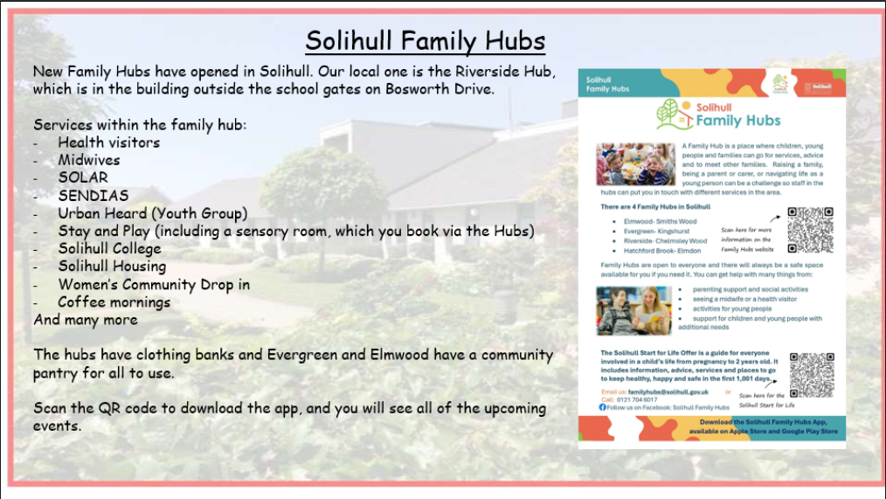

Slide 19
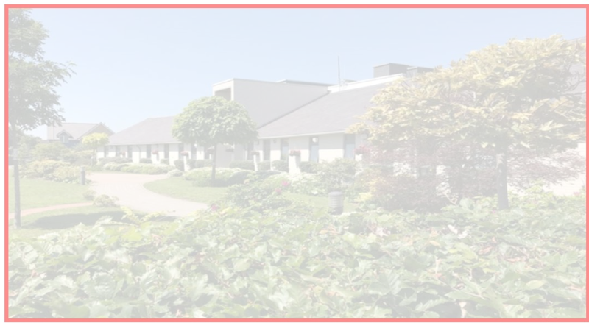


Building the Kingdom
Building the Kingdom is a faith-based initiative that weaves Catholic values throughout our curriculum. By engaging with big questions, children are encouraged to explore themes of faith, justice, and their role in the world. This approach supports our mission to guide young people into becoming compassionate, responsible individuals who live the Gospel and understand their place in God’s plan.
Alongside its central place in our school curriculum, we will also be introducing monthly BTK homework for you to enjoy with your child at home. Each month, you’ll receive a BTK question to respond to in any way you choose, whether through writing, art, or another creative form. We warmly invite you to take part in this journey together.

Slide 20
WEBSITE AND COMMUNICATION
All relevant information is on our website.
Website details:
  https://www.stannessolihull.co.uk/
Our weekly newsletter which has lots of photos of class activities can be found on our website every Friday.

Slide 21
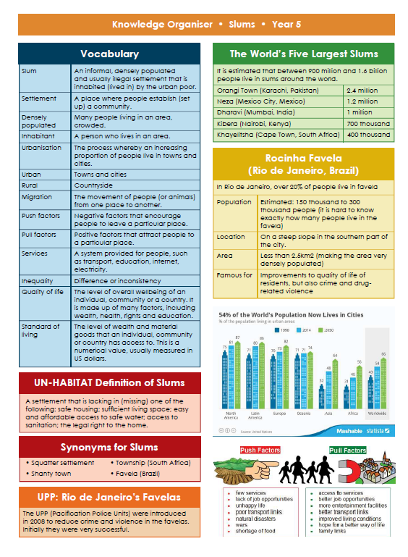

Knowledge Organisers
Each half term your child will bring home a Knowledge Organiser to show you what we will be learning about in Science, History or Geography over the half-term.
Please have a look at these with your children and talk about some of the language and things we will be looking at in preparation.

Slide 22

Enrichment
At St. Anne’s, we aim for all children to experience an after school enrichment activity.

Slide 23
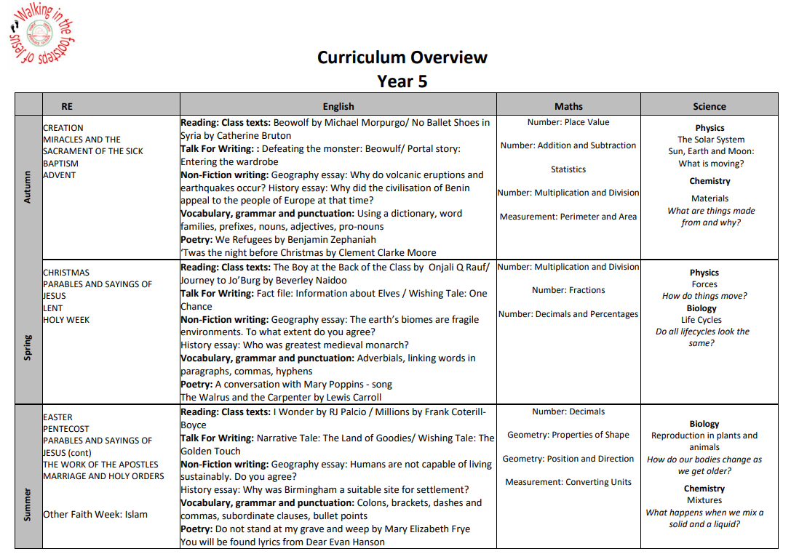

Slide 24
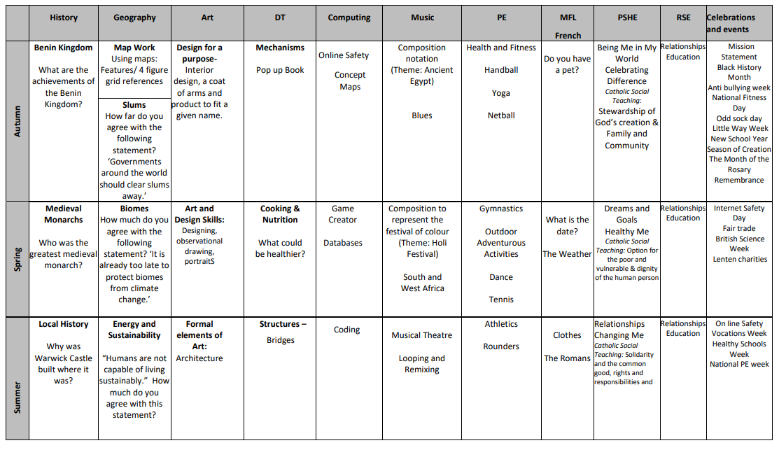

Slide 25

Please ensure all of your child’s uniform is named- especially jumpers. As you can imagine there are 30 jumpers that are all identical!
Please send them to school with a named water bottle every day and also their reading bag.
If your child has any new medical issues, or any changes to those already existing, please let your class teacher know via the office.
We hope all of the children have a fantastic year in year 5!

Slide 26
And Finally …
If you have any questions, please speak to the teacher. If you need a more lengthier meeting then this can be arranged by appointment. Any questions or queries can also be emailed into parent mail, which is managed by the office staff.
parentmail@st-annes.solihull.sch.uk
In the event of an urgent response,
please contact the school office 0121 779 8060
Thank you for your support and cooperation!
We are so excited about the year ahead and looking forward to getting to know the children and having
a fantastic year in year 5!

