Slide 1


Welcome to Year 4

Slide 2

Prayer to Saint Anne
Saint Anne
Since Mary was your daughter
and Jesus your grandson,
look lovingly upon our families
in the same way that you looked upon the
Holy Family in Nazareth,
and intercede for us in heaven
where we all hope to meet one day
as members of the one, splendid family of God,
our sins forgiven,
our problems solved
and our hearts filled with love
Amen

Slide 3



Slide 4
CATHOLIC LIFE, PRAYER AND LITURGY
As a Catholic School we practise our faith every day.
All children take part in Prayer and Liturgy each day.
Children also take part in school assemblies and also go to Church.
Children say daily prayers. All children receive a prayer booklet at the beginning of the new academic year. Please practise these prayers with your children at home.

Slide 5


Slide 6
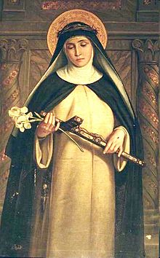
Year 4 Class Saint
St. Catherine of Siena
Feast Day: 29th April
Patron Saint of: Fire prevention, Europe, Italy and Rome, and nurses. She has also been declared Doctor of the Church.
Birth: 25th March 1347 (Siena Italy)
Death: 29 April 1380 (in Rome)
Canonized: In the year 1461 by Pope Pius II

Slide 7


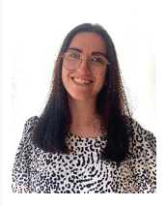
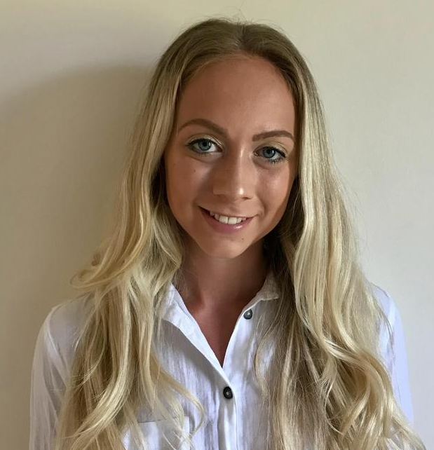
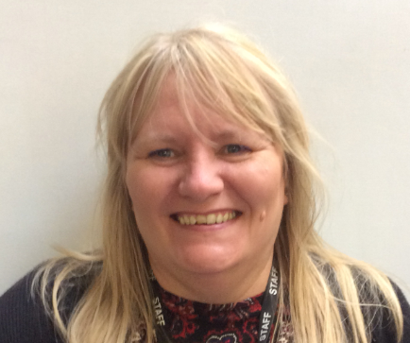
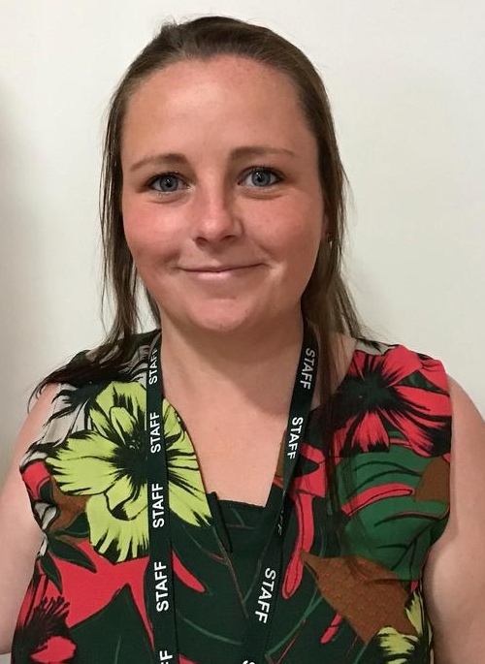
Meet the Year 4 Team!
Please note as well as the Year 4 team there will be other school staff including inclusion staff, staff who cover part time hours, senior leaders, dinner supervisors and staff who cover absences who will also work in this year group as required linked to school organisation.
Miss Rees
Miss Powell
Phase Leader
Mrs Bethell
Mrs Hennessy

Slide 8
The school gates open for the start of the day a few minutes before 8.30am each
morning.
School begins at 8.30am.
Registration finishes at 8.40am.
Children who arrive after 8.40am need to go to the main office to be registered. They will receive a late mark.
Children who arrive at school after 9.15 receive an Unauthorised mark that morning.
(10 or more unauthorised absences may require the involvement of external agencies)
The children at Saint Anne’s work very hard every single day.
They continue their learning until 3.15pm. It takes several minutes to get coats , belongings etc
before children leave. With 30 children to dismiss it can take 5 or so minutes after 3.15 to dismiss
all children. Please be patient.
Friday finish - gates open at 2.05pm and children need to be collected by 2.10pm.
All children must be collected by an authorised adult. If another adult is going to collect your child please inform your class teacher with advance notice.
Parent Reminders

Slide 9




Uniform
Winter Uniform
White collared shirt
Green tie (available through Parent Pay)
Red jumper or cardigan
Girls – Grey school skirt
Boys – Grey school trousers
Black school shoes
Summer Uniform
Girls
Red gingham summer dress
Red cardigan
White socks
Black school shoes
Boys
Red polo
Red jumper
Grey school shorts
Dark socks
Black school shoes
Children are expected to bring their book bags every day as part of their uniform.
Trainers should only be worn on PE days.

Slide 10

P.E
To keep your children as safe as possible we are asking all children to come to school wearing their PE kit on their PE day.
Year 4 P.E days are Wednesday and Thursday
A reminder that P.E kit consists of red polo shirt, black jogging bottoms and trainers (no converse). Children must come in wearing their school jumper/cardigan.
In addition to their school jumper /cardigan children may come to school with a plain black sweatshirt/hoodie on top of their school jumper/cardigan. Wearing a black hoodie should not replace a school red cardigan/jumper.
In school they take their black hoodie off with their coat and keep it for the PE lesson.

Slide 11
Swimming
Children will be going swimming on a Thursday.
They need their costume/shorts, towel, goggles and a swimming cap is optional.
Please avoid jewellery on P.E days.

Slide 12

Reading
Children’s reading records and books (which need to be changed) are to be brought into school EVERY DAY, to be checked by their teacher. They will be returned to the child daily. On a Friday they will also bring home a ‘bedtime storybook’ to share with an adult over the weekend.
The expectation is for children to
read for at least 10 minutes each day.
Please sign their reading record
when you have listened to
your child read every day.
It is important that you listen to your child read every day to help us develop your child’s reading for pleasure.

Slide 13
Homework
Homework will be set on a Friday and should be completed by the following Wednesday.
Maths Worksheets
Each week your child will receive maths homework . These will be mainly maths fluency worksheets to improve accuracy.
If you have any questions about home work please don’t hesitate to ask!

Slide 14
Craft Aprons
Please can your child bring to school a painting overall for Art and Design & Technology lessons as soon as possible.
This will protect their clothing during painting, gluing or other art and design activities.
From our experience, we know that an ideal painting overall is an old adult shirt with sleeves, which the child should wear back to front or an old adult t-shirt. Each child should have his/her own overall or apron, which will be kept at school.

Slide 15
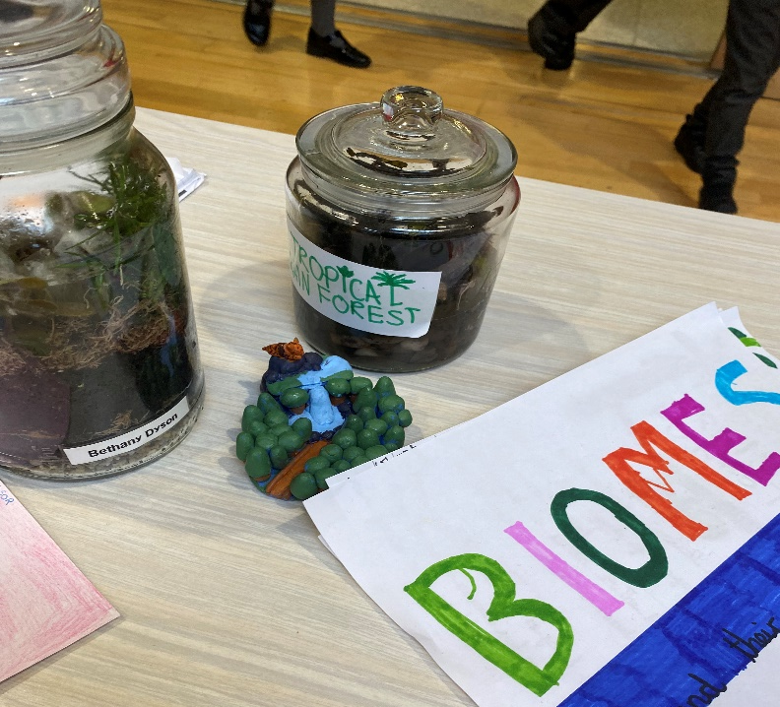
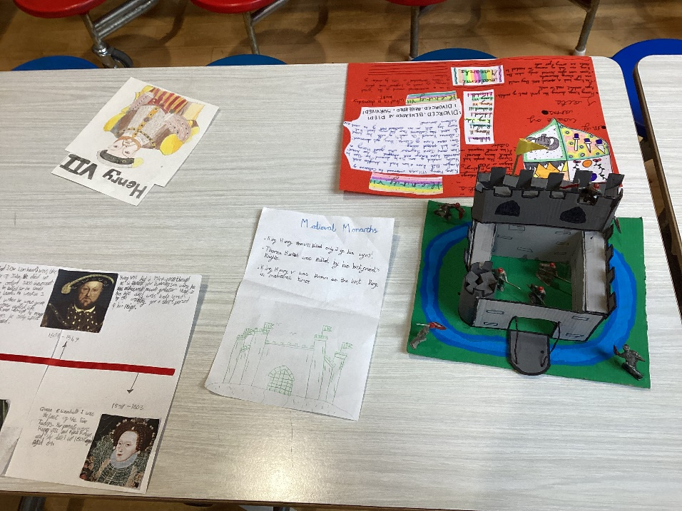
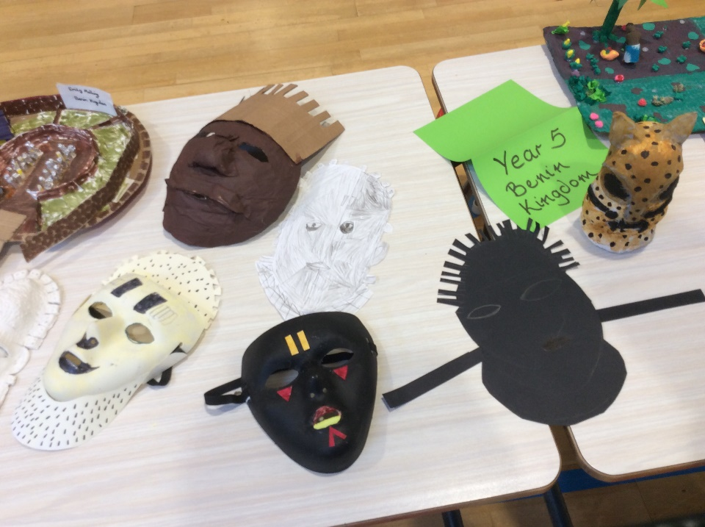
Home Learning Projects

Slide 16
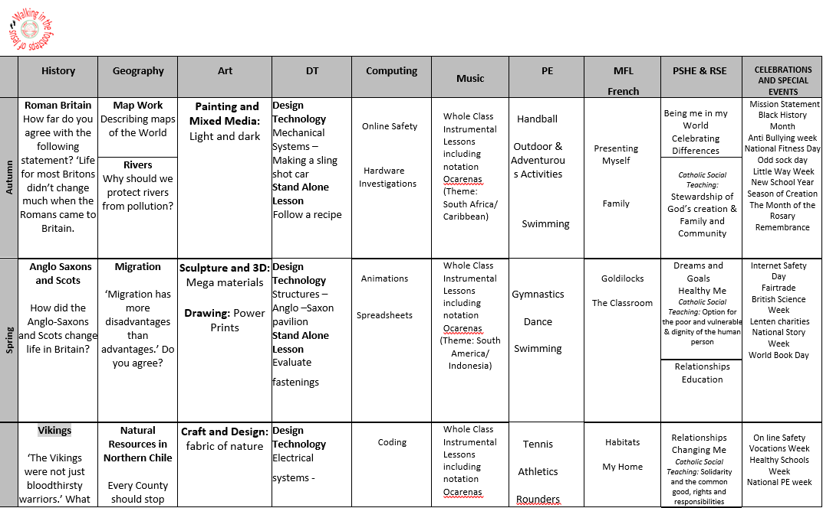
Curriculum Overview

Slide 17
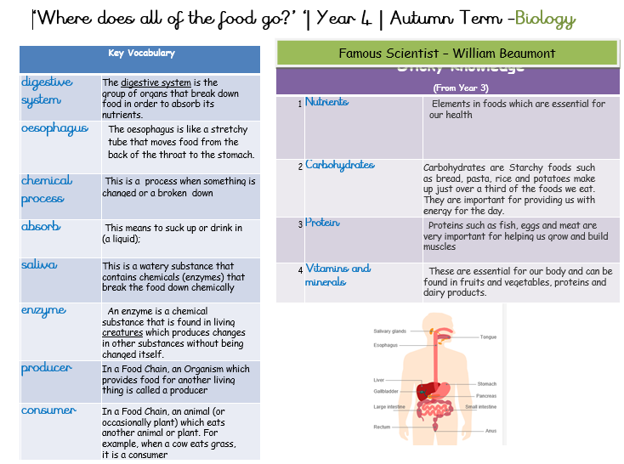
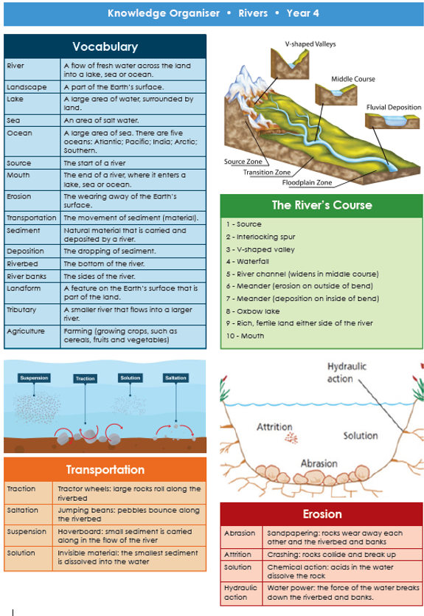
Knowledge Organisers
Each half term your child will bring home a Knowledge Organiser to show you what we will be learning about in history or geography over the half-term.
Please have a look at these with your children and talk about some of the language and outcomes we will be looking at in preparation for the upcoming lessons.

Slide 18

Relationships Education
Children follow a diocesan programme TEN TEN.
Partnership work with families.
Parent access to materials and website:
https://www.tentenresources.co.uk/life-to-the-full-primary/

Slide 19


Enrichment
At St. Anne’s, we aim for all children to experience an after school enrichment activity.

Slide 20
Attendance
Regular school attendance is essential if children are to enjoy their education and make good progress.
At St. Anne’s Catholic Primary School, we believe that regular school attendance is the key to enabling children to maximise the educational opportunities available to them and become emotionally resilient, confident and competent adults who are able to realise their full potential and make a positive contribution to their community.
Expected levels of attendance:
98-100% | Excellent. Accessing all learning opportunities
96-97% | Good. Very few learning opportunities missed
94-95% | Risk of under achievement up to 50 missed lessons Up to 10 school days absent in an academic year
92-93% | Risk of under achievement Up to 75 missed lessons Up to 15 school days absent in an academic year.
90-92 | Severe risk of under achievement Up to 100 missed lessons Up to 19 school days absent in an academic year
90% and below | Extreme risk of underachievement over 100 missed lessons Pupil is persistently absent upwards of 22 school days absent in an academic year
50% and below | Extreme risk of underachievement Pupil is severely absent At least half of all lesson and days missed
School Day and Punctuality
It is important that pupils are punctual so that they do not miss out on the beginning of each school day. Children must attend on time to be given a present mark for the session.
If a pupil arrives late to school every day, their learning begins to suffer. Below is a graph showing how being late to school every-day over a school year adds up to lost learning time

Slide 21
Please remember that holidays are not authorised in school term time.
Families who take holidays during school term time can be fined.
The fines are for each child and both parents are fined.
We want every child in school every day. Every day missed is a missed day of learning.
Parent Reminders

Slide 22
Leave of absence
Unauthorised leave of absence of 10 or more sessions
Local authority will issue a fine per parent per child. If paid within 28 days this is £160. If paid within 21 days it is reduced to £80.
If the threshold is met a 2nd time in three years and a 2nd Penalty notice is issued to the same parent in relation to the same child – this will a flat rate of £160 if paid within 28 days.
A third penalty notice cannot be issued to the same parent in respect of the same child within 3 years of the date of issue of the first. In a case where the national threshold is met for a third time (or subsequent times) within those 3 years, alternative action should be taken instead. This will often include considering prosecution.
Please note:
A leave of absence form will need to be completed at least 2 weeks before the absence.

Slide 23

Solihull Family Hubs
New Family Hubs have opened in Solihull. Our local one is the Riverside Hub, which is in the building outside the school gates on Bosworth Drive.
Services within the family hub:
Health visitors
Midwives
SOLAR
SENDIAS
Urban Heard (Youth Group)
Stay and Play (including a sensory room, which you book via the Hubs)
Solihull College
Solihull Housing
Women’s Community Drop in
Coffee mornings
And many more
The hubs have clothing banks and Evergreen and Elmwood have a community pantry for all to use.
Scan the QR code to download the app, and you will see all of the upcoming events.

Slide 24
School Dinners
We have a new catering provider in school.
To order your child’s dinner, please order this via Blue Runner,
We need you to order their dinners for a week ahead before your child comes into school on a Monday .
There is more guidance on our website for ordering your child’s dinners.
There is also a family information pack, produced by Aspens for you all to look at.
Please remember, there are no options for sandwiches, baguettes or wraps, however a varied, hot and nutritious dinner is available every day, including a jacket potato or pasta pot.
Please apply for Free School Meals if you think you may be entitled to these via Solihull Council.

Slide 25
Please ensure all of your child’s uniform is named- especially jumpers.
Please send them to school with a named water bottle every day and also their reading bag.
If you have any questions, please speak to the teacher at the start of the day. If you need a more lengthier meeting then this can be arranged.
If your child has any new medical issues, or any changes to those already existing, please let your class teacher know via the office.
In the event of an urgent response,
please contact the school office 0121 7798060
And Finally …
We are so excited about the year ahead and looking forward to getting to know the children and having
a fantastic year in Year 4!

