Slide 1



Slide 2


Slide 3

Prayer to Saint Anne
Saint Anne
Since Mary was your daughter
and Jesus your grandson,
look lovingly upon our families
in the same way that you looked upon the
Holy Family in Nazareth,
and intercede for us in heaven
where we all hope to meet one day
as members of the one, splendid family of God,
our sins forgiven,
our problems solved
and our hearts filled with love
Amen

Slide 4
Catholic Life and Collective Worship
As a Catholic School we practise our faith every day.
All children take part in Celebrating the Word of God each day.
Children also take part in liturgies and also go to Church.
Children say daily prayers. All children receive a prayer booklet at the beginning of the new academic year. Please practise these prayers with your children at home.

Slide 5
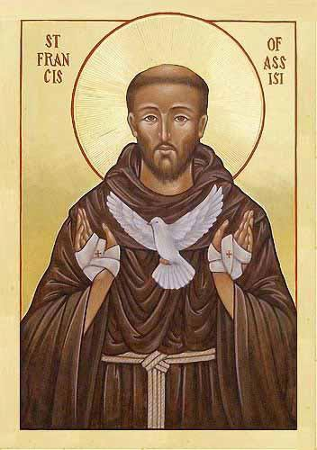
Year 1 Class Saint: Saint Francis of Assisi
Feast Day: October 4th
Patron Saint of: animals and ecology
Birth: Around 1181 - 1182
Death: October 3rd 1226
Canonised: July 16, 1228, by his former protector, Pope Gregory IX.

Slide 6
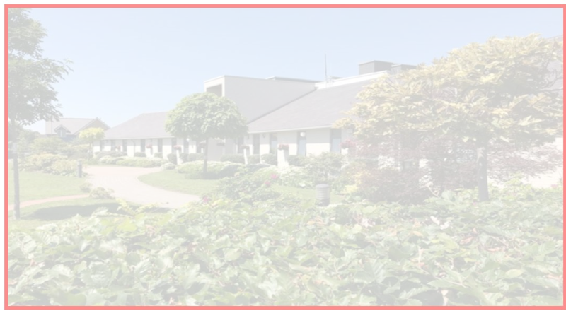


Building the Kingdom
Building the Kingdom is a faith-based initiative that weaves Catholic values throughout our curriculum. By engaging with big questions, children are encouraged to explore themes of faith, justice, and their role in the world. This approach supports our mission to guide young people into becoming compassionate, responsible individuals who live the Gospel and understand their place in God’s plan.
Alongside its central place in our school curriculum, we will also be introducing monthly BTK homework for you to enjoy with your child at home. Each month, you’ll receive a BTK question to respond to in any way you choose, whether through writing, art, or another creative form. We warmly invite you to take part in this journey together.

Slide 7
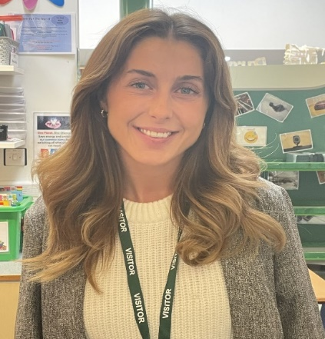
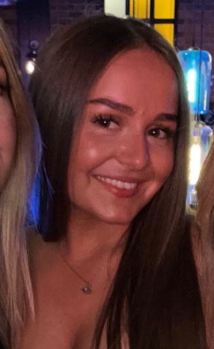
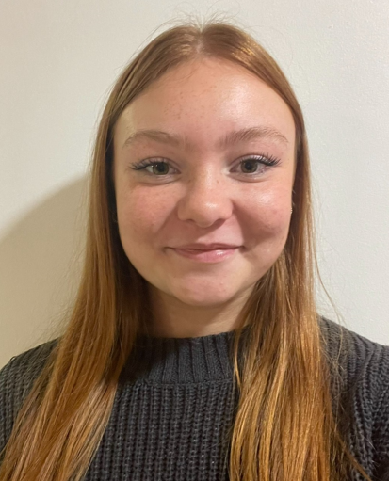
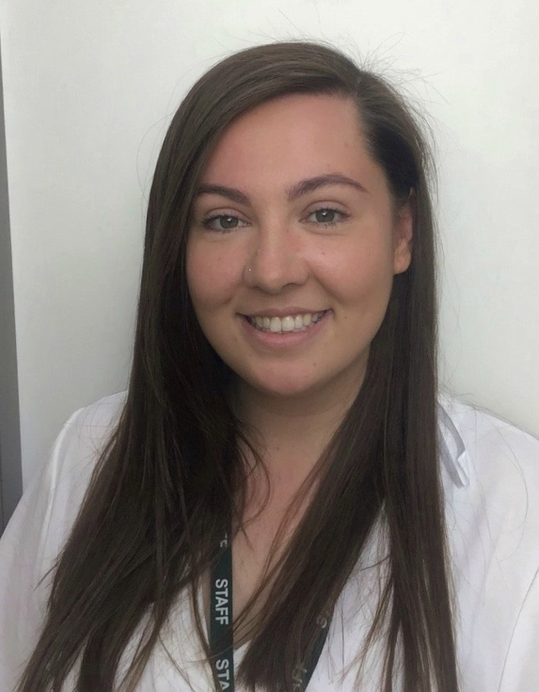
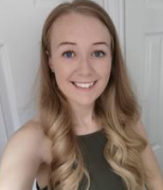
Meet the Year 1 Team!
Please note as well as the Year 1 team there will be other school staff including inclusion staff, staff who cover part time hours, senior leaders, dinner supervisors and staff who cover absences who will also work in this year group as required linked to school organisation.
In 1I we have… Miss Ingleston Miss McGuire Miss Mansell
In 1O’C we have… Miss O’Connor Miss Cartlidge

Slide 8
Parent Reminders
The school gates open for the start of the day a few minutes before 8.30am each
morning.
School begins at 8.30am.
Registration finishes at 8.40am.
Children who arrive after 8.40am need to go to the main office to be registered. They will receive a late mark.
Children who arrive at school after 9.10 receive an Unauthorised mark that morning.
(10 or more unauthorised absences may require the involvement of external agencies)
The children at Saint Anne’s work very hard every single day.
They continue their learning until 3.15pm. It takes several minutes to get coats , belongings etc
before children leave. With 30 children to dismiss it can take 5 or so minutes after 3.15 to dismiss
all children. Please be patient.
Friday finish - gates open at 2.05pm and children need to be collected by 2.10pm.
All children must be collected by an authorised adult. If another adult is going to collect your child please inform your class teacher with advance notice.
If you have any queries wherever possible please send these into our
parent email: parentmail@st-annes.solihull.sch.uk

Slide 9
Homework
Maths
Each week your child will receive maths homework. This will link either to key skills that your child is expected to know by the end of year 1 or their weeks learning in class.
Spelling Frame
Please log on to Spelling Frame to access the list of words for this week. You will also receive a printed list of the words every Monday. Ideally, children who have access to the online resource should take the test on Spelling Frame (as many times as they wish) and they will also be assessed in school each Friday.
Building the Kingdom homework
Alongside its central place in our school curriculum, we will also be introducing monthly BTK homework for you to enjoy with your child at home. Each month, you’ll receive a BTK question to respond to in any way you choose, whether through writing, art, or another creative form. We warmly invite you to take part in this journey together.

Slide 10
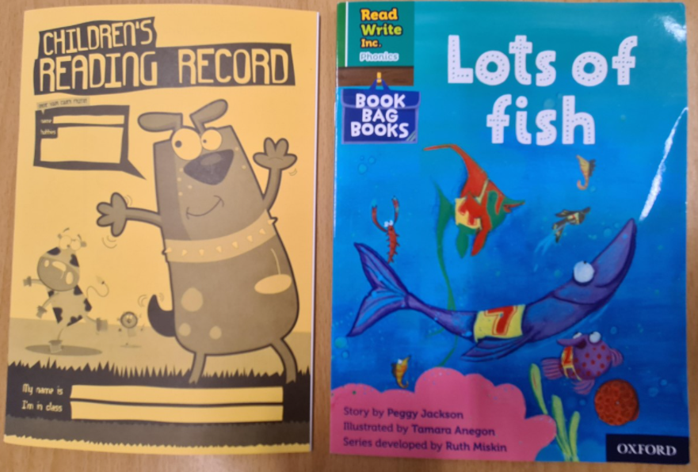
Reading
The expectation is for children to read for at least 10 minutes each day.
Please sign their reading journal when you have listened to your child read each day.
Children’s reading books will be checked and changed daily. All children are expected to bring their book bag and reading diary with them into school every day as it is part of their uniform.
It’s incredibly important that you listen to your children read every night to help us develop your child’s reading ability.
Children will also bring home a bedtime story for you to read to your child. This will be changed each day. This does not need to be recorded in reading diaries.

Slide 11

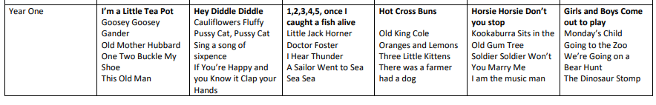
Home learning
Nursery Rhymes
Over the year we will be focusing on different nursery rhymes each term. We will send these home for you to practise with your child.

Slide 12



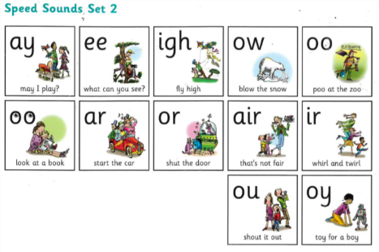

Phonics is a way of teaching children the skills of reading and writing.
How we teach phonics in school:
Phonics is taught every day.
Phonics is differentiated in each class and children are grouped based on their phonics needs.
Phonics is reinforced throughout all lessons and learning, to embed the skills and knowledge.

Slide 13

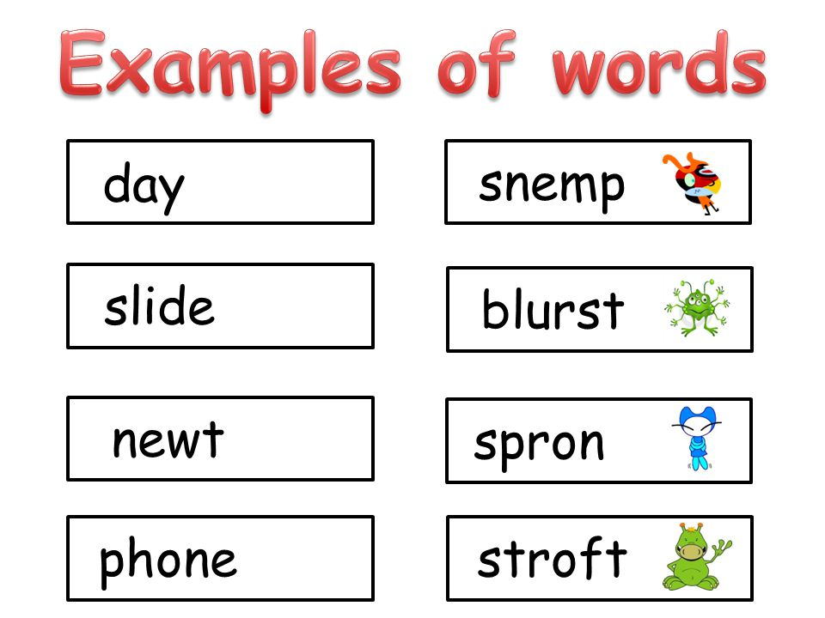
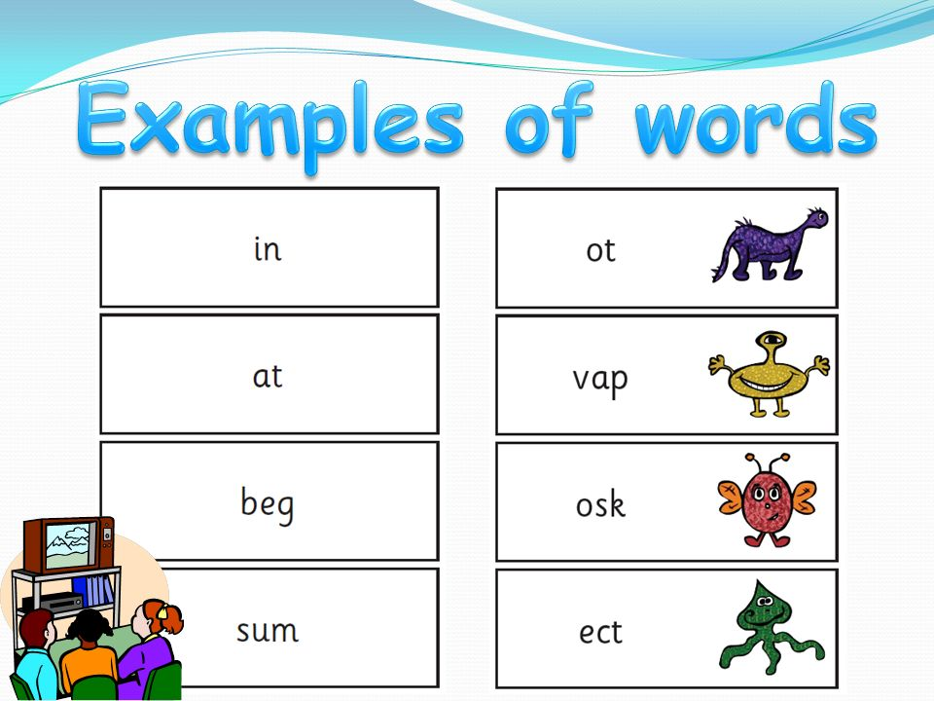
Phonics Screening
At the end of year 1 we have a phonics screening check to asses the children’s phonics ability.
Children are asked to read 40 real and nonsense words.
This is used as an assessment tool to inform teachers planning.
Children are assessed individually by a teacher. They do not know they are being assessed and are told that they are playing a game. (Please support school with this- children do not need to know.)
If your child doesn’t meet the pass rate they will retake the check in year 2.
Parents will be informed of the results alongside the end of year report.

Slide 14
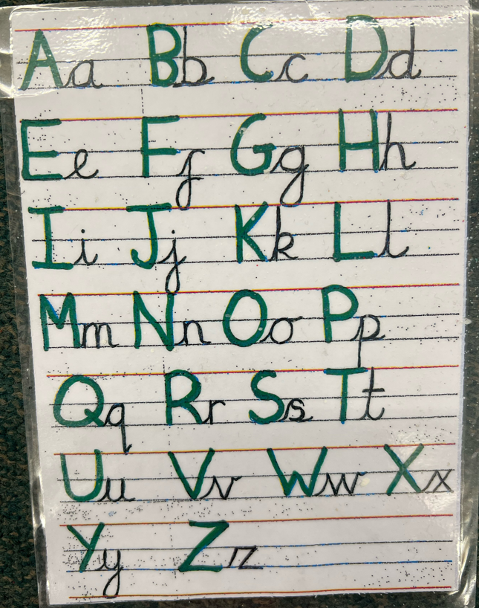
Handwriting
In year one children transition to Pre-cursive handwriting. In pre cursive handwriting, children practise adding lead-ins and lead-outs to letters (whooshes and hooks), which then ensures the letters start and finish in the correct place for writing to be joined. When we feel the children are ready by Summer term in Year One then cursive joins can begin to be taught.

Slide 15

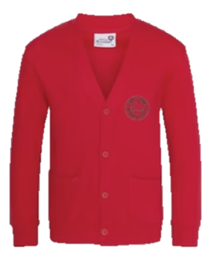


Uniform
Winter Uniform
White collared shirt
Green tie (available through Parent Pay)
Red jumper or cardigan
Girls – Grey school skirt
Boys – Grey school trousers
Black school shoes. (No Converse)
Summer Uniform
Girls
Red gingham summer dress
Red cardigan
White socks
Black school shoes
Boys
Red polo
Red jumper
Grey school shorts
Dark socks
Black school shoes
Children are expected to bring their book bags every day as part of their uniform.
Trainers should only be worn on PE days.
Smart watches with cameras or voice recording functions are not permitted.

Slide 16

P.E
To keep your children as safe as possible we are asking all children to come to school wearing their PE kit on their PE day.
Year 1 P.E days are Tuesday and Thursday.
A reminder that P.E kit consists of red polo shirt, black jogging bottoms and trainers. Children must come in wearing their school jumper/cardigan.
In addition to their school jumper /cardigan children may come to school with a plain black sweatshirt/hoodie on top of their school jumper/cardigan. Wearing a black hoodie should not replace a school red cardigan/jumper.
In school they take their black hoodie off with their coat and keep it for the PE lesson.
For shoes children must wear appropriate trainers.

Slide 17
Jewellery
The wearing of any jewellery is not encouraged, watches are the only exception. We only allow analogue watches that support children to learn to tell the time - no digital/smart watches are permitted.
Children must not wear rings, chains, necklaces or earrings that hang below the ear e.g. sleepers. If parents still wish children to wear earrings, despite the risks of injury, only the small plain tiny stud type are allowed (maximum number of one per ear in the centre of the lobe). Staff cannot be held responsible for looking after items of jewellery such as watches or studs.
Children are also expected to take their own earrings out for P.E lessons as required. Children must NOT wear earrings of any type for swimming.
Therefore, we discourage any jewellery on P.E days.

Slide 18
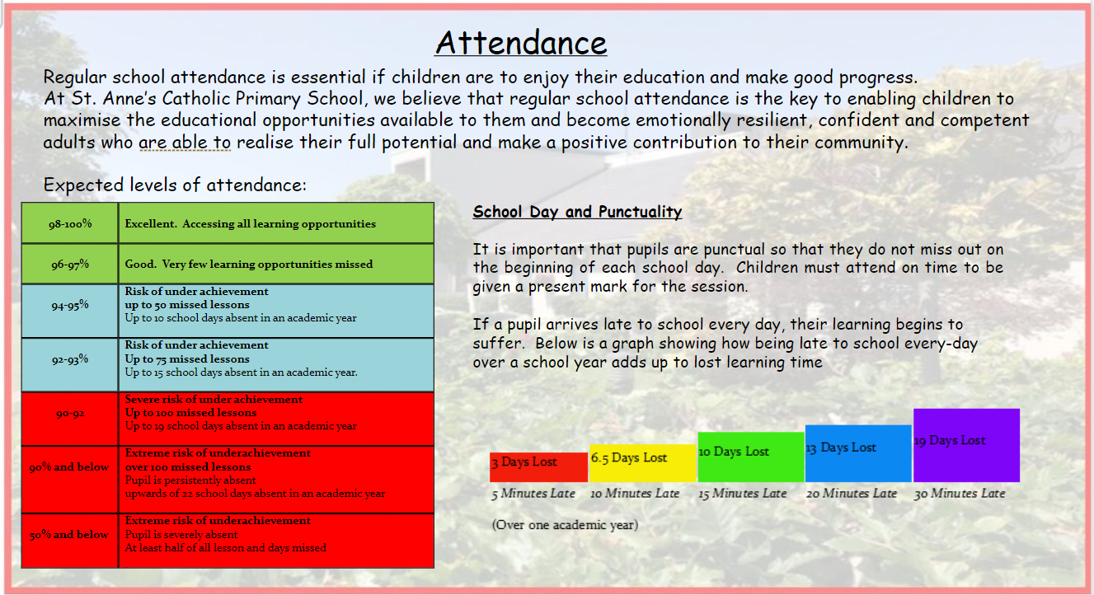

Slide 19
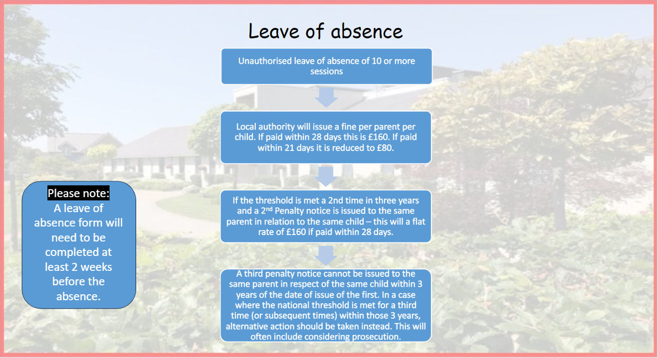

Slide 20
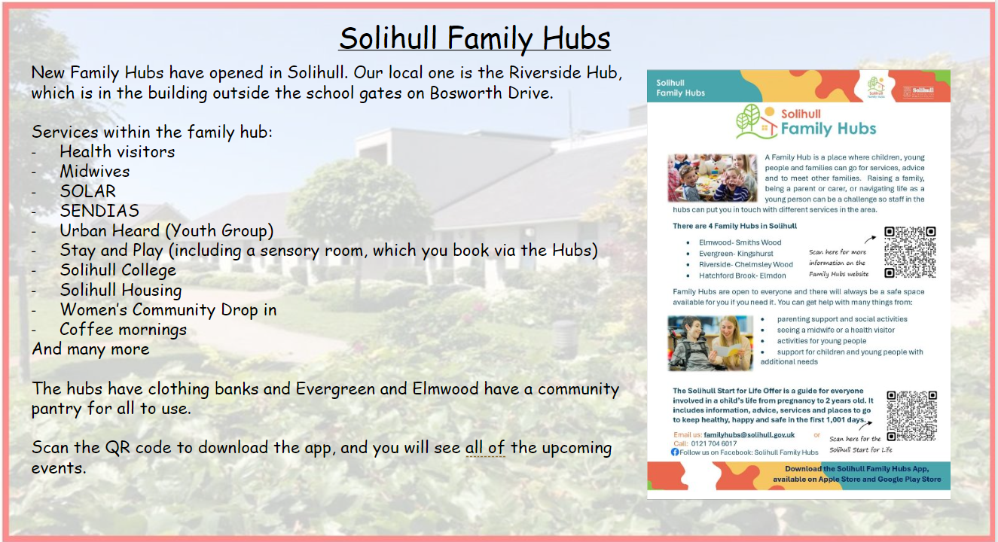

Slide 21

School Dinners
To order your child’s dinner, please order this via BlueRunner.
We need you to order their dinners for a week ahead before your child comes into school on a Monday .
Your ParentPay account will need to be in credit as all meals have to be paid for in advance.
There is more guidance on our website for ordering your child’s dinners.
There is also a family information pack, produced by Aspens for you all to look at.
Please remember, there are no options for baguettes or wraps, however a varied, hot and nutritious dinner is available every day, including a jacket potato or pasta pot or sandwiches.
If you are not able to access your ParentPay account, please contact the school office via Parent mail.
Please apply for Free School Meals if you think you may be entitled to these via Solihull Council.

Slide 22




Our Curriculum:
St. Anne’s Unique and Special Curriculum
Our Mission Statement underpins our curriculum- each and every child is unique and special and every decision we make cherishes this principle.
Our curriculum includes the taught and untaught curriculum.
As such it provides broad, in depth instruction of all the subjects from the National Curriculum, as well as spiritual, moral, personal, social and emotional development and vocational and cultural development.
Our Curriculum is designed to meaningfully convey the following content:-
National Curriculum
Diocesan Strategy
St Anne’s mission
Virtues
Catholic Social Teachings
British Values

Slide 23
St. Anne’s Curriculum – ‘Unique and Special’
Our knowledge and skills based curriculum is underpinned by the four key curriculum drivers below:
All of our approaches to teaching and learning focus on developing children’s spoken language and vocabulary
Spirituality and Diversity
Knowledge and Skills
Aspirations and Possibilities
Well being and Love

Slide 24
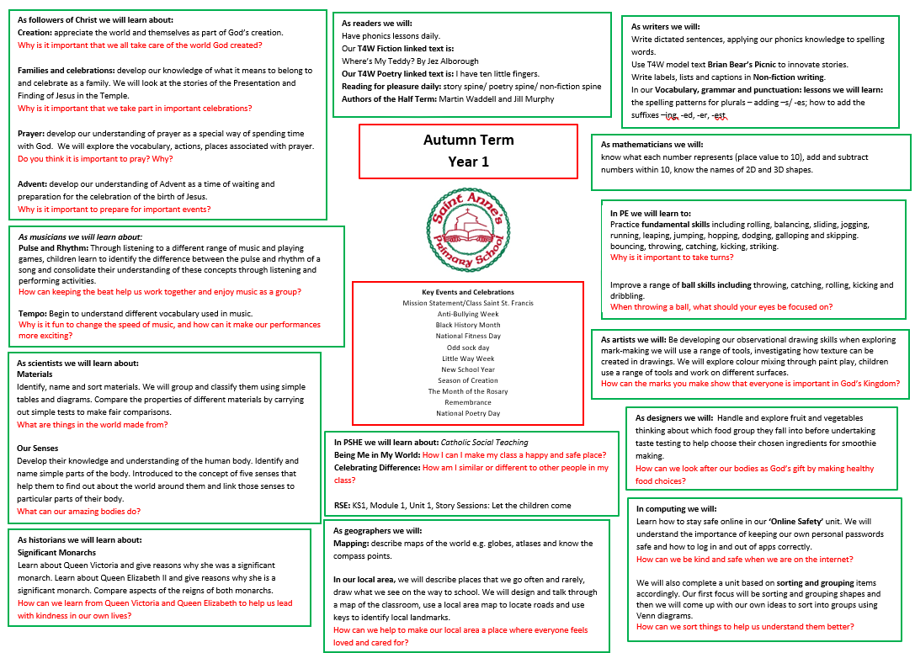
Each term you will receive a curriculum overview so you understand what your child will be learning in school.

Slide 25
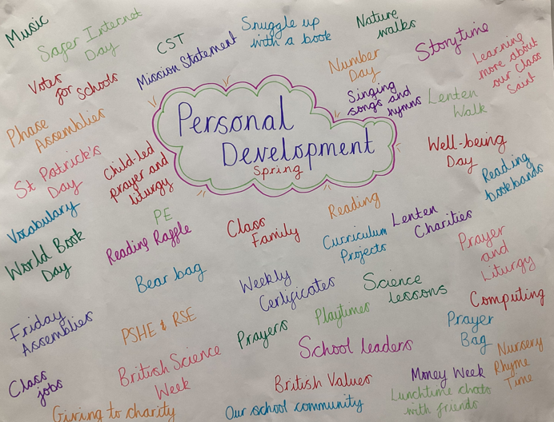
Character Education and
Personal Development Opportunities
Spiritual, Morale, Social, Vocational, Cultural development including emotional and physical development are key aspects of character education.
Here are some ways in which we enrich and encourage children’s personal development in Year 1.

Slide 26

Relationships Education
Children follow a diocesan programme TEN TEN.
Partnership work with families.
Parent access to materials and website:
https://www.tentenresources.co.uk/life-to-the-full-primary/

Slide 27

Online Safety
We support parents and families and aim to work together
with you to keep children safe online
How to set up parental controls
Talking to your child about staying safe online
Individual guidance for the sites, apps and games that
your child uses
Important to understand and consider the parental
responsibilities linked to e-safety with the support of
school.
https://www.internetmatters.org/wp-content/uploads/2015/05/ncro3p-Internet-Matters_E-safety_Primary_1.pdf
https://www.nspcc.org.uk/preventing-abuse/keeping-children- safe/online-safety/

Slide 28
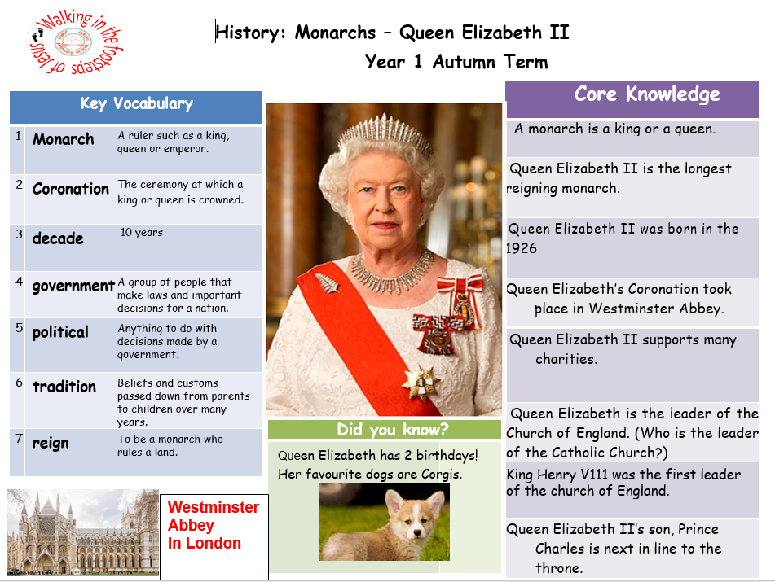

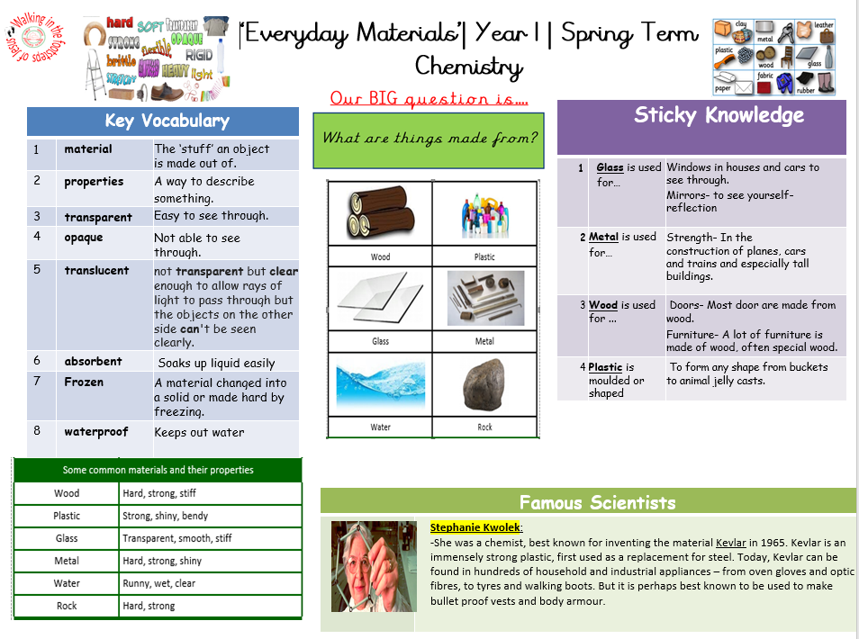

Knowledge Organisers
Each half term your child will bring home an overview of the curriculum for the upcoming weeks paired with the appropriate Knowledge Organisers.
Please have a look at these with your children and talk about some of the language and things we will be looking at in preparation. Knowledge organisers are also a fantastic resource for consolidating learning at home.

Slide 29
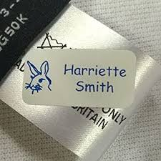


Please ensure all items of your child’s uniform have their names in them.
Please send them to school with a named water bottle every day.
A medical form is needed for any new creams/gels/soaps that have been prescribed by a doctor. Please ask us for one of these.
We hope all of the children have a fantastic year in Year 1!
And Finally …

Slide 30
If you have any questions please phone the school office or send your class teacher an email.
parentmail@st-annes.solihull.sch.uk
In the event of an urgent response,
please contact the school office 0121 779 8060
We will not hesitate to help!
Thank you for all your support and cooperation!

