Slide 1



Do you kn ow your
Set 3 and additional sounds?
Test your child’s knowledge of Set 3 and additional sounds.
Each slide has a grapheme on it, ask them to say the sound and phrase, then move onto the next side.
Helping Hint
On every page there is a “Helping Hint” button,
press this to reveal the Picture or Phrase.
Start

Slide 2
The end
How did you do?
Give yourself a “Rollercoaster!”

Slide 3
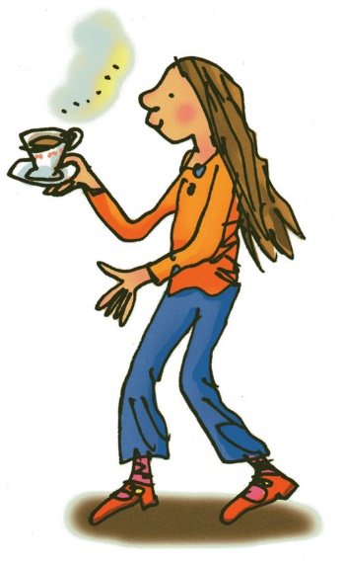


Helping Hint
ea – cup of tea
stop
back button
next letter

Slide 4
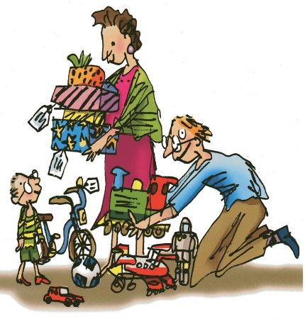
Helping Hint
oi – spoil the boy
stop
back button
next letter

Slide 5
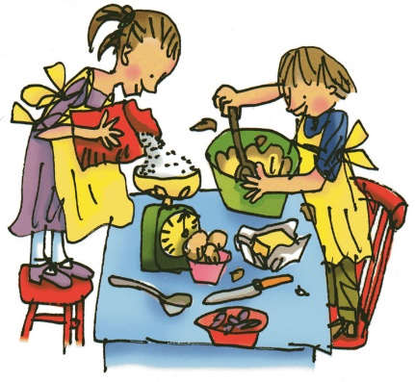
Helping Hint
a-e – make a cake
stop
back button
next letter

Slide 6
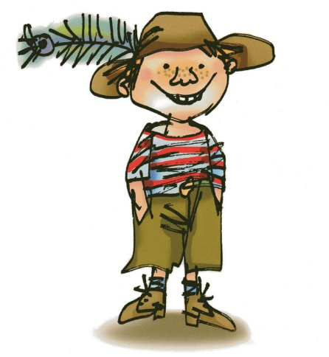
Helping Hint
i-e – nice smile
stop
back button
next letter

Slide 7
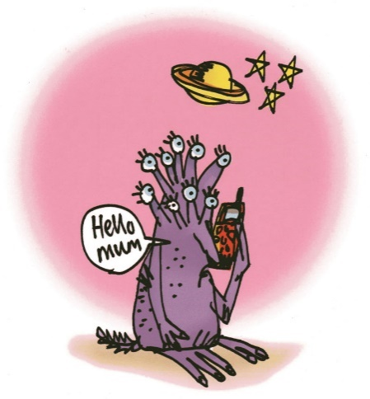
Helping Hint
o-e – phone home
stop
back button
next letter

Slide 8
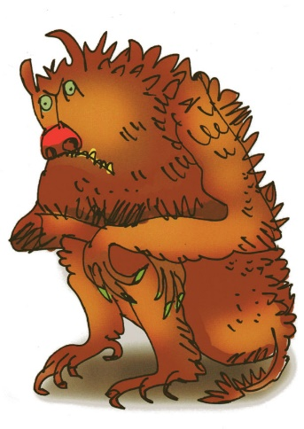
Helping Hint
u-e – huge brute
stop
back button
next letter

Slide 9

Helping Hint
aw – yawn at dawn
stop
back button
next letter

Slide 10
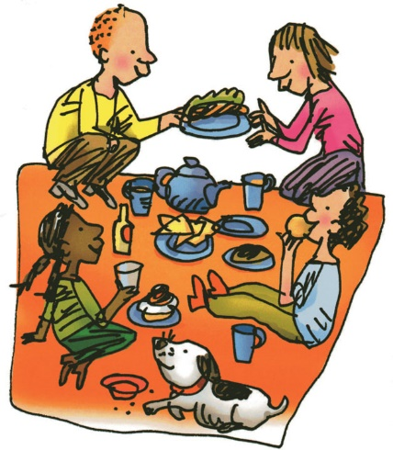
Helping Hint
are – care and share
stop
back button
next letter

Slide 11
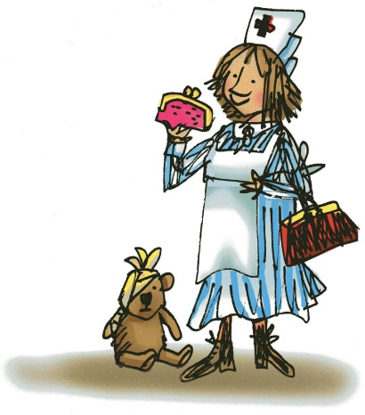
Helping Hint
ur – nurse with a purse
stop
back button
next letter

Slide 12
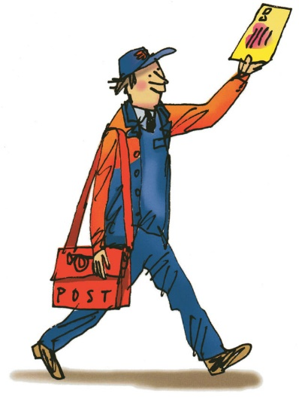
Helping Hint
er – a better letter
stop
back button
next letter

Slide 13
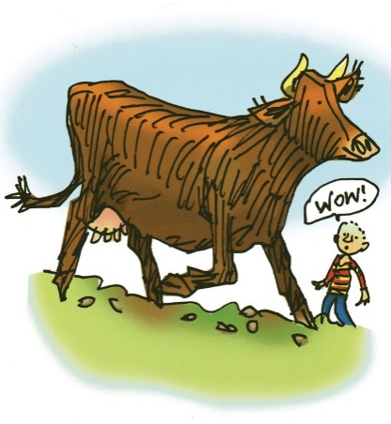
Helping Hint
ow – brown cow
stop
back button
next letter

Slide 14
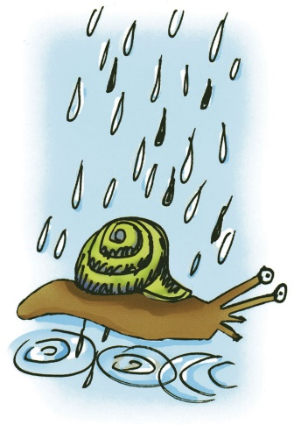
Helping Hint
ai – snail in the rain
stop
back button
next letter

Slide 15
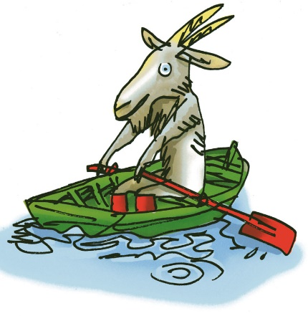
Helping Hint
oa – goat in a boat
stop
back button
next letter

Slide 16
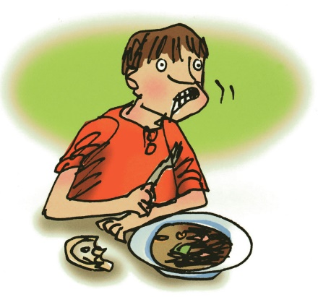
Helping Hint
ew – chew the stew
stop
back button
next letter

Slide 17
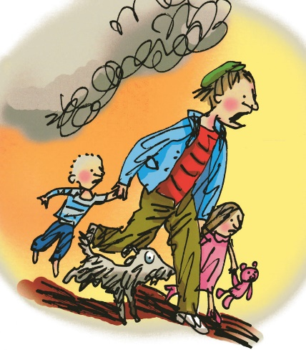
Helping Hint
ire – fire, fire!
stop
back button
next letter

Slide 18
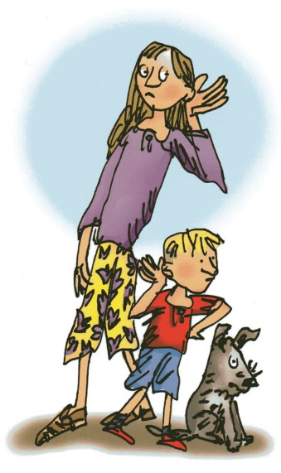
Helping Hint
ear – hear with your ear
stop
back button
next letter

Slide 19
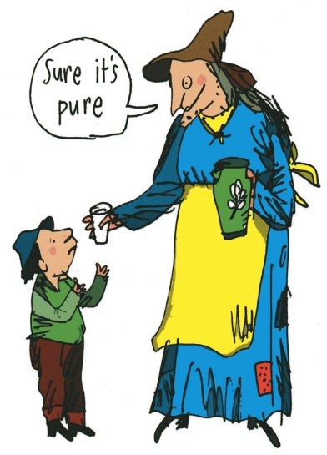
Helping Hint
ure – sure it’s pure
stop
back button
next letter

Slide 20
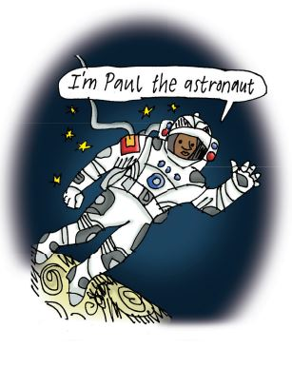
Helping Hint
au – Paul the astronaut
stop
back button
next letter

Slide 21
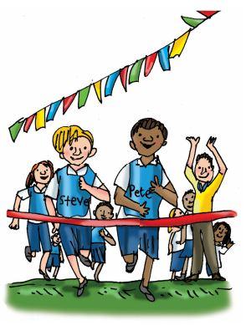
Helping Hint
e-e – go Pete and Steve!
stop
back button
next letter

Slide 22
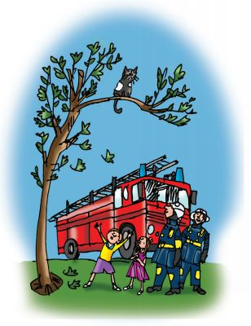
Helping Hint
ue – come to the rescue!
stop
back button
next letter

Slide 23
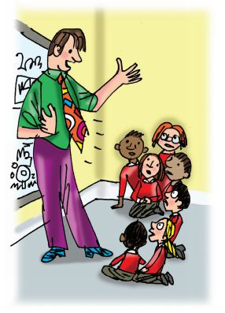
Helping Hint
ie – terrible tie!
stop
back button
next letter

Slide 24
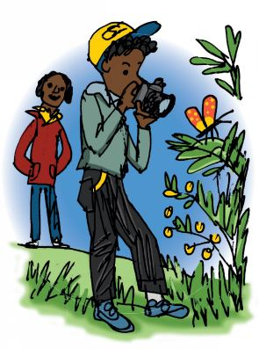
Helping Hint
ph – take a photo
stop
back button
next letter

Slide 25
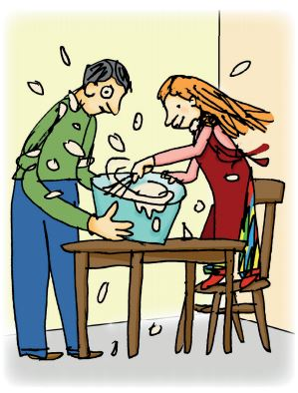
Helping Hint
wh – whisk, whisk
stop
back button
next letter

Slide 26
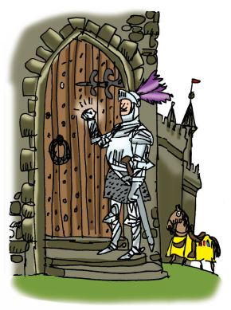
Helping Hint
kn – knock knock, who’s there?
stop
back button
next letter

