Slide 1



Do you kn ow your
Set 1 Sounds?
Test your child’s knowledge of Set 1 sounds.
Each slide has a letter on it, ask them to say the sound and then move onto the next side.
Helping Hint
On every page there is a “Helping Hint” button,
press this to reveal the Picture or Phrase.
Start

Slide 2
The end
How did you do?
Give yourself a “1,2,3, well done me!”

Slide 3



Helping Hint
a – a, a, apple
stop
back button
next letter

Slide 4
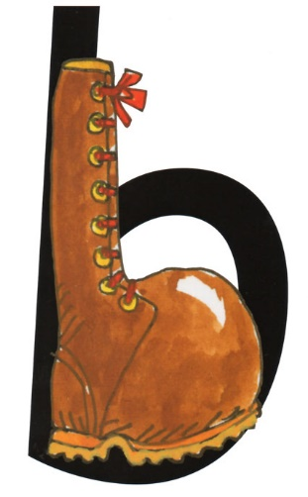
Helping Hint
b - b, b, boot
stop
back button
next letter

Slide 5

Helping Hint
c - c, c, caterpillar
stop
back button
next letter

Slide 6
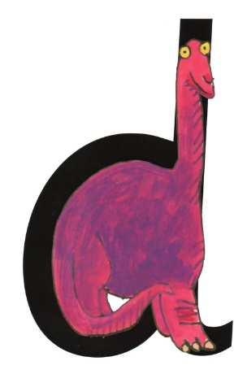
Helping Hint
d - d, d, dinosaur
stop
back button
next letter

Slide 7
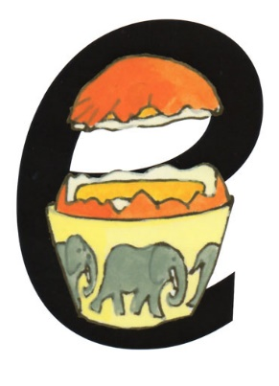
Helping Hint
e - e, e, egg
stop
back button
next letter

Slide 8

Helping Hint
f - ffflower
stop
back button
next letter

Slide 9
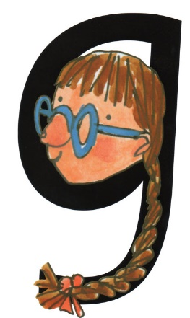
Helping Hint
g - g, g, girl
stop
back button
next letter

Slide 10
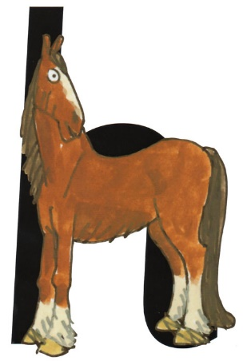
Helping Hint
h - h, h, horse
stop
back button
next letter

Slide 11
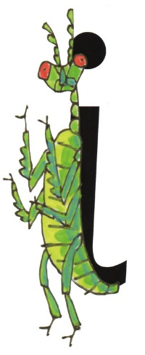
Helping Hint
i - i, i, insect
stop
back button
next letter

Slide 12
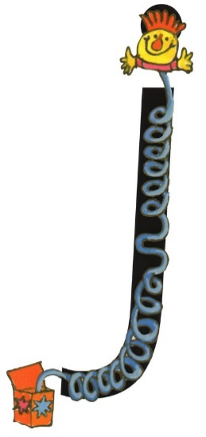
Helping Hint
j - j, j, jack-in-a-box
stop
back button
next letter

Slide 13

Helping Hint
k - k, k, kangaroo
stop
back button
next letter

Slide 14
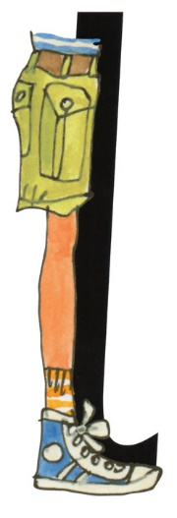
Helping Hint
l - lllleg
stop
back button
next letter

Slide 15
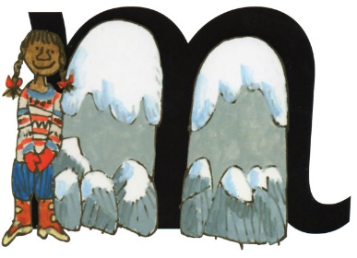
Helping Hint
m - mmmmmaisie
stop
back button
next letter

Slide 16
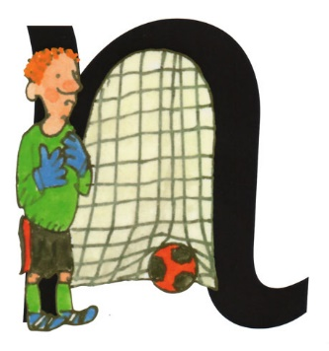
Helping Hint
n - nnnnet
stop
back button
next letter

Slide 17
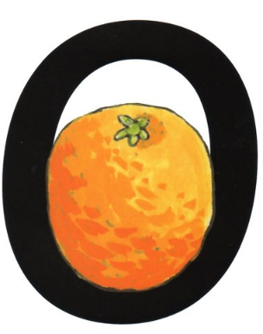
Helping Hint
o - o, o, orange
stop
back button
next letter

Slide 18
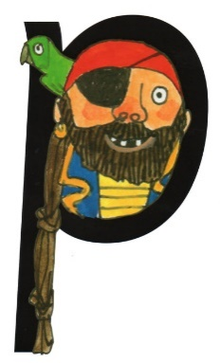
Helping Hint
p - p, p, pirate
stop
back button
next letter

Slide 19

Helping Hint
qu - qu, qu, queen
stop
back button
next letter

Slide 20
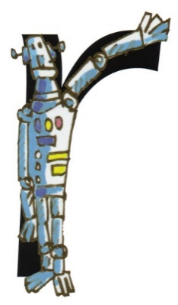
Helping Hint
r - rrrrobot
stop
back button
next letter

Slide 21

Helping Hint
s - ssssnake
stop
back button
next letter

Slide 22

Helping Hint
t - t, t, tower
stop
back button
next letter

Slide 23

Helping Hint
u - u, u, umbrella
stop
back button
next letter

Slide 24

Helping Hint
v - vvvulture
stop
back button
next letter

Slide 25

Helping Hint
w - w, w, worm
stop
back button
next letter

Slide 26

Helping Hint
x - exercise
stop
back button
next letter

Slide 27

Helping Hint
y - y, y, yak
stop
back button
next letter

Slide 28

Helping Hint
z - zzzzip
stop
back button
next letter

Slide 29
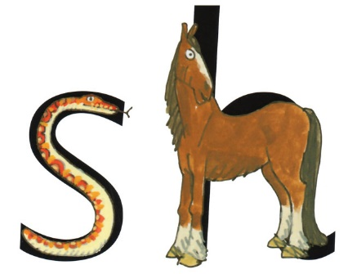
Helping Hint
sh - shhhh
stop
back button
next letter

Slide 30
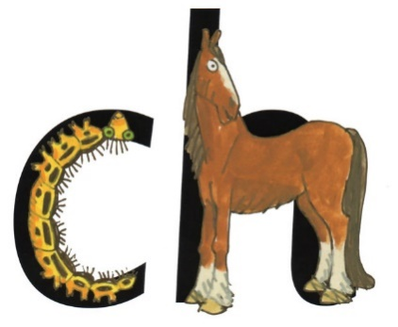
Helping Hint
ch – ch, ch, choo
stop
back button
next letter

Slide 31
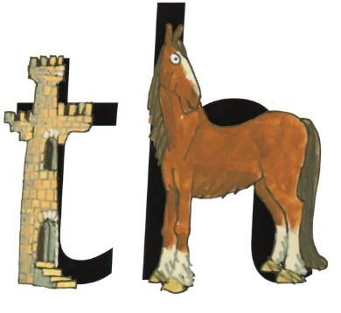
Helping Hint
th – thhhank you
stop
back button
next letter

Slide 32
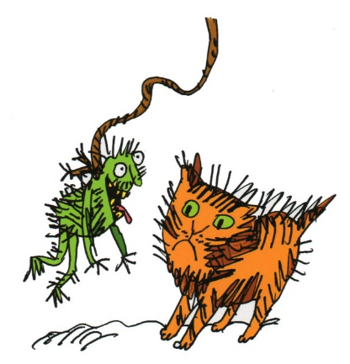
Helping Hint
ng – thing on a string
stop
back button
next letter

Slide 33
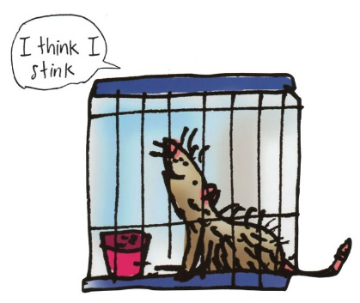
Helping Hint
nk – I think I stink
stop
back button
next letter

Slide 34
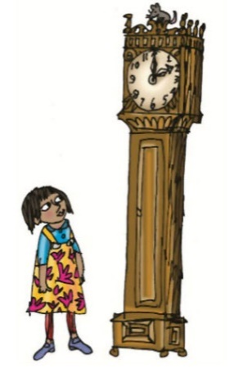
Helping Hint
ck – tick tock clock
stop
back button
next letter

