Slide 1
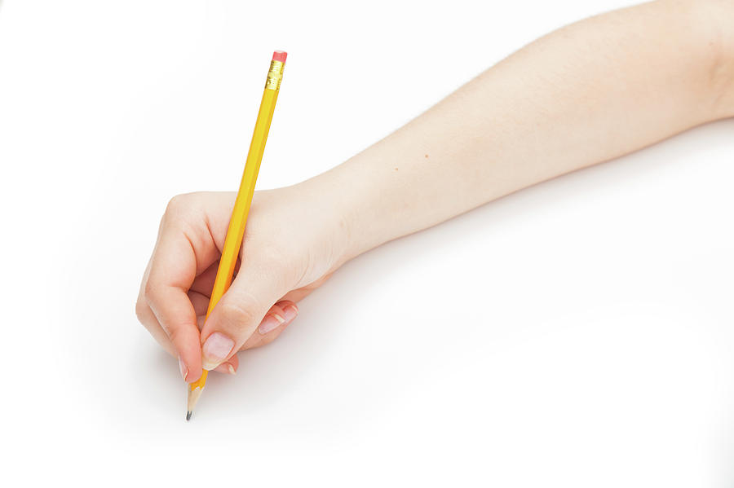



Can you write your
Set 1 Sounds?
Test your child’s handwriting of Set 1 sounds.
Each slide has a letter on it, ask them to say the handwriting phrase whilst they write the sound.
Don’t forget to
use your
pinchy fingers!
Helping Hint
On every page there is a “Helping Hint” button,
press this to reveal the Picture or Phrase.
Start

Slide 2
The end
How did you do?
Give yourself a “Hip, Hip, Hooray!”

Slide 3
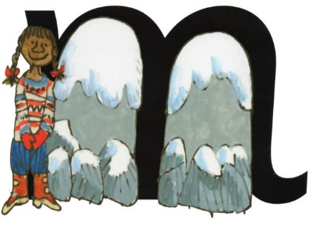



Helping Hint
m – Maisie, mountain, mountain
m
stop
back button
next letter

Slide 4


Helping Hint
a – round the apple, down the leaf
stop
back button
next letter

Slide 5
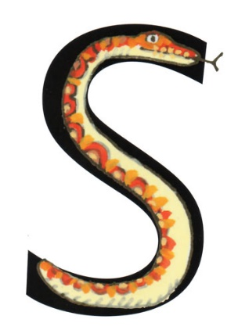

Helping Hint
s – slither down the snake
stop
back button
next letter

Slide 6
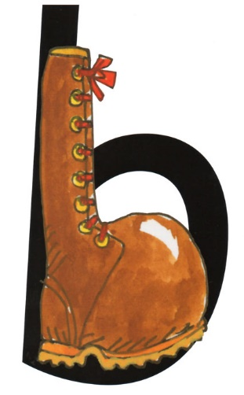

Helping Hint
b – down the laces to the heel, round the toe
stop
back button
next letter

Slide 7
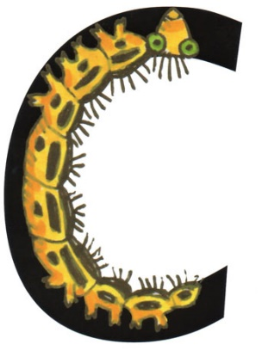

Helping Hint
c – curl around the caterpillar
stop
back button
next letter

Slide 8
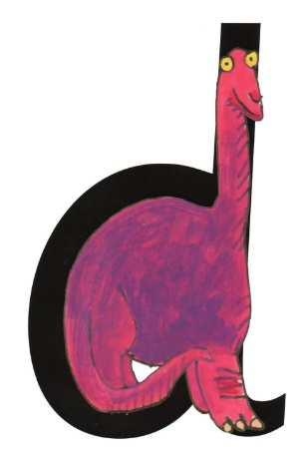

Helping Hint
d – round his bottom, up his tall neck,
down to his feet
stop
back button
next letter

Slide 9
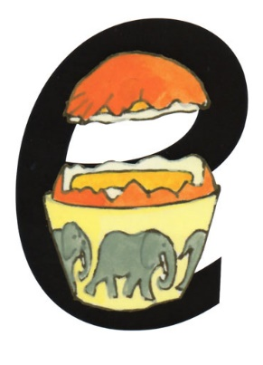

Helping Hint
e – lift off the top and scoop out the egg
stop
back button
next letter

Slide 10


Helping Hint
f – down the stem and draw the leaves
stop
back button
next letter

Slide 11
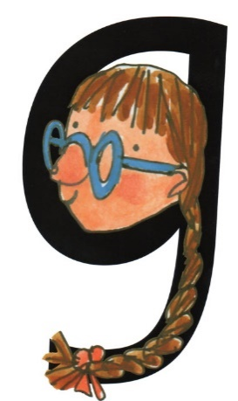

Helping Hint
g – round her face, down her hair
and give it a curl
stop
back button
next letter

Slide 12
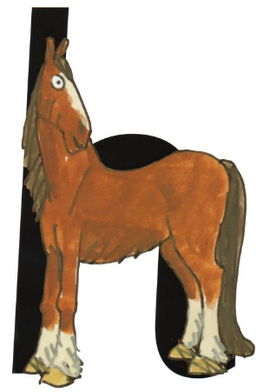

Helping Hint
h – down the head to the hooves
and over his back
stop
back button
next letter

Slide 13
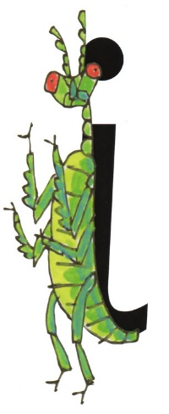

Helping Hint
i – down the body, dot the head
stop
back button
next letter

Slide 14
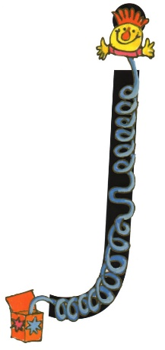

Helping Hint
j – down his body, curl and dot
stop
back button
next letter

Slide 15
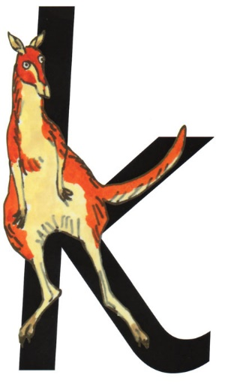

Helping Hint
k – down the kangaroo’s body, tail and leg
stop
back button
next letter

Slide 16
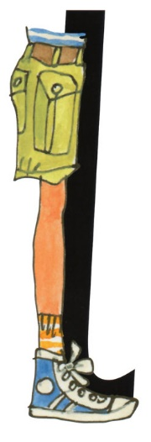

Helping Hint
l – down the long leg
stop
back button
next letter

Slide 17
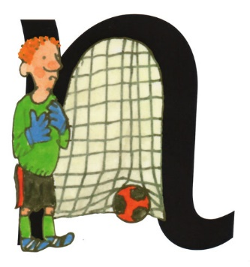

Helping Hint
n – down Nobby, over his net
stop
back button
next letter

Slide 18
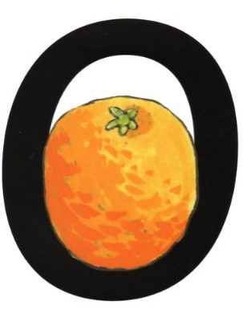

Helping Hint
o – all around the orange
stop
back button
next letter

Slide 19
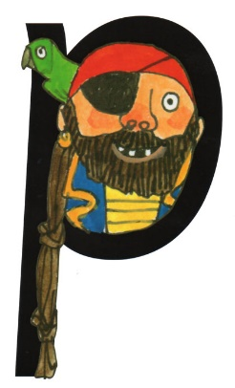

Helping Hint
p – down the plait and over
the pirate’s face
stop
back button
next letter

Slide 20
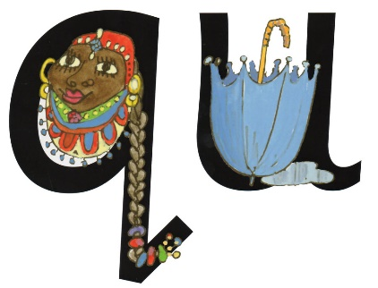

q – round her head, up past her earrings
and down her hair with a flick. Then…
u - down and under, up to the top and draw the puddle
The Queen ALWAYS takes her umbrella out with her!
Helping Hint
stop
back button
next letter

Slide 21
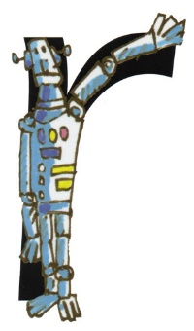

Helping Hint
r – down his back, then curl over his arm
stop
back button
next letter

Slide 22
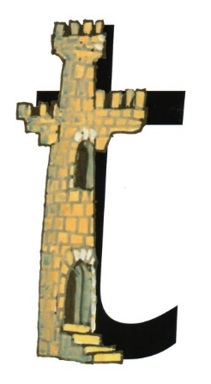

Helping Hint
t – down the tower, across the tower
stop
back button
next letter

Slide 23
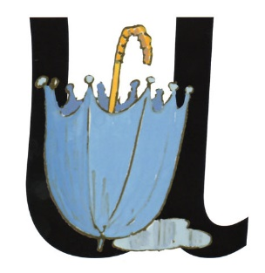

Helping Hint
u - down and under, up to the top
and draw the puddle
stop
back button
next letter

Slide 24


Helping Hint
v – down the wing, up the wing
stop
back button
next letter

Slide 25
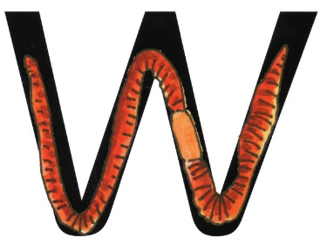

Helping Hint
w – down, up, down, up
stop
back button
next letter

Slide 26
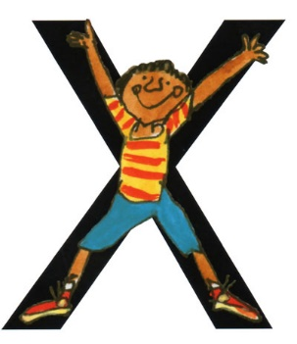

Helping Hint
x – down the arm and leg, up the other side
stop
back button
next letter

Slide 27
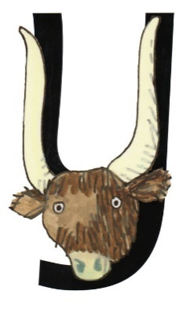

Helping Hint
y – down the horn, up the horn
and under his head
stop
back button
next letter

Slide 28
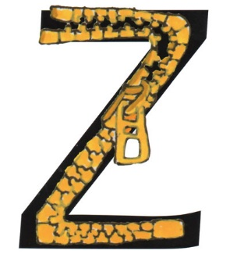

Helping Hint
z – zig-zag-zig
stop
back button
next letter

Slide 29
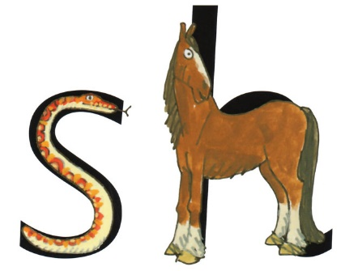

sh – shhhh says the horse to the snake
s – slither down the snake
h – down the head to the hooves and over his back
Helping Hint
stop
back button
next letter

Slide 30
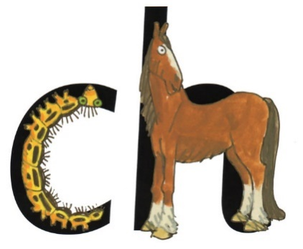

ch – ch, ch, choo
c – curl around the caterpillar
h – down the head to the hooves and over his back
Helping Hint
stop
back button
next letter

Slide 31
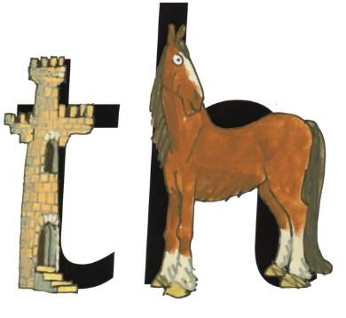

th – thhhank you
t – down the tower, across the tower
h – down the head to the hooves and over his back
Helping Hint
stop
back button
next letter

Slide 32
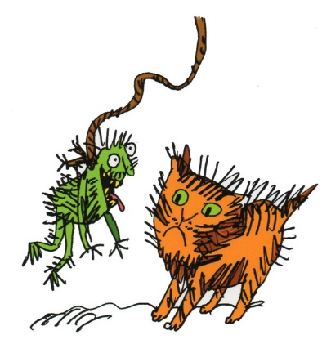

ng – thing on a string
n – down Nobby, over his net
g – round her face, down her hair and give it a curl
Helping Hint
stop
back button
next letter

Slide 33
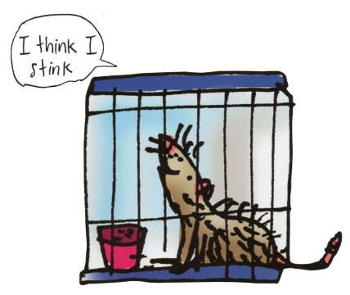

nk – I think I stink
n – down Nobby, over his net
k – down the kangaroo’s body, tail and leg
Helping Hint
stop
back button
next letter

Slide 34
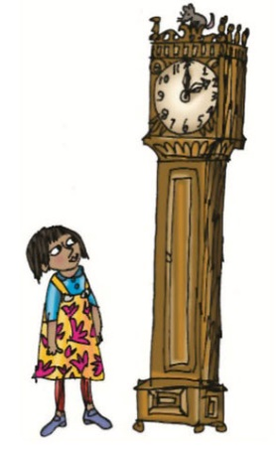
ck – tick tock clock
c – curl around the caterpillar
k – down the kangaroo’s body, tail and leg
Helping Hint
stop
back button
next letter

