Slide 1
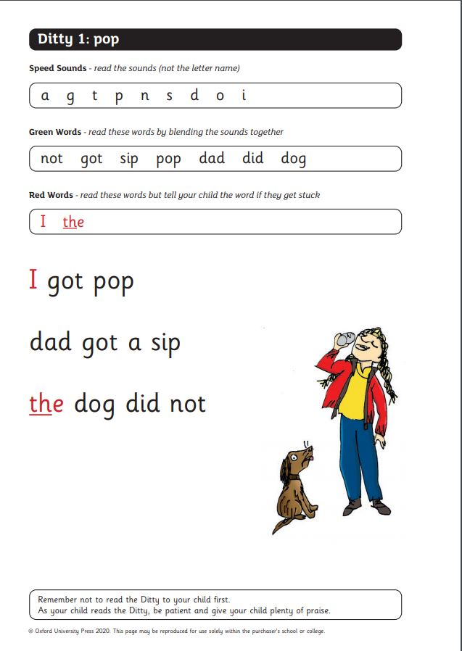


Do you kn ow your
Red Words?
of
I
the
put
Test your child’s knowledge of red words.
Each slide has a red word on it, ask them to say the word,
then move onto the next side.
Helping Hint
On every page there is a “Helping Hint” button,
press this to reveal the sound that is tricking you.
Start

Slide 2

The end
How did you do?
Give yourself a “faaan-tastic!”

Slide 3


Helping Hint
I – When you talk about yourself you say “I”
stop
back button
next word

Slide 4
Helping Hint
of – the “f” is tricking you
stop
back button
next word

Slide 5
Helping Hint
my – the “y” is tricking you
stop
back button
next word

Slide 6
Helping Hint
the – the “e” is tricking you
stop
back button
next word

Slide 7
Helping Hint
no – the “o” is tricking you
stop
back button
next word

Slide 8
Helping Hint
put – the “u” is tricking you
stop
back button
next word

