Slide 1

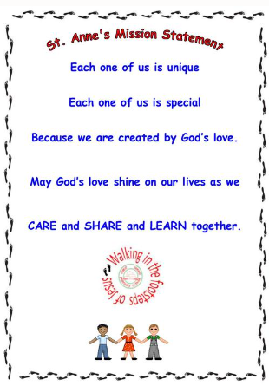
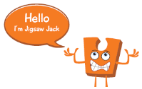
Year 1 - Knowledge Organiser PSHE
Key Vocabulary
Jigsaw – Being Me in My World
Should we have consequences for people who choose not to listen, are unkind or make it hard for us to learn? What rights do we have in school?
Belonging | To feel comfortable and happy in an environment.
Calm | A quiet and peaceful state.
Consequences | A result of a particular action or situation, often one that is not good or convenient.
Proud | Feeling pleased, satisfied and worthy because of something one owns or has done.
Responsibility | Having an expectation to do something.
Rewards | To give something in return for an achievement.
Rights | Something you should expect to have automatically e.g. a right to come to school.
Safe | Free or secure from harm or danger.
Special | Something or someone who is important and unique.
Valued | Useful and important.
Reflective Questions
What Makes Our School Great?
As good citizens of Saint Anne’s Catholic Primary school it is important for our children to know and live out our school ‘Mission Statement.’ Children recognise that they are special and unique and created by God’s love. We establish a culture where children care, share and learn together in a safe and welcoming environment where they are loved, listened to and valued.
Learning Outcomes
I feel safe and special in my class.
I understand that I belong to my class and school.
I can help make my class be a safe place for everyone to learn..
I recognise how it feels to be proud of an achievement.
I recognise a range of feelings when I face certain consequences.
I am choosing to follow the Learning Charter.
Jigsaw Learning Charter
Weekly Celebrations:
Week 1- Help others to feel welcome.
Week 2 – Try to make our school community a better place.
Week 3 – Think about everyone’s right to learn.
Week 4 – Care about other people’s feelings.
Week 5 – Work well with others.
Week 6 – Choose to follow the Learning Charter.

