Slide 1



Do you kn ow your
Set 1 and 2 Special Friends ?
Test your child’s knowledge of Set 1+2 special friends.
Each slide has a grapheme on it, ask them to say the sound and then move onto the next side.
Helping Hint
On every page there is a “Helping Hint” button,
press this to reveal the Picture or Phrase.
Start

Slide 2
The end
How did you do?
Give yourself a “Spec-tacular!”

Slide 3



Helping Hint
qu - qu, qu, queen
stop
back button
next letter

Slide 4

Helping Hint
sh - shhhh
stop
back button
next letter

Slide 5

Helping Hint
ch – ch, ch, choo
stop
back button
next letter

Slide 6

Helping Hint
th – thhhank you
stop
back button
next letter

Slide 7
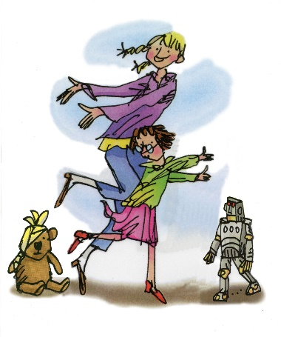
Helping Hint
th – this and that
stop
back button
next letter

Slide 8
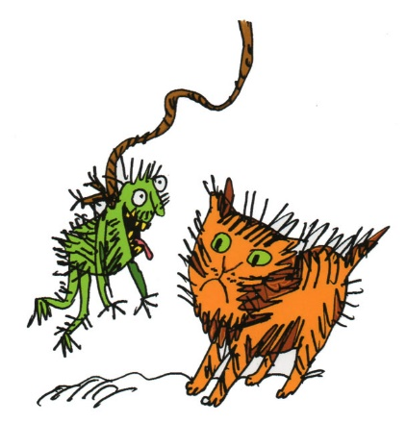
Helping Hint
ng – thing on a string
stop
back button
next letter

Slide 9
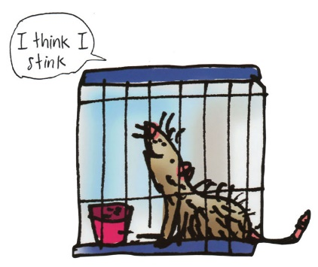
Helping Hint
nk – I think I stink
stop
back button
next letter

Slide 10
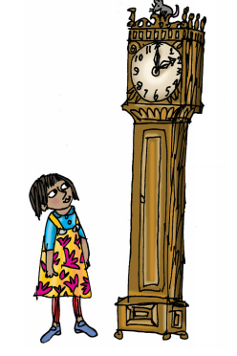
Helping Hint
ck – tick tock clock
stop
back button
next letter

Slide 11
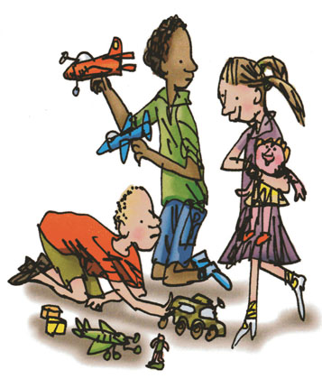
Helping Hint
ay – may I play?
stop
back button
next letter

Slide 12
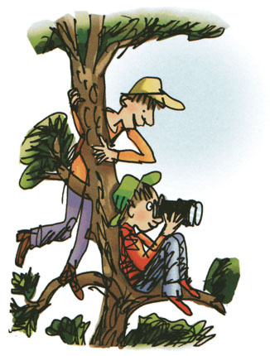
Helping Hint
ee – what can you see?
stop
back button
next letter

Slide 13
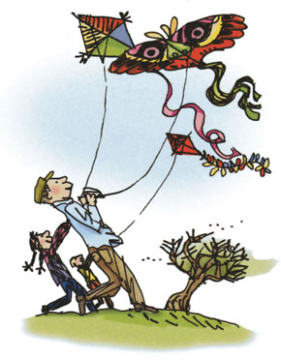
Helping Hint
igh – fly high
stop
back button
next letter

Slide 14
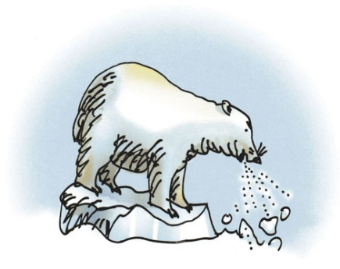
Helping Hint
ow – blow the snow
stop
back button
next letter

Slide 15
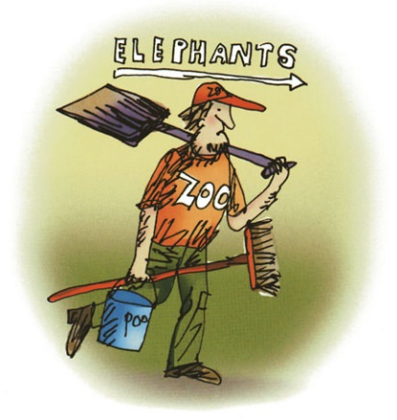
Helping Hint
oo – poo at the zoo
stop
back button
next letter

Slide 16

Helping Hint
oo – look at a book
stop
back button
next letter

Slide 17
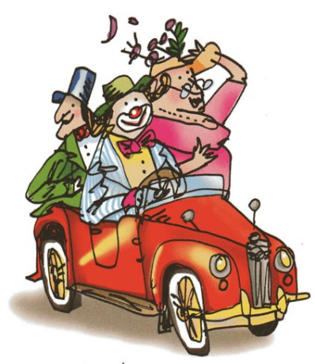
Helping Hint
ar – start the car
stop
back button
next letter

Slide 18
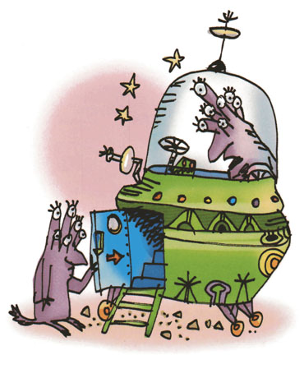
Helping Hint
or – shut the door
stop
back button
next letter

Slide 19
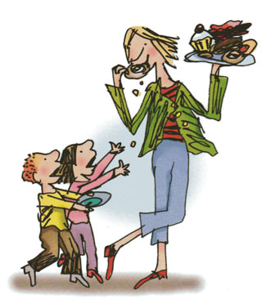
Helping Hint
air – that’s not fair
stop
back button
next letter

Slide 20
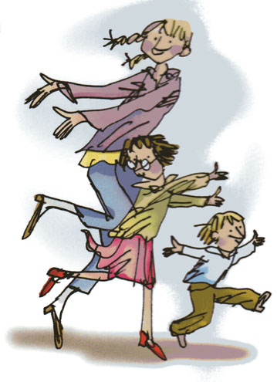
Helping Hint
ir – whirl and twirl
stop
back button
next letter

Slide 21
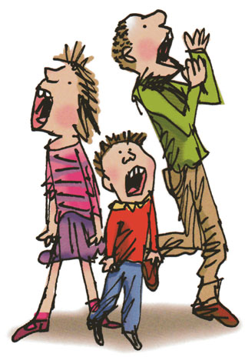
Helping Hint
ou – shout it out
stop
back button
next letter

Slide 22
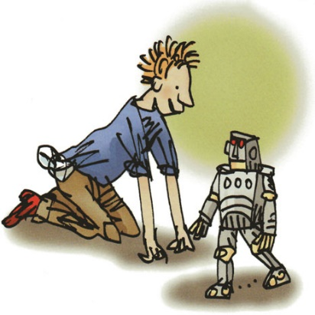
Helping Hint
oy – toy for a boy
stop
back button
next letter

