Slide 1


Slide 2


Slide 3
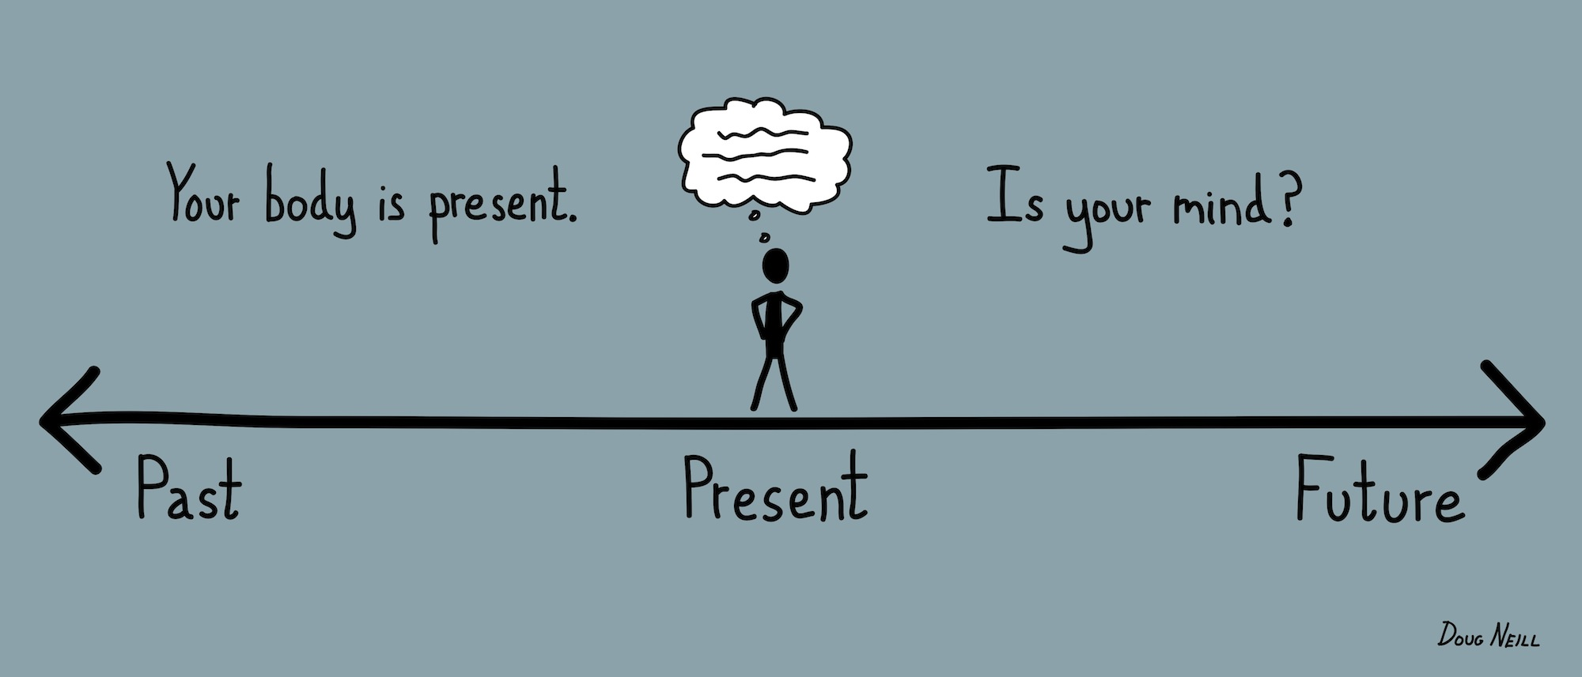

Slide 4
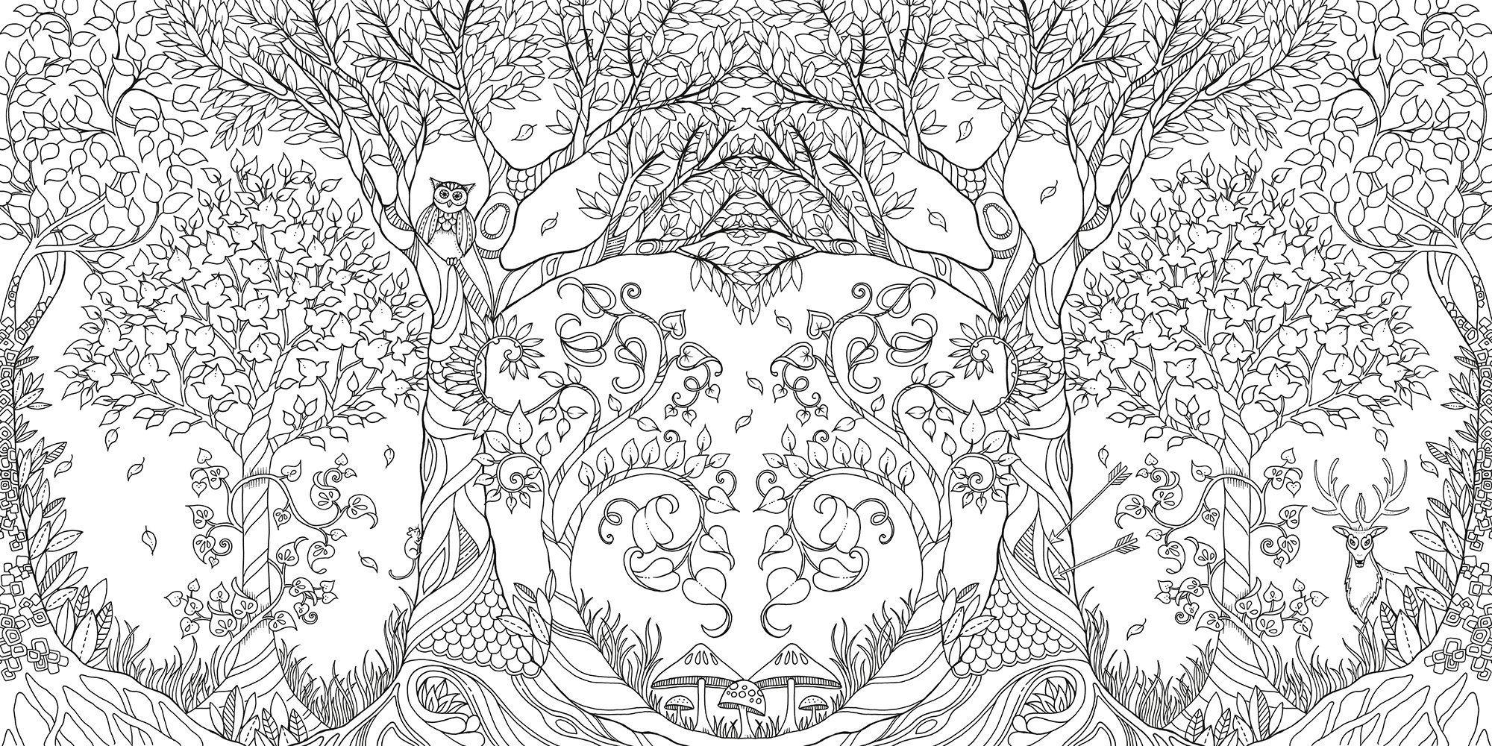

Slide 5



https://app.gonoodle.com/channels/flow

Slide 6


