Slide 1

Welcome to our Assembly
Treat
everyone
well!

Slide 2
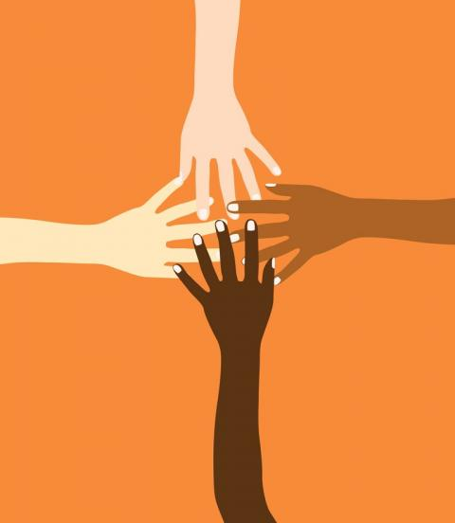
Welcome to our Assembly
Everybody is important, and has the right to be safe and happy even if they are different.

Slide 3

There are many differences between people; one difference is the colour of our skin.
It is important to make sure that all people are treated fairly, and that’s why lots of people all over the country and the world are part of the Black Lives Matter movement.

Slide 4

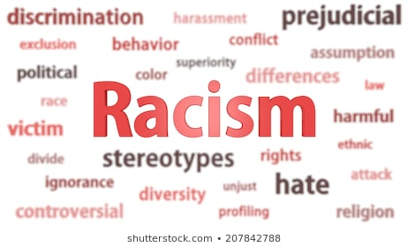
Racism is when you treat someone differently and unfairly because; they have different coloured skin or they are from a different country or their culture is different.

Slide 5
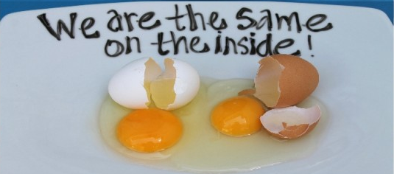
It’s important to remember that we are all the same.

Slide 6
Where is Racism?
Racism is all over the world and it must be stopped!
Sometimes people in power can be racist.
Sometimes they use their power to treat people unfairly.

Slide 7
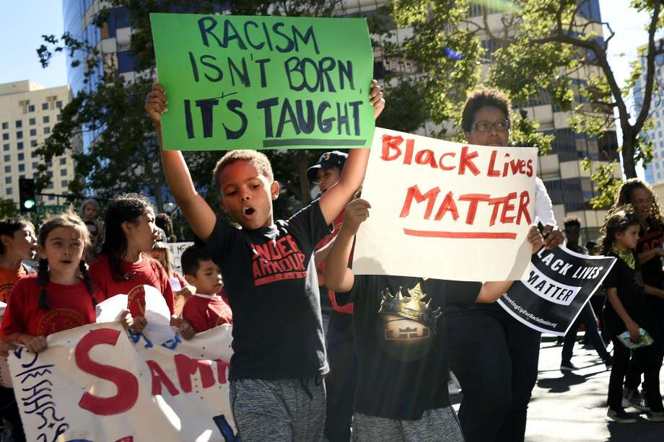

Slide 8
What is the “Black Lives Matter Movement”?
Black Lives matter was created in 2013.
Their mission is to end violence.
This organisation holds events to educate people.

Slide 9
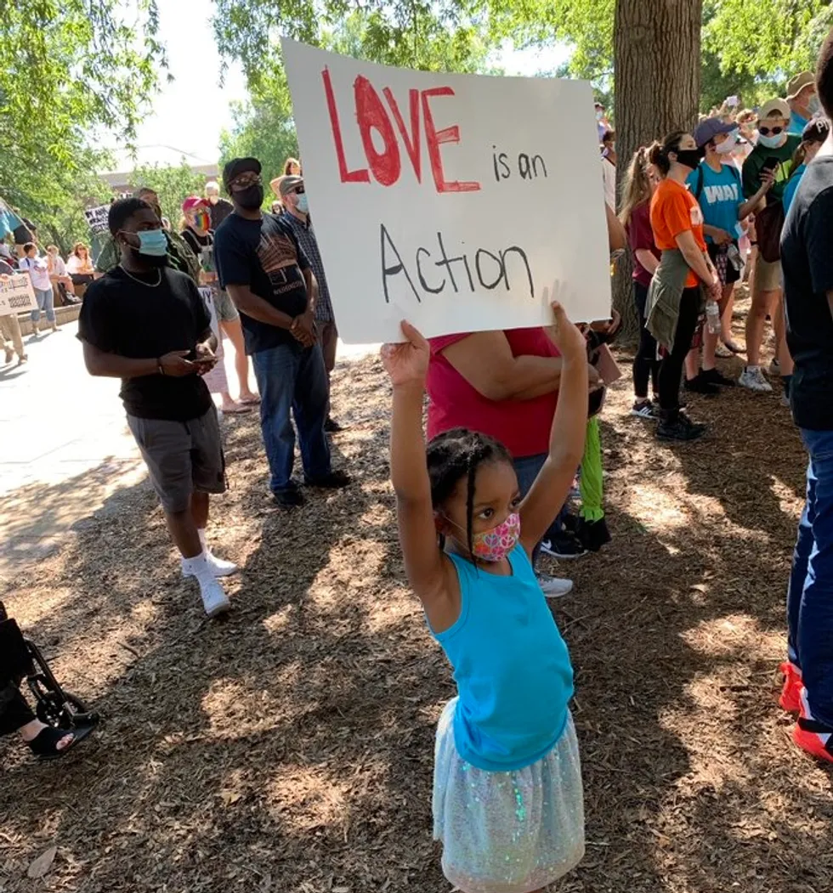
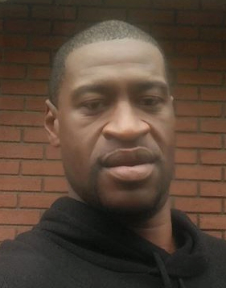
Why is this issue so important right now?
Right now, the whole world is speaking out against racism and the unfair treatment of black people, especially George Floyd who died on 25th March.

Slide 10
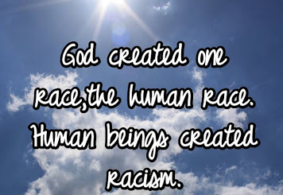

Slide 11
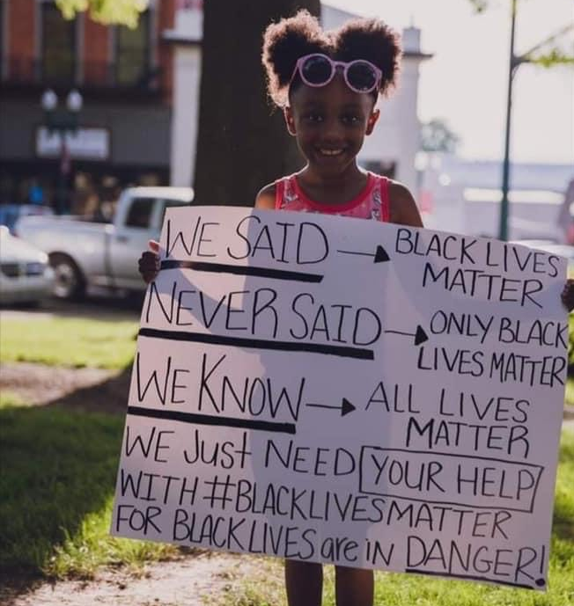

Slide 12
Let us pray
Dear Lord
Help us to learn from Jesus who fought against injustice.
Help us to fight for those who are worried.
Help us to open our eyes and have the courage to stand up to those who are worrying others and stand along side those who are speaking out.
May You watch over those who we love and those who love us, this day and always.
Amen

