Slide 1

Welcome to Nursery

Slide 2
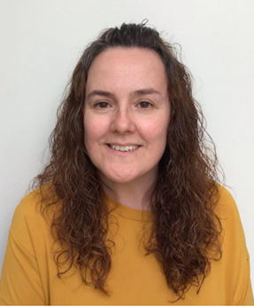
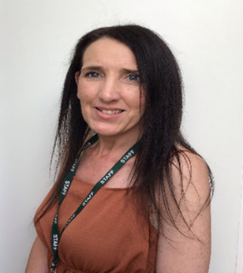
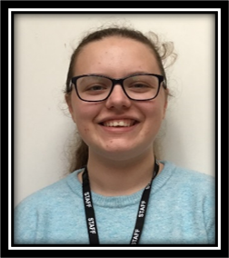
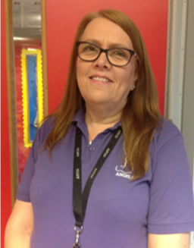
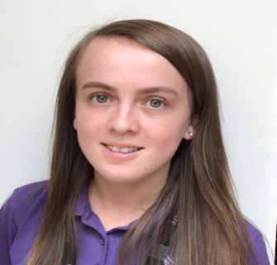
Meet the Nursery Team
Mrs Handley Mrs Ballard
Miss Mason Mrs Stokes Miss Stokes

Slide 3


Slide 4

Prayer to Saint Anne
Saint Anne
Since Mary was your daughter
and Jesus your grandson,
look lovingly upon our families
in the same way that you looked upon the
Holy Family in Nazareth,
and intercede for us in heaven
where we all hope to meet one day
as members of the one, splendid family of God,
our sins forgiven,
our problems solved
and our hearts filled with love
Amen

Slide 5
Catholic Life-Prayer and Liturgy
As a Catholic School we practise our faith every day.
All children take part in celebration of the word each day. Nursery children say the Morning Offering prayer together and learn to say their own thank you and sorry prayers.
The Sign of the Cross (Nursery)
From my head, to my heart.
From this shoulder, to this shoulder.
I belong to God.

Slide 6
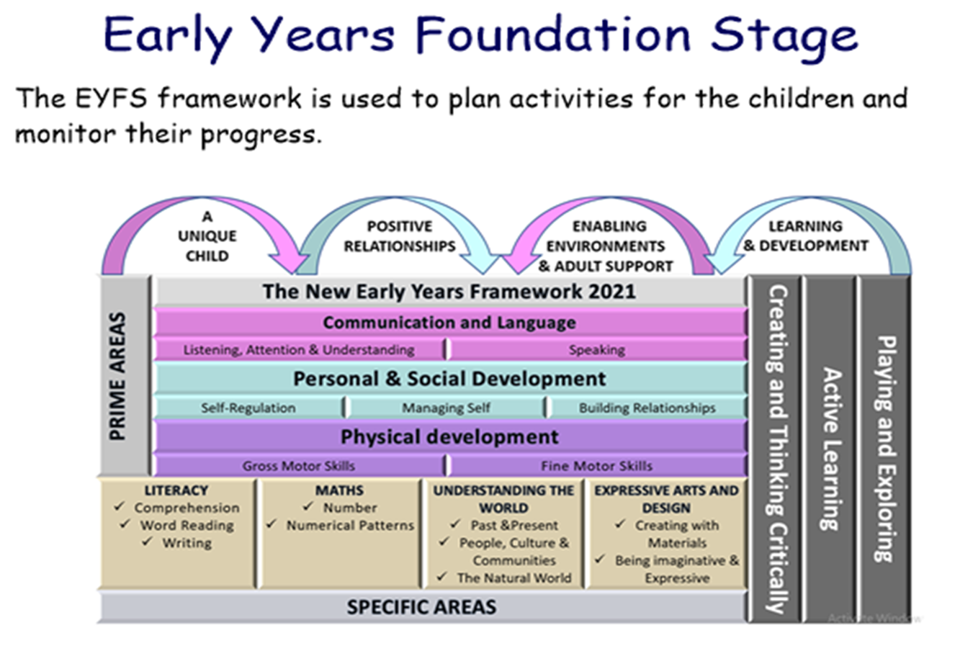
The EYFS
To lay the foundations for learning through a fun play-based curriculum. We nurture the children’s growth in many ways across the seven areas of learning.

Slide 7
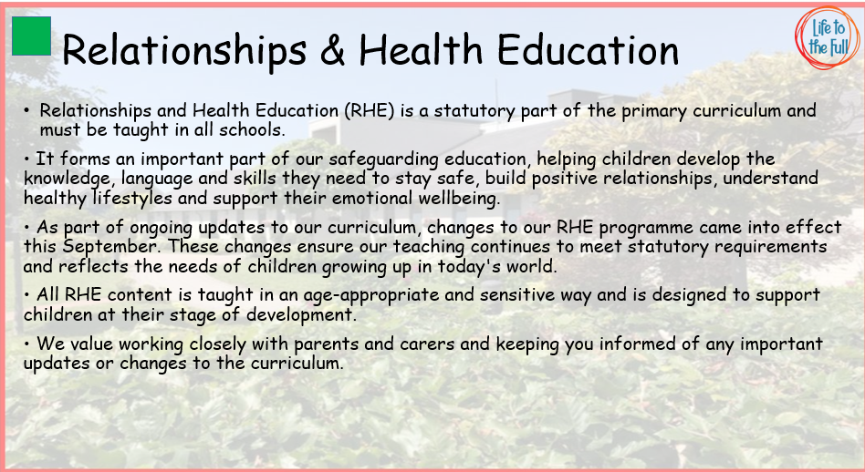

Slide 8
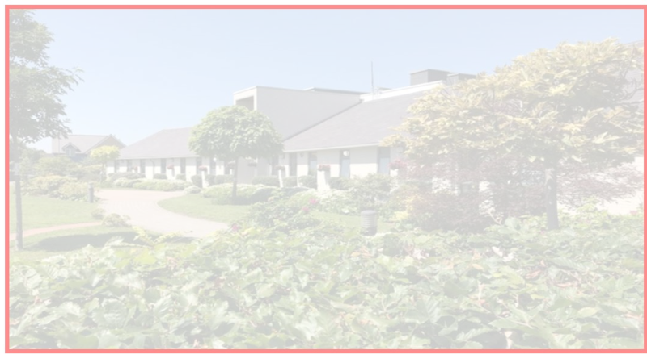

Building the Kingdom
Building the Kingdom is a faith-based initiative that weaves Catholic values throughout our curriculum. By engaging with big questions, children are encouraged to explore themes of faith, justice, and their role in the world. This approach supports our mission to guide young people into becoming compassionate, responsible individuals who live the Gospel and understand their place in God’s plan.

Slide 9
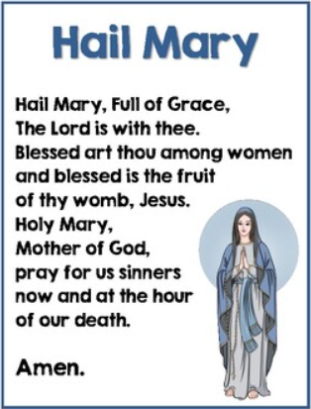
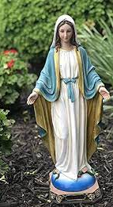
Nursery Class Saint: Mary

Slide 10
Parent Reminders
The school gates open for the start of the day a few minutes before 8.30am each morning.
Nursery begins at 8.30am. and finishes at 11.30 am.
Children who arrive late will need to go to the main office to be registered. They will receive a late mark.
Children who arrive at school after 9.10 receive an Unauthorised mark that morning. (10 or more unauthorised absences may require the involvement of external agencies)
All children must be collected by an authorised adult. If another adult is going to collect your child please inform your class teacher with advance notice.
If you have any queries wherever possible please send these into our
parent email: parentmail@st-annes.solihull.sch.uk

Slide 11
Attendance
Regular school attendance is essential if children are to enjoy their education and make good progress.
At St. Anne’s Catholic Primary School, we believe that regular school attendance is the key to enabling children to maximise the educational opportunities available to them and become emotionally resilient, confident and competent adults who are able to realise their full potential and make a positive contribution to their community.
Expected levels of attendance:
98-100% | Excellent. Accessing all learning opportunities
96-97% | Good. Very few learning opportunities missed
94-95% | Risk of under achievement up to 50 missed lessons Up to 10 school days absent in an academic year
92-93% | Risk of under achievement Up to 75 missed lessons Up to 15 school days absent in an academic year.
90-92 | Severe risk of under achievement Up to 100 missed lessons Up to 19 school days absent in an academic year
90% and below | Extreme risk of underachievement over 100 missed lessons Pupil is persistently absent upwards of 22 school days absent in an academic year
50% and below | Extreme risk of underachievement Pupil is severely absent At least half of all lesson and days missed
School Day and Punctuality
It is important that pupils are punctual so that they do not miss out on the beginning of each school day. Children must attend on time to be given a present mark for the session.
If a pupil arrives late to school every day, their learning begins to suffer. Below is a graph showing how being late to school every-day over a school year adds up to lost learning time

Slide 12
Leave of absence
Unauthorised leave of absence of 10 or more sessions
Local authority will issue a fine per parent per child. If paid within 28 days this is £160. If paid within 21 days it is reduced to £80.
If the threshold is met a 2nd time in three years and a 2nd Penalty notice is issued to the same parent in relation to the same child – this will a flat rate of £160 if paid within 28 days.
A third penalty notice cannot be issued to the same parent in respect of the same child within 3 years of the date of issue of the first. In a case where the national threshold is met for a third time (or subsequent times) within those 3 years, alternative action should be taken instead. This will often include considering prosecution.
Please note:
A leave of absence form will need to be completed at least 2 weeks before the absence.

Slide 13




Reading
The expectation is for children to share a reading for pleasure book with a family member at least three times a week. Please sign your child’s reading diary once you have a shared a book with your child.
All children are expected to bring their book bag and reading diary with them into school every day. The reading records and books are checked by nursery staff and children can then choose a new book. It’s incredibly important that you share and read books to your child.

Slide 14




Phonics in Nursery
Phonics is taught every day.
During the Autumn and Spring terms we use Letters and Sounds and Singing Phonics.
During the Summer term children follow the Read Write Inc phonics scheme.

Slide 15
Physical Education
On P.E day we ask children to come into school wearing their PE kit.
Nursery P.E day is on Wednesdays.
P.E kit consists of yellow polo shirt, black jogging bottoms and pumps or trainers. Children must come in wearing their school jumper/cardigan.
The wearing of any jewellery is not encouraged. Children must not wear rings, chains or necklaces. Children must not wear earrings that hang below the ear. If parents still wish children to wear earrings, despite the risks of injury, only the small plain tiny stud type are allowed (maximum number of one per ear in the centre of the lobe). Staff cannot be held responsible for looking after items of jewellery.

Slide 16

Maths
We will share number songs, rhymes and counting activities.
Phonics
We will share phonics games, rhymes and activities.
Nursery Rhymes
Please continue to learn and rehearse a variety of
Nursery Rhymes with your child.
Topic Homework
Each half term, we will send home a list of suggested activities linked to our learning theme. Homework is set half termly and should be returned by the end of each half term. We love celebrating the wonderful work children complete at home! Their work will be shared in class and displayed in the hall for children across the school to enjoy. It is a lovely opportunity to spend time learning together and explore your child’s school topics.
Nursery Home Learning

Slide 17
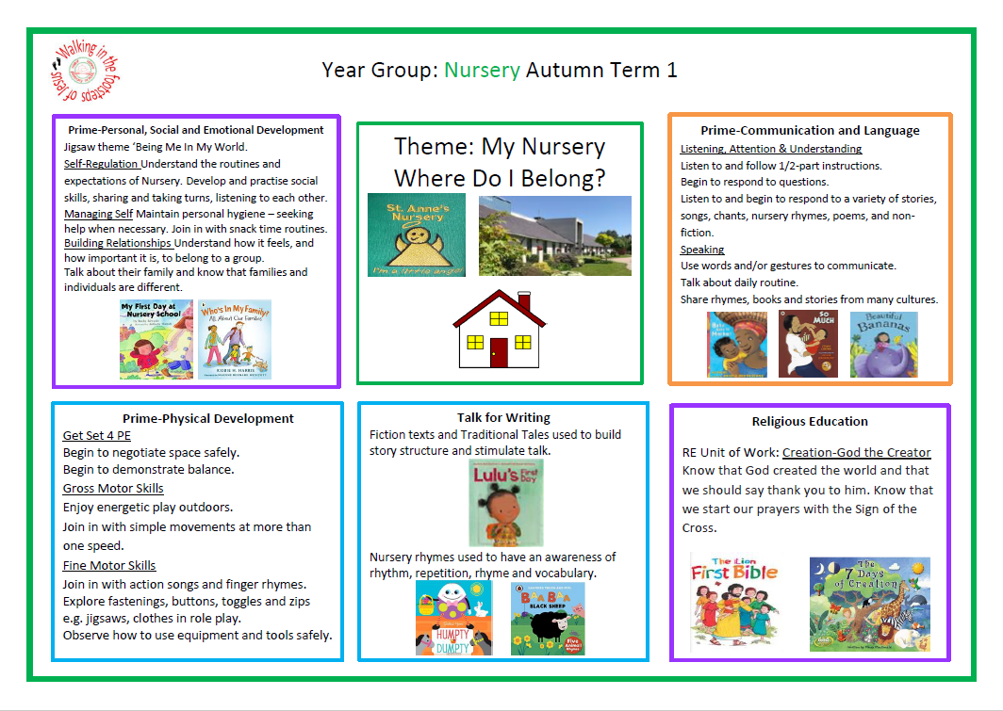
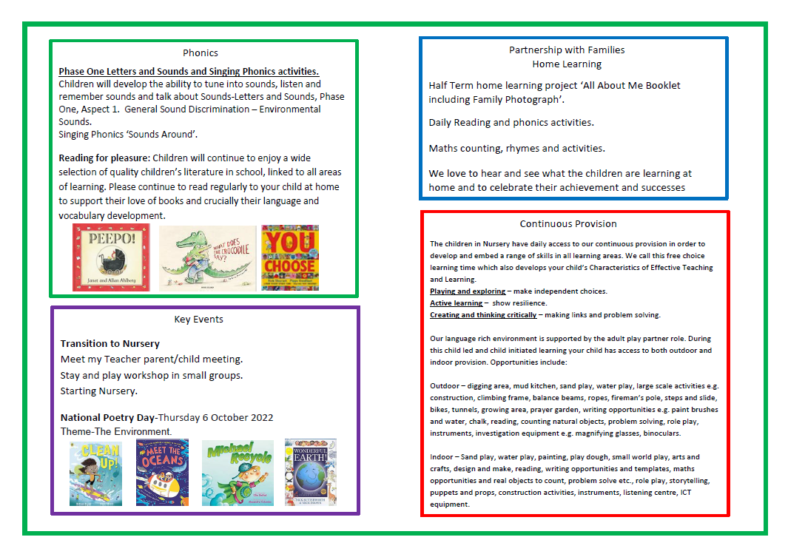
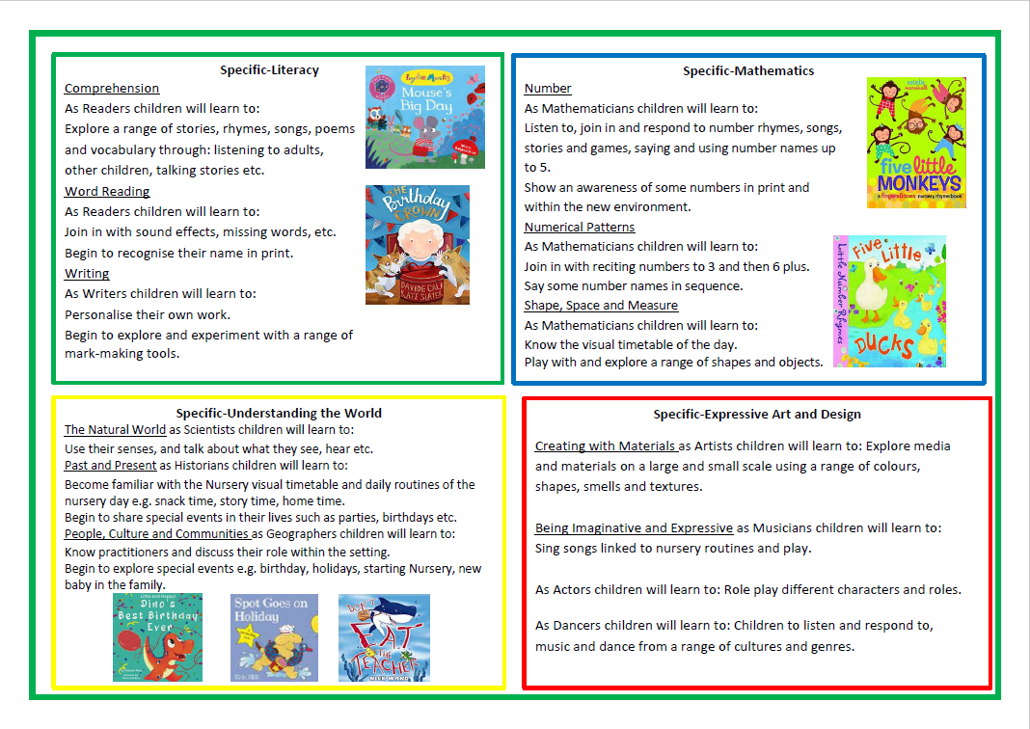
Half Term Curriculum Overview
Each half term your child will bring home a curriculum overview of the upcoming weeks. Please have a look at these with your children and talk about some of the language, vocabulary and things we will be looking at in preparation. Curriculum overviews are good for consolidating learning at home.

Slide 18
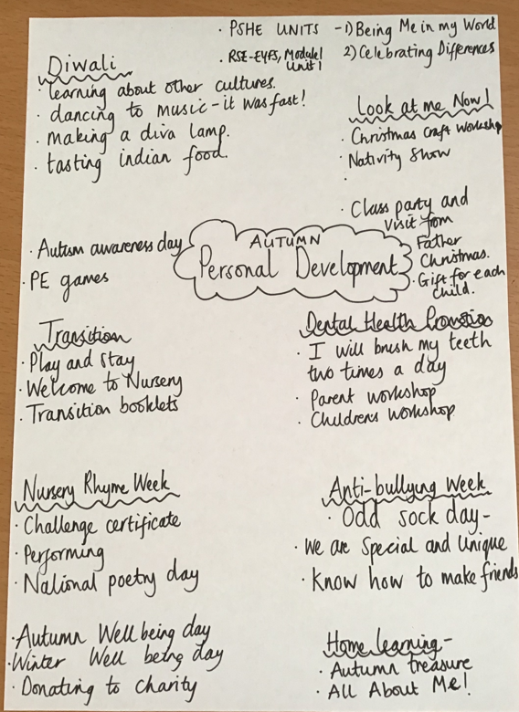
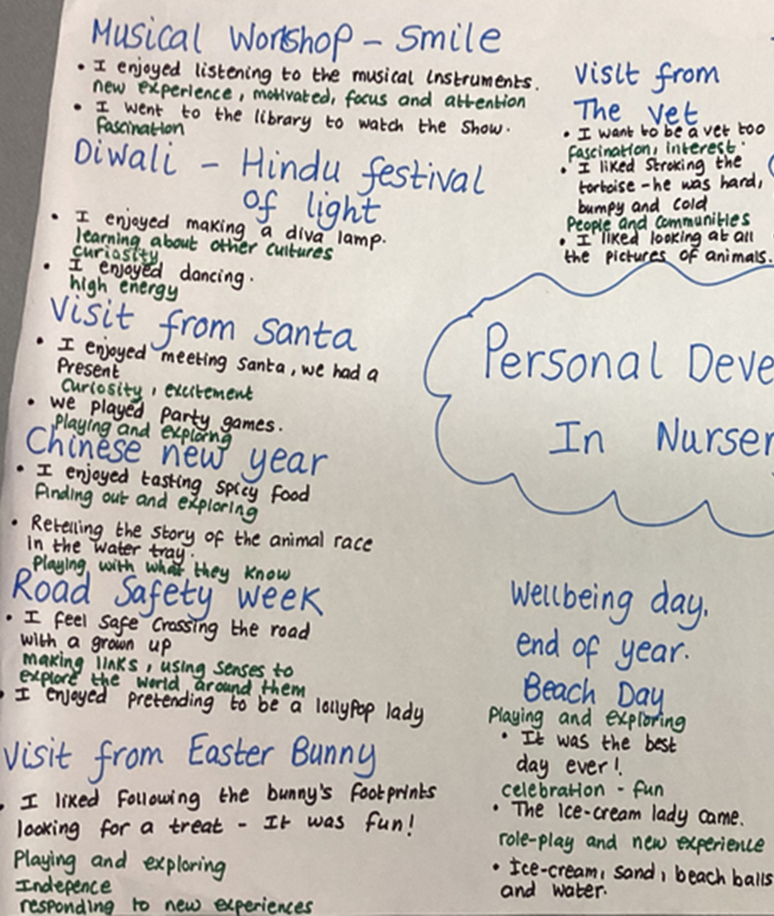
Personal Development Opportunities
We also believe that children’s personal development is just as important as their academic progress.
Here are some examples of ways in which we enrich and encourage children’s personal development in Nursery.

Slide 19


Online Safety
We support parents and families and aim to work
together with you to keep children safe online.
How to set up parental controls.
Talking to your child about staying safe online.
Individual guidance for the sites, apps and games that your child uses.
Important to understand and consider the parental responsibilities linked to e-safety with the support of school.
https://www.internetmatters.org/wp-content/uploads/2015/05/ncro3p-Internet-Matters_E-safety_Primary_1.pdf
https://www.nspcc.org.uk/preventing-abuse/keeping-children- safe/online-safety/

Slide 20

Solihull Family Hubs
Family Hubs have opened in Solihull. Our local one is the Riverside Hub, which is in the building outside the school gates on Bosworth Drive.
Services within the family hub:
Health visitors
Midwives
SOLAR
SENDIAS
Urban Heard (Youth Group)
Stay and Play (including a sensory room, which you book via the Hubs)
Solihull College
Solihull Housing
Women’s Community Drop in
Coffee mornings
And many more
The hubs have clothing banks and Evergreen and Elmwood have a community pantry for all to use.
Scan the QR code to download the app, and you will see all of the upcoming events.

Slide 21
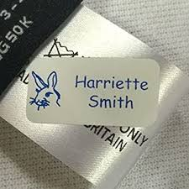


Please ensure all items of your child’s uniform have their names on them.
Please send them to school with a named water bottle every day.
A medical form is needed for any new medication that have been prescribed by a doctor.
We wish all the children a wonderful year in Nursery!
And Finally …

Slide 22
If you have any questions, please phone the school office or send your class teacher an email.
parentmail@st-annes.solihull.sch.uk
In the event of an urgent response,
please contact the school office 0121 779 8060
We will not hesitate to help!
Thank you for all your support and cooperation!

