Slide 1



Slide 2

Prayer to St. Anne
Saint Anne
Since Mary was your daughter
and Jesus your grandson,
look lovingly upon our families
in the same way that you looked upon the
Holy Family in Nazareth,
and intercede for us in heaven
where we all hope to meet one day
as members of the one, splendid family of God, our sins forgiven, our problems solved and our hearts filled with love
Amen

Slide 3


St. Anne's Mission

Slide 4

Meet the Year 5 Team!
In 5P we have …
Miss Powell
Miss Weaver
Miss Showell
Mrs Malone
Miss Drinkwater
In 5S we have …
Other school staff including inclusion staff, staff who cover part time hours senior leaders, dinner supervisors do also work cross school, as required, linked to school organisation

Slide 5
CATHOLIC LIFE AND COLLECTIVE WORSHIP
As a Catholic School we practise our faith every day.
All children take part in Celebration of the Word each day.
Children also take part in whole school assemblies and attend Church.
Children say daily prayers.

Slide 6
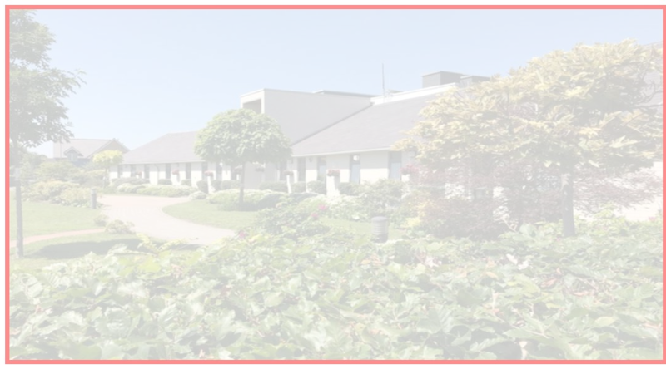


Building the Kingdom
Building the Kingdom is a faith-based initiative that weaves Catholic values throughout our curriculum. By engaging with big questions, children are encouraged to explore themes of faith, justice, and their role in the world. This approach supports our mission to guide young people into becoming compassionate, responsible individuals who live the Gospel and understand their place in God’s plan.
Alongside its central place in our school curriculum, we will also be introducing monthly BTK homework for you to enjoy with your child at home. Each month, you’ll receive a BTK question to respond to in any way you choose, whether through writing, art, or another creative form. We warmly invite you to take part in this journey together.

Slide 7
Parent Reminders
The school gates open for the start of the day a few minutes before 8.30am each
morning.
School begins at 8.30am.
Registration finishes at 8.40am.
Children who arrive after 8.40am need to go to the main office to be registered. They will receive a late mark.
Children who arrive at school after 9.15 receive an Unauthorised mark that morning.
(10 or more unauthorised absences may require the involvement of external agencies)
The children at Saint Anne’s work very hard every single day.
They continue their learning until 3.15pm. It takes several minutes to get coats , belongings etc
before children leave. With 30 children to dismiss it can take 5 or so minutes after 3.15 to dismiss
all children. Please be patient.
Friday finish - gates open at 2.05pm and children need to be collected by 2.10pm.
All children must be collected by an authorised adult. If another adult is going to collect your child please inform your class teacher with advance notice.

Slide 8

Homework
Homework will be set on a Friday and should be completed by the following Wednesday.
Daily:
Reading
Weekly:
Spellings (spelling frame) Please log on to 'Spelling Frame' to access the list of words for the week. You will also receive a printed list of the words. Ideally, children who have access to the online resource should take the test on Spelling Frame (as many times as they wish) and they will also be tested in school each Friday.
Maths activity
SPAG activity
Monthly:
BTK Homework/Topic Projects

Slide 9
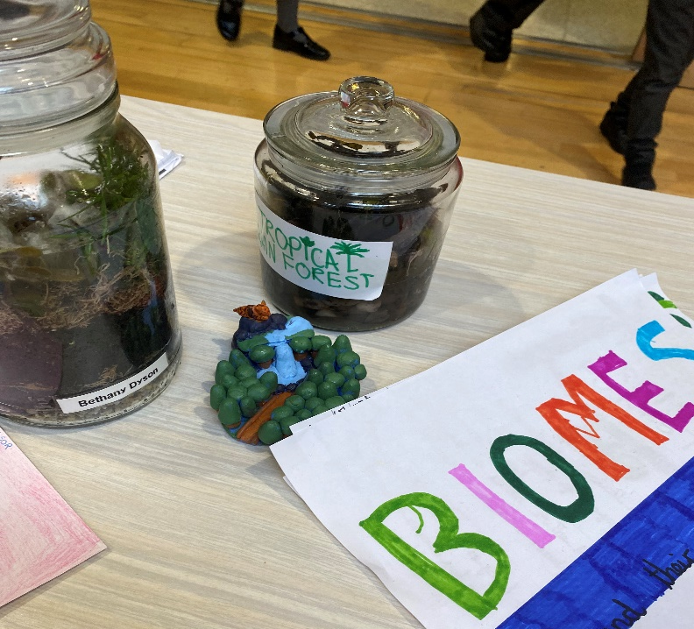
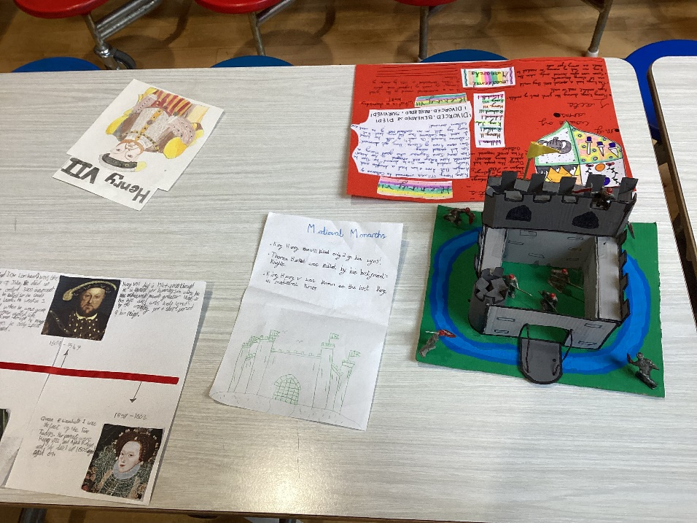
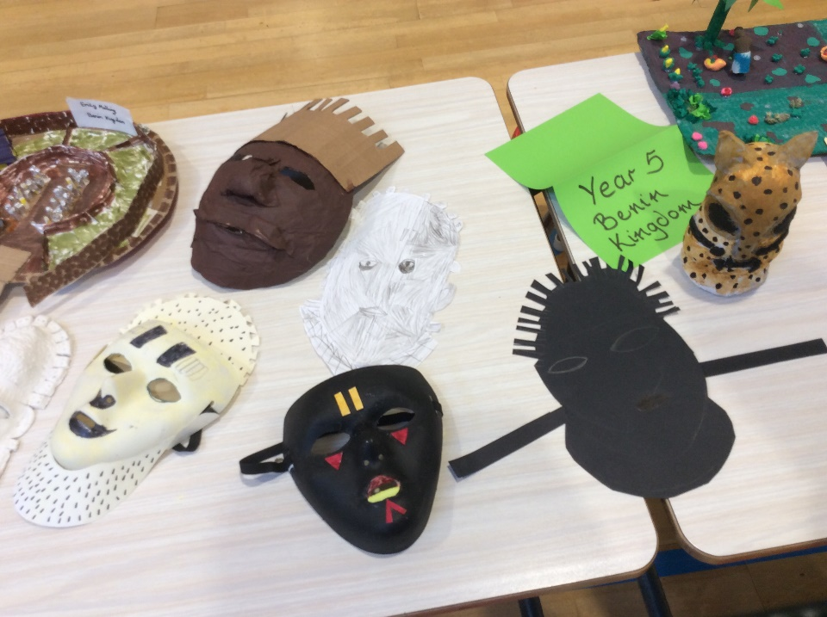
Home Learning Projects
Children will have the opportunity to engage with a project linked to their current learning. This will typically be linked to their Science/Geography or History topic of the term. We are always so impressed with the creativity of these projects, and we can’t wait to see what will be produced this year!

Slide 10

Reading
The expectation is for children to read for at least 10 minutes each day.
Please sign their reading journal when you have listened to your child read each day.
Children’s reading books will be checked and changed daily. All children are expected to bring their book bag and reading diary with them into school every day as it is part of their uniform.
It’s incredibly important that you listen to your children read every night to help us develop your child’s reading ability.

Slide 11




Uniform
Winter Uniform
White collared shirt
Green tie (available through Parent Pay)
Red jumper or cardigan
Girls – Grey school skirt
Boys – Grey school trousers
Black school shoes
Summer Uniform
Girls
Red gingham summer dress
Red cardigan
White socks
Black school shoes
Boys
Red polo
Red jumper
Grey school shorts
Dark socks
Black school shoes
Children are expected to bring their book bags every day as part of their uniform.
Trainers should only be worn on PE days.
Smart watches with cameras or voice recording functions are not permitted.

Slide 12

P.E
To keep your children as safe as possible we are asking all children to come to school wearing their PE kit on their PE day.
Year 5 P.E days are Wednesday and Thursday
A reminder that P.E kit consists of red polo shirt, black jogging bottoms and trainers (no converse). Children must come in wearing their school jumper/cardigan.
In addition to their school jumper /cardigan children may come to school with a plain black sweatshirt/hoodie on top of their school jumper/cardigan. Wearing a black hoodie should not replace a school red cardigan/jumper.
In school they take their black hoodie off with their coat and keep it for the PE lesson.

Slide 13
PE and Jewellery
The wearing of any jewellery is not encouraged; watches are the only exception. We only allow analogue watches that support children to learn to tell the time - no digital/smart watches are permitted.
Children must not wear rings, chains, necklaces or earrings that hang below the ear e.g. sleepers. If parents still wish children to wear earrings, despite the risks of injury, only the small plain tiny stud type are allowed (maximum number of one per ear in the centre of the lobe). Staff cannot be held responsible for looking after items of jewellery such as watches or studs.
Children are also expected to take their own earrings out for P.E lessons as required.
Therefore, we discourage any jewellery on P.E days.
P.E

Slide 14
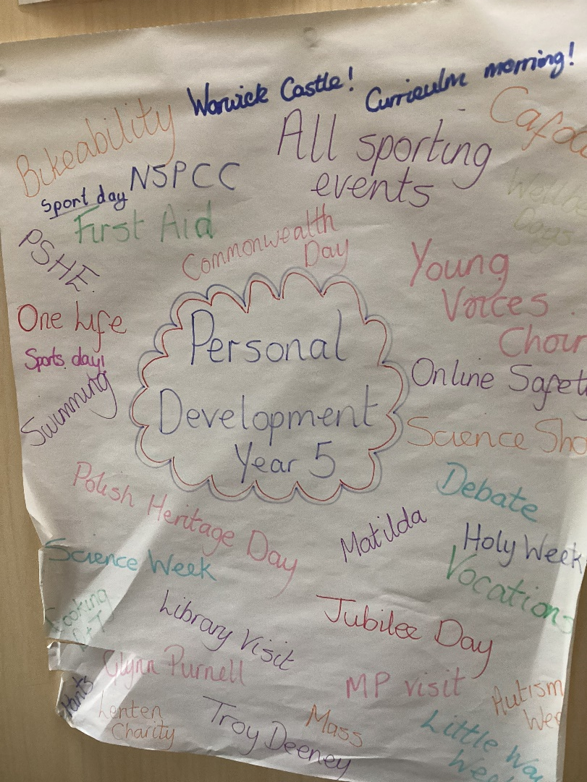
Personal Development Opportunities
Children follow a programme called JIGSAWS to support their Personal Development.
There is a strong focus on British Values.
Throughout the year, children will receive a range of personal development opportunities such as:
First Aid Training
Bikeability
NSPCC Assemblies and Lessons
Various Visitors
Online Safety Week
Sporting Events
Local Library Visit
Themed Days – Polish Heritage Day, Bastille Day
Lenten Charities
Visits to JHNCC

Slide 15

Enrichment
At St. Anne’s, we aim for all children to experience an after school enrichment activity.

Slide 16

Relationships & Health Education
Relationships and Health Education (RHE) is a statutory part of the primary curriculum and must be taught in all schools.
• It forms an important part of our safeguarding education, helping children develop the knowledge, language and skills they need to stay safe, build positive relationships, understand healthy lifestyles and support their emotional wellbeing.
• As part of ongoing updates to our curriculum, changes to our RHE programme came into effect this September. These changes ensure our teaching continues to meet statutory requirements and reflects the needs of children growing up in today's world.
• All RHE content is taught in an age-appropriate and sensitive way and is designed to support children at their stage of development.
• We value working closely with parents and carers and keeping you informed of any important updates or changes to the curriculum.

Slide 17
In July, we shared details of the proposed changes and invited parent feedback through a consultation process.
We were delighted to receive overwhelmingly positive and supportive responses, and we would like to thank everyone who took the time to share their views.
• We remain committed to working in partnership with families and welcome any questions you may have about the curriculum.
• Parents and carers can view curriculum materials and find out more about the programme using the link below:
Life to the Full Parent Information https://www.tentenresources.co.uk/life-to-the-full-primary/
• If you have any questions or concerns, please speak to your child's class teacher in the first instance, or contact a member of the senior leadership team.

Slide 18

This is the letter shared win July outlining the proposed changes and inviting consultation feedback prior to implementation in September.

Slide 19
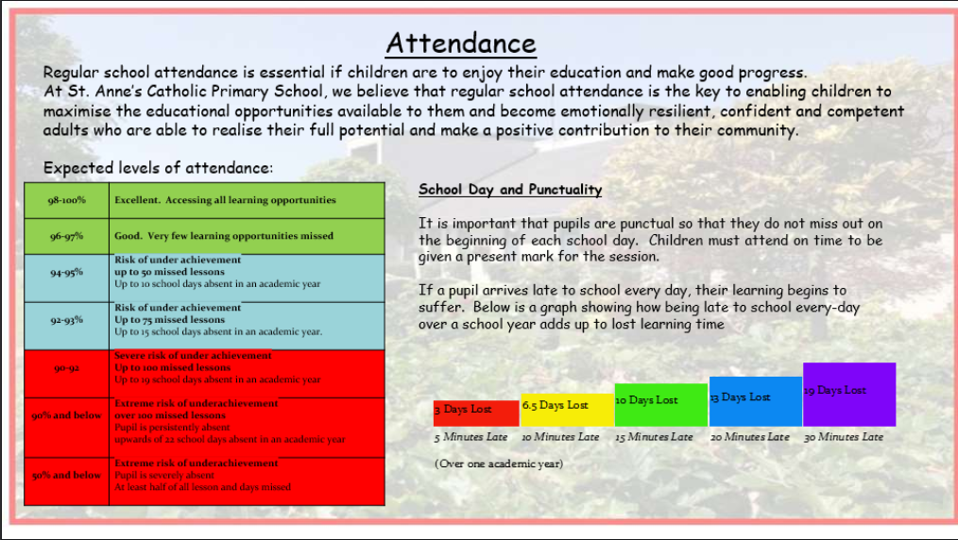

Slide 20
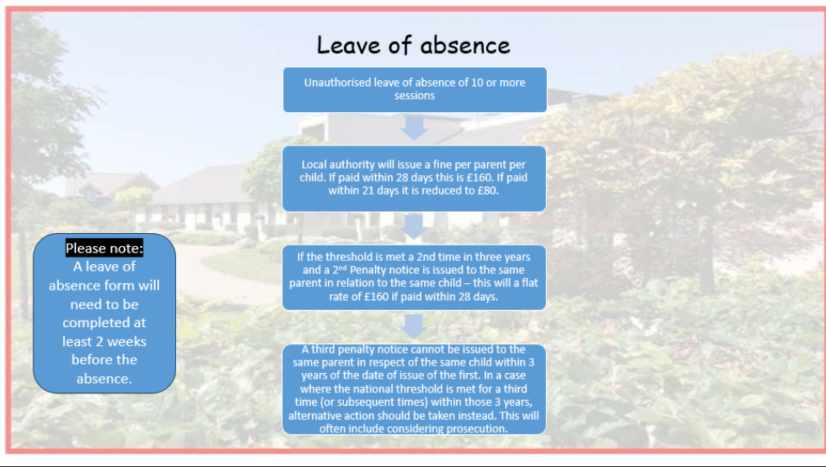

Slide 21

School Dinners
To order your child’s dinner, please order this via ParentPay.
We need you to order their dinners for a week ahead before your child comes into school on a Monday.
Your ParentPay account will need to be in credit as all meals have to be paid in advance.
There is more guidance on our website for ordering your child’s dinners.

Slide 22
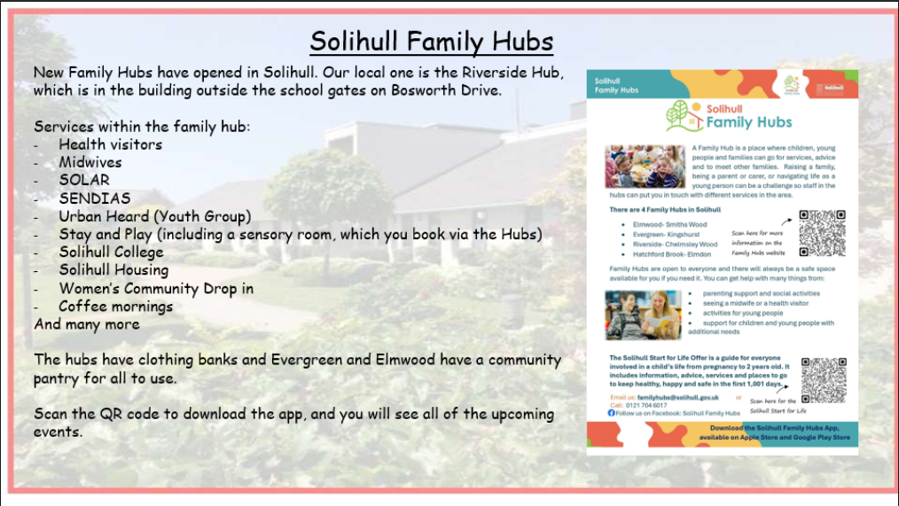

Slide 23
WEBSITE AND COMMUNICATION
All relevant information is on our website.
Website details:
  https://www.stannessolihull.co.uk/
Our weekly newsletter which has lots of photos of class activities can be found on our website every Friday.

Slide 24
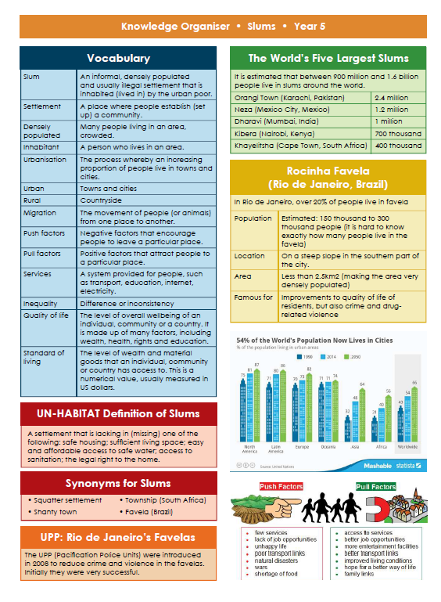

Knowledge Organisers
Each half term your child will bring home a Knowledge Organiser to show you what we will be learning about in Science, History or Geography over the half-term.
Please have a look at these with your children and talk about some of the language and things we will be looking at in preparation.

Slide 25
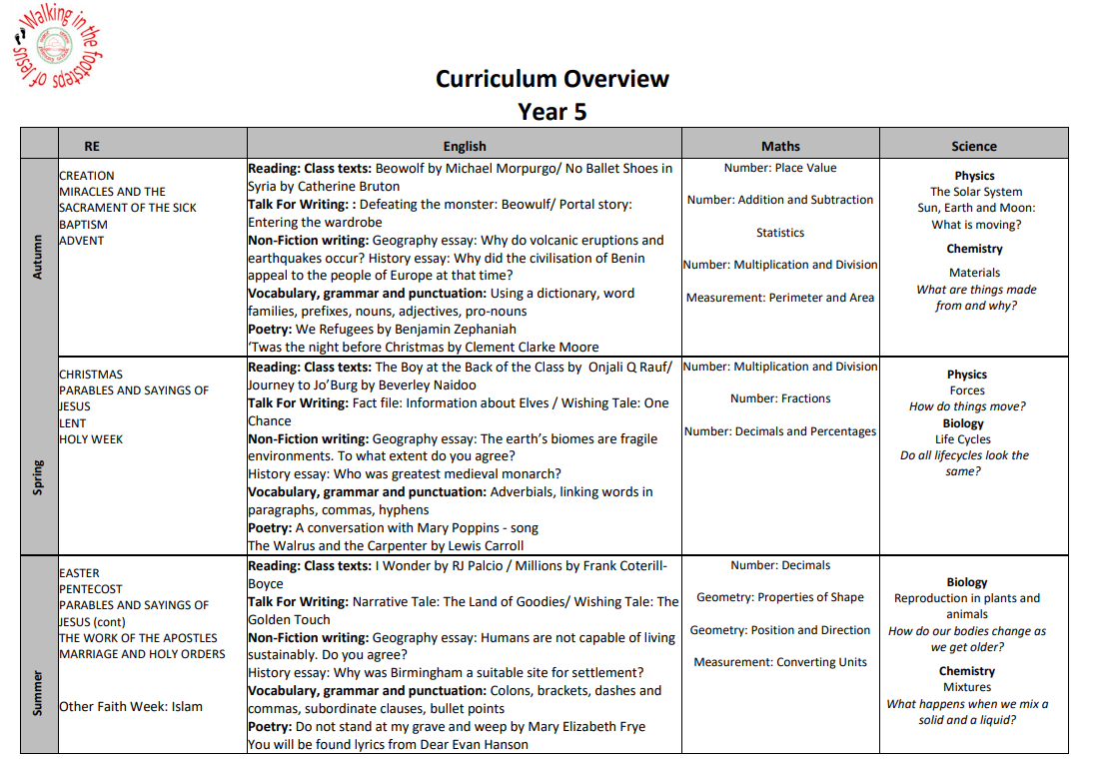

Slide 26
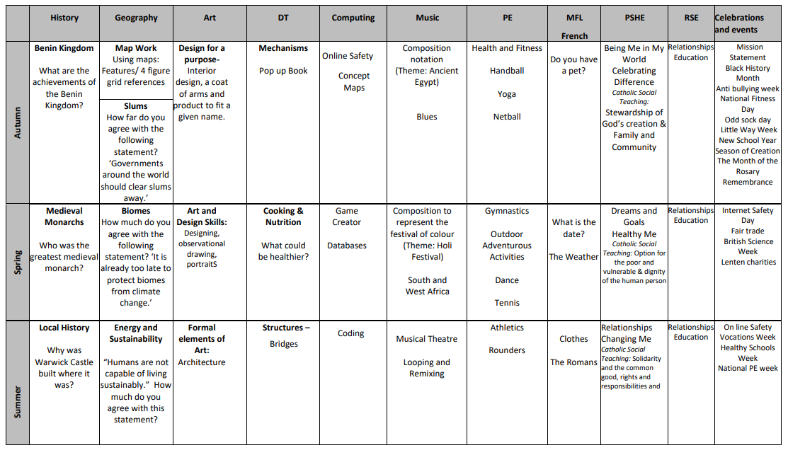

Slide 27

Please ensure all of your child’s uniform is named- especially jumpers. As you can imagine there are 30 jumpers that are all identical!
Please send them to school with a named water bottle every day and their reading bag.
If your child has any new medical issues, or any changes to those already existing, please let your class teacher know via the office.
We hope all of the children have a fantastic year in year 5!

Slide 28
And Finally …
If you have any questions, please speak to the teacher at the start of the day. If you need a lengthier meeting, then this can be arranged. Any questions or queries can also be emailed into parent mail, which is managed by the office staff.
parentmail@st-annes.solihull.sch.uk
In the event of an urgent response,
please contact the school office 0121 779 8060
Thank you for your support and cooperation!
We are so excited about the year ahead and looking forward to getting to know the children and having
a fantastic year in year 5!

