Slide 1



Slide 2

LB

Slide 3

RP
Prayer to Saint Anne
Saint Anne
Since Mary was your daughter
and Jesus your grandson,
look lovingly upon our families
in the same way that you looked upon the
Holy Family in Nazareth,
and intercede for us in heaven
where we all hope to meet one day
as members of the one, splendid family of God,
our sins forgiven,
our problems solved
and our hearts filled with love
Amen

Slide 4
Catholic Life
Celebration of the Word
RP
As a Catholic School we practise our faith every day.
All children take part in a celebration of the word each day.
Children also take part in school assemblies and also go to Church.
Children say daily prayers. All children will receive a prayer booklet.
Please practise these prayers with your children at home.

Slide 5

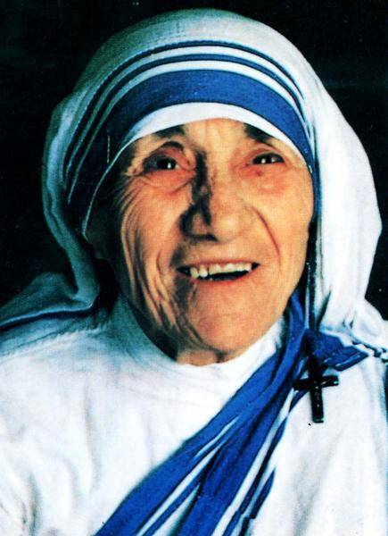
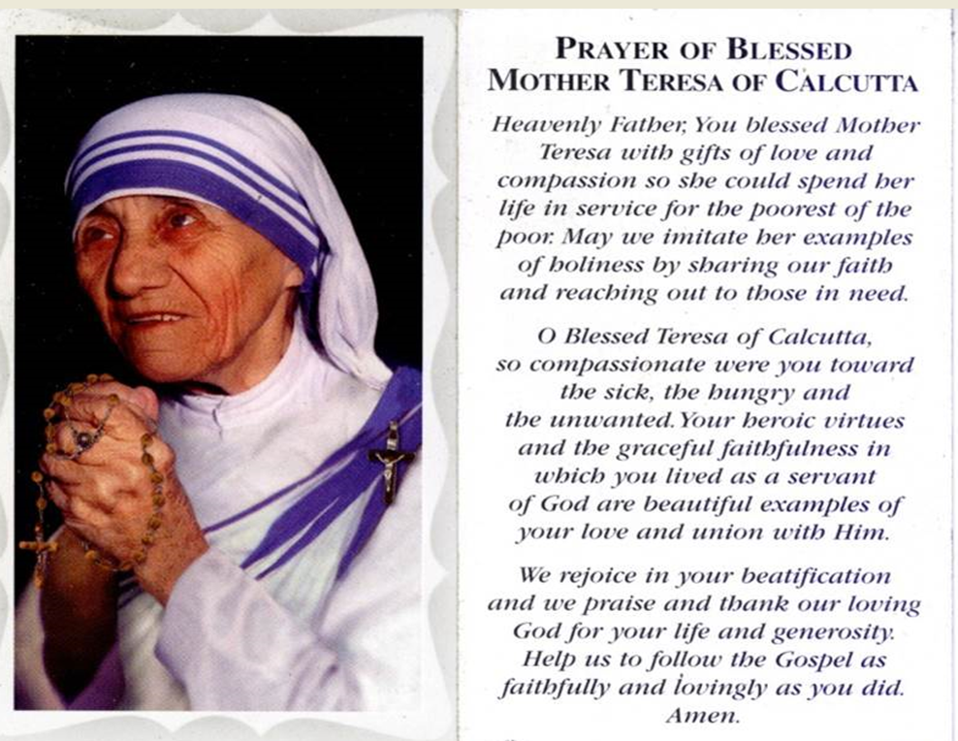

Year 2 Class Saint
Mother Teresa
LB
Feast Day: September 5th
Birth: August 26th 1910
Death: September 5th 1997
Beatified: October 19th 2003 by Pope John Paul II
Canonized: September 4th 2016 by Pope Francis

Slide 6
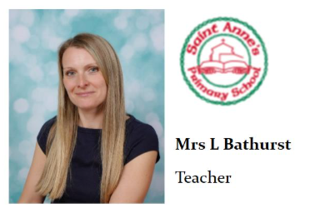

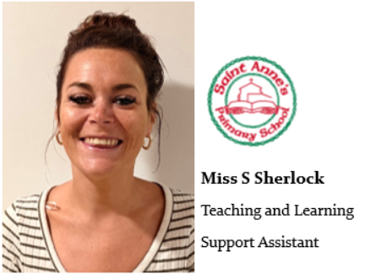
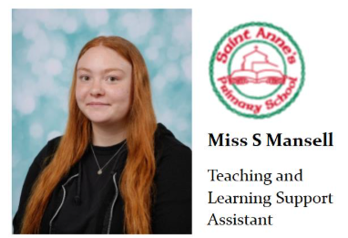
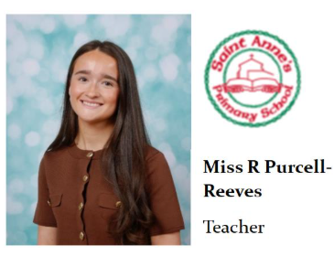
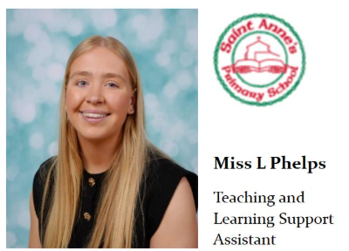
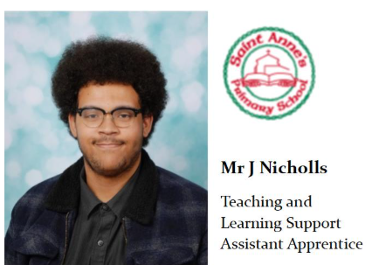
Please note as well as the Year 2 team there will be other school staff including inclusion staff, staff who cover part-time hours, senior leaders, dinner supervisors and staff who cover absences who will also work in this year group as required linked to school organisation.
RP
Meet the Year 2 Team!
In Class 2B we have …
In Class 2P we have …

Slide 7
LB
Parent Reminders
The school gates open for the start of the day a few minutes before 8.30am each
morning.
School begins at 8.30am.
Registration finishes at 8.40am.
Children who arrive after 8.40am need to go to the main office to be registered. They will receive a late mark.
Children who arrive at school after 9.15 receive an Unauthorised mark that morning.
(10 or more unauthorised absences may require the involvement of external agencies)
The children at Saint Anne’s work very hard every single day.
They continue their learning until 3.15pm. It takes several minutes to get coats , belongings etc
before children leave. With 30 children to dismiss it can take 5 or so minutes after 3.15 to dismiss
all children. Please be patient.
Friday finish - gates open at 2.05pm and children need to be collected by 2.10pm.
All children must be collected by an authorised adult. If another adult is going to collect your child please inform your class teacher/ school office with advance notice.
If you have any queries wherever possible please send these into our
parent email: parentmail@st-annes.solihull.sch.uk

Slide 8

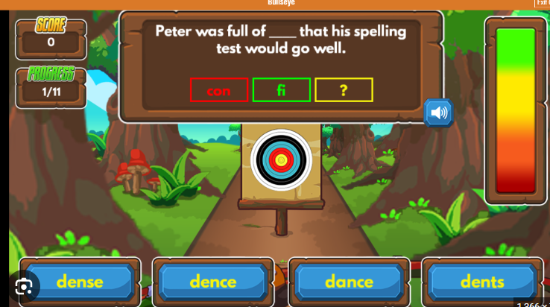
Homework
RH
Daily:
Reading
Weekly:
Spellings (spelling frame)
Maths activity- This will link either to key skills that your child is expected to know by the end of year 2 or their weeks learning in class.
Half-termly:
Topic (Geography or History)

Slide 9
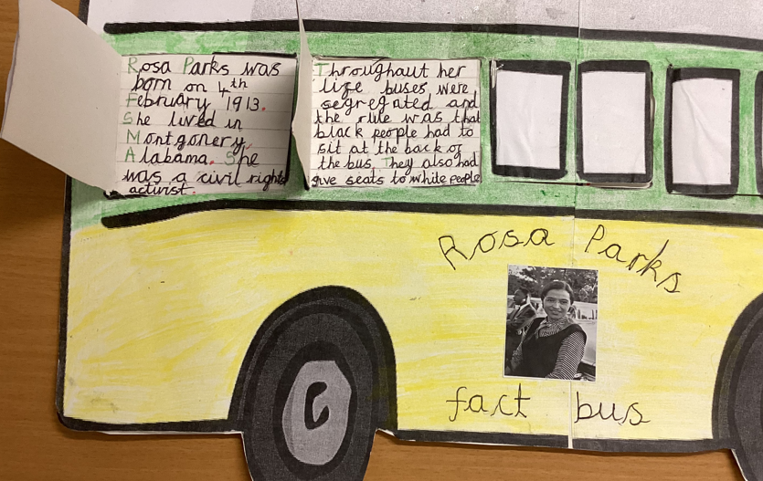
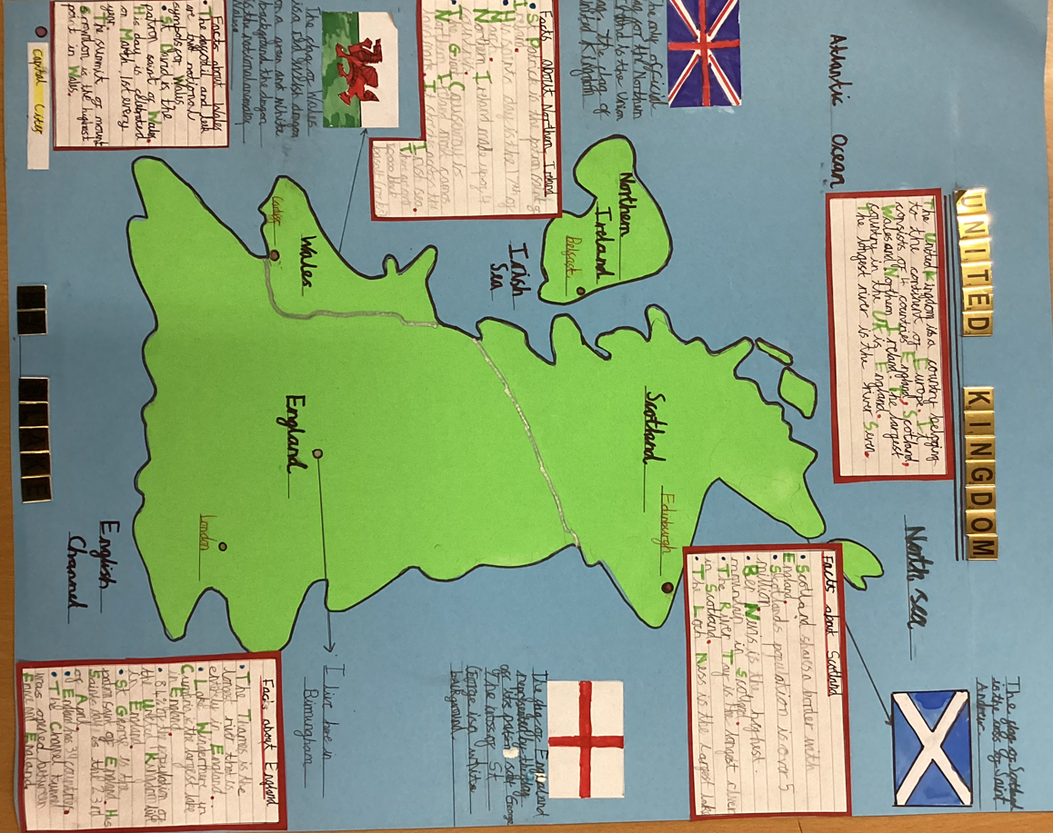
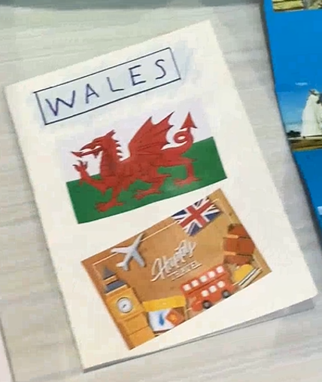
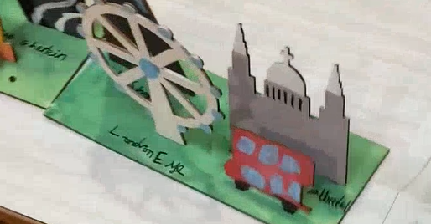
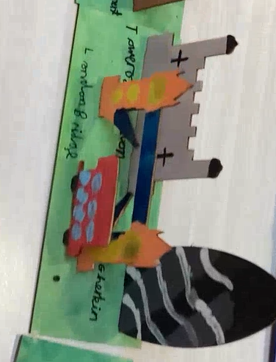
Topic Homework Ideas
Each half term your child will come home with one piece of topic homework. This can be compiled and presented in a variety of different ways such as:
Posters
PowerPoint
Booklet
Artwork
RH

Slide 10



Reading
LB
The expectation is for children to read for at least 10 minutes each day.
Please sign their reading journal when you have listened to your child read each day.
Children’s reading books will be checked and changed daily. All children are expected to bring their book bag and reading diary with them into school every day as it is part of their uniform.
It’s incredibly important that you listen to your children read every night to help us develop your child’s reading ability. On a Friday they will also bring home a ‘bedtime storybook’ to share with an adult over the weekend.

Slide 11

RP
P.E
We are continuing to request all children to come to school wearing their PE kit on their PE day.
Year 2 P.E days are Monday and Wednesday.
A reminder that P.E kit consists of red polo shirt, black jogging bottoms and trainers. Children must come in wearing their school jumper/cardigan.
In addition to their school jumper /cardigan children may come to school with a plain black sweatshirt/hoodie on top of their school jumper/cardigan. Wearing a black hoodie should not replace a school red cardigan/jumper.
In school they take their black hoodie off with their coat and keep it for the PE lesson.

Slide 12
P.E
The wearing of any jewellery is not encouraged; watches are the only exception. We only allow analogue watches that support children to learn to tell the time - no digital/smart watches are permitted.
Children must not wear rings, chains, necklaces or earrings that hang below the ear e.g. sleepers. If parents still wish children to wear earrings, despite the risks of injury, only the small plain tiny stud type are allowed (maximum number of one per ear in the centre of the lobe). Staff cannot be held responsible for looking after items of jewellery such as watches or studs.
Children are also expected to take their own earrings out for P.E lessons as required. Children must NOT wear earrings of any type for swimming.
Therefore, we discourage any jewellery on P.E days.
RP

Slide 13
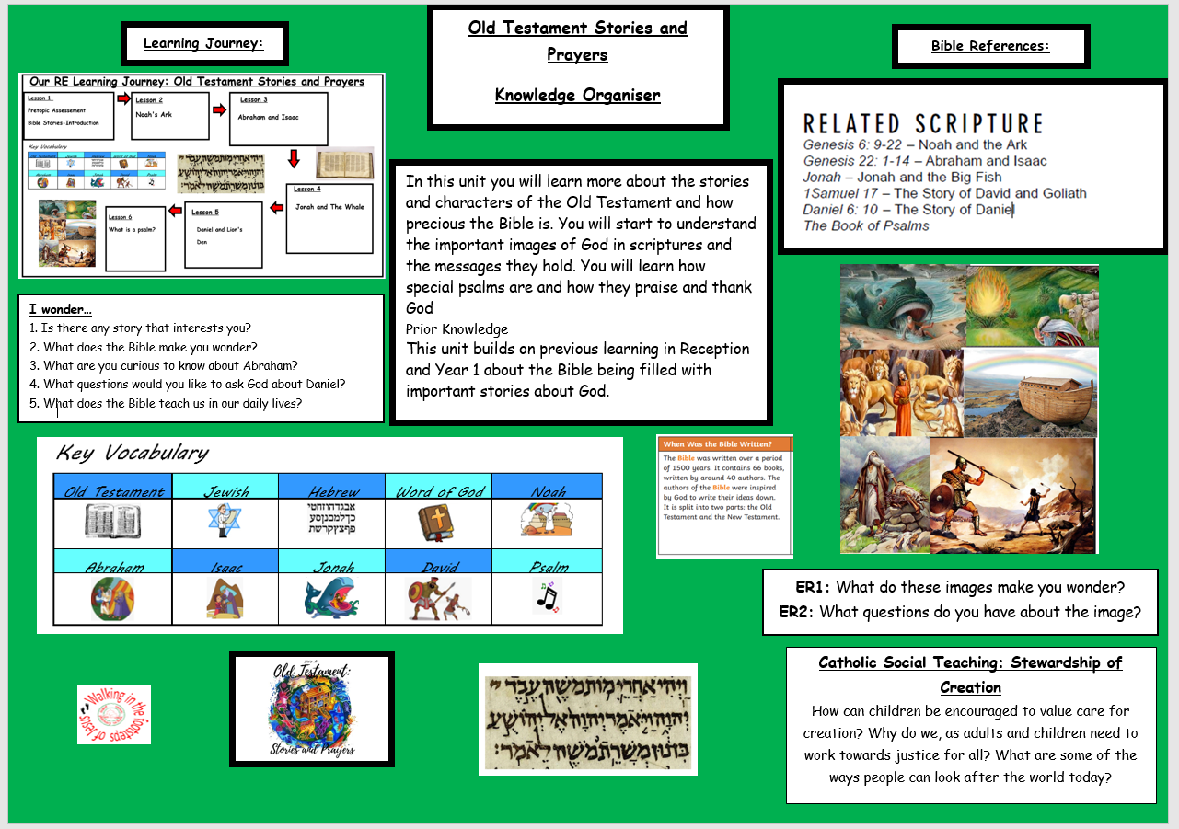
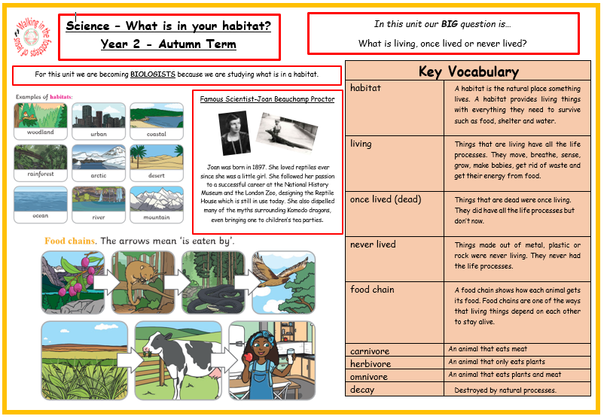
LB
Knowledge Organisers
Each half term your child will bring home an overview of the curriculum for the upcoming weeks paired with the appropriate Knowledge Organisers.
Please have a look at these with your children and talk about some of the language and things we will be looking at in preparation. Knowledge organisers are also a fantastic resource for consolidating learning at home.

Slide 14
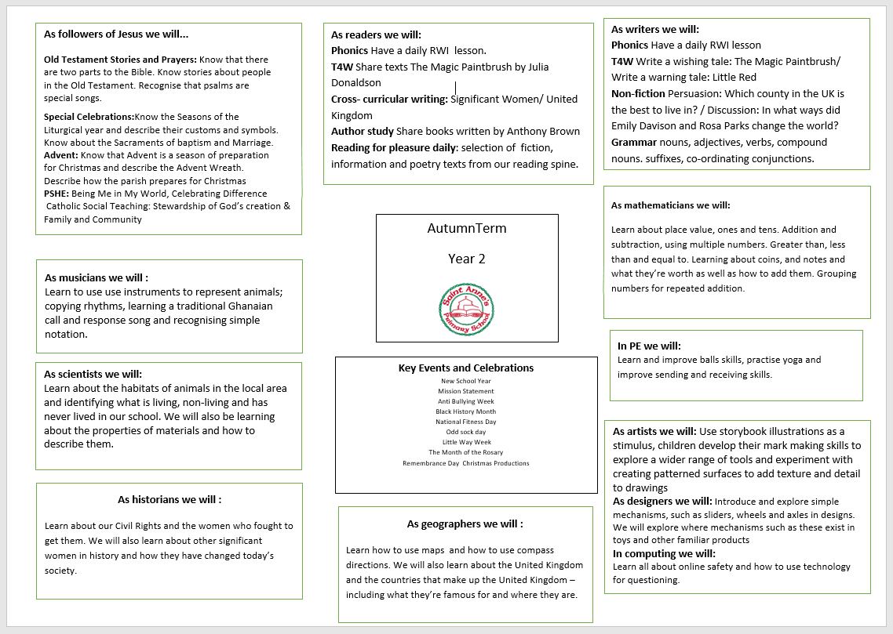
Curriculum Overview
LB

Slide 15


Personal Development Opportunities
RP
We also believe that children’s development is just as important as their academic progress.
Here are some ways in which enrich and encourage children’s personal development in Year 2.

Slide 16

Relationships and Health Education
LB
Relationships and Health Education (RHE) is a statutory part of the primary curriculum and must be taught in all schools.
• It forms an important part of our safeguarding education, helping children develop the knowledge, language and skills they need to stay safe, build positive relationships, understand healthy lifestyles and support their emotional wellbeing.
• As part of ongoing updates to our curriculum, changes to our RHE programme came into effect this September. These changes ensure our teaching continues to meet statutory requirements and reflects the needs of children growing up in today's world.
• All RHE content is taught in an age-appropriate and sensitive way and is designed to support children at their stage of development.
• We value working closely with parents and carers and keeping you informed of any important updates or changes to the curriculum.

Slide 17
LB
In July, we shared details of the proposed changes and invited parent feedback through a consultation process.
We were delighted to receive overwhelmingly positive and supportive responses, and we would like to thank everyone who took the time to share their views.
• We remain committed to working in partnership with families and welcome any questions you may have about the curriculum.
• Parents and carers can view curriculum materials and find out more about the programme using the link below:
Life to the Full Parent Information https://www.tentenresources.co.uk/life-to-the-full-primary/
• If you have any questions or concerns, please speak to your child's class teacher in the first instance, or contact a member of the senior leadership team.

Slide 18
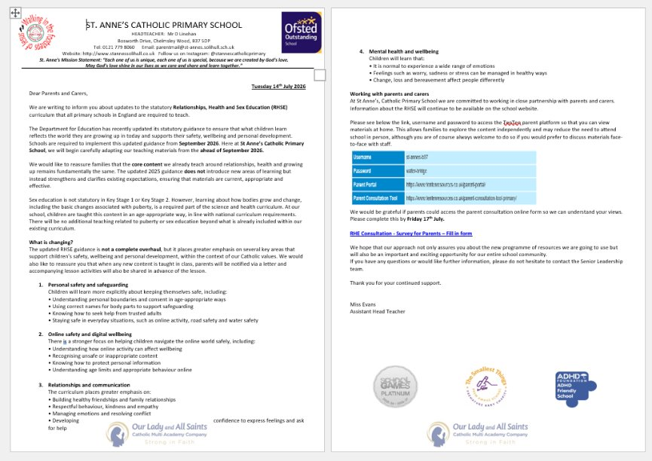
LB
This is the letter shared win July outlining the proposed changes and inviting consultation feedback prior to implementation in September.

Slide 19
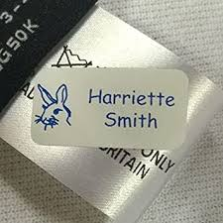

Please ensure all items of your child’s uniform have their names in them.
Please send them to school with a named water bottle every day-WATER ONLY.
A medical form is needed for any new creams/gels/soaps that have been prescribed by a doctor. Please ask us for one of these.
We hope all of the children have a fantastic year in Year 2!
RP
And Finally …

Slide 20
If you have any questions please phone the school office or send your class teacher an email.
parentmail@st-annes.solihull.sch.uk
In the event of an urgent response,
please contact the school office 0121 779 8060
We will not hesitate to help!
Thank you for all your support and cooperation!
LB

