Slide 1


Notes:
Good Morning
Thank you for taking the time to join us this morning.
Purpose of this meeting – give you key information about the course of the year.
Children have settled into year 1 beautifully.

Slide 2

Prayer to Saint Anne
Saint Anne
Since Mary was your daughter
and Jesus your grandson,
look lovingly upon our families
in the same way that you looked upon the
Holy Family in Nazareth,
and intercede for us in heaven
where we all hope to meet one day
as members of the one, splendid family of God,
our sins forgiven,
our problems solved
and our hearts filled with love
Amen
Notes:
If we could start with our st anne’s prayer by making the sign of the cross together.

Slide 3
Catholic Life and Collective Worship
As a Catholic School we practise our faith every day.
All children take part in Celebrating the Word of God each day.
Children also take part in liturgies and go to Church.
Children say daily prayers.

Slide 4
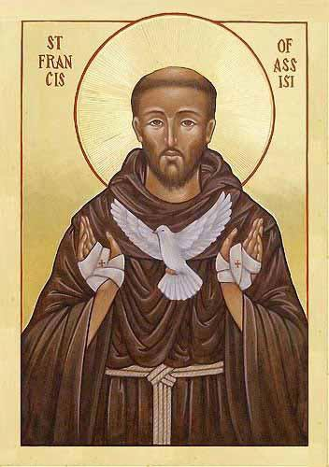
Year 1 Class Saint: Saint Francis of Assisi
Feast Day: October 4th
Patron Saint of: animals and ecology
Birth: Around 1181 - 1182
Death: October 3rd 1226
Canonised: July 16, 1228, by his former protector, Pope Gregory IX.
Notes:
Each year group has a focus class saint.
Over the year the children will learn about the life of St Francis and the qualities that we can take from him.
There will be projects sent home that focus on St Francis and his life so it would be lovely if you could participate in them with your child or children.

Slide 5
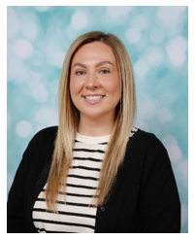
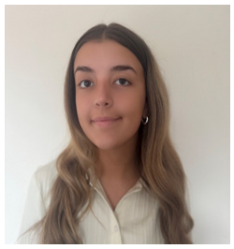
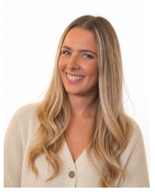
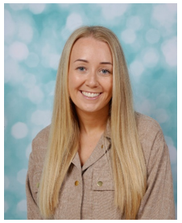
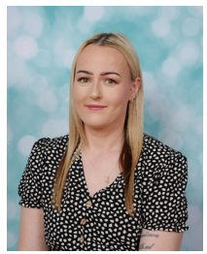
Meet the Year 1 Team!
Please note as well as the Year 1 team there will be other school staff including inclusion staff, staff who cover part time hours, senior leaders, dinner supervisors and staff who cover absences who will also work in this year group as required linked to school organisation.
In 1O’C we have… Miss O’Connor Miss Strong
In 1S we have… Miss Smart Miss Cartlidge Miss Bell
Notes:
I am also the KS1 lead.
First port of call is class teacher but if there is anything you wish to discuss further I will be your next port of call.

Slide 6
Parent Reminders
The school gates open for the start of the day a few minutes before 8.30am each
morning.
School begins at 8.30am.
Registration finishes at 8.40am.
Children who arrive after 8.40am need to go to the main office to be registered. They will receive a late mark.
Children who arrive at school after 9.10 receive an Unauthorised mark that morning.
(10 or more unauthorised absences may require the involvement of external agencies)
The children at Saint Anne’s work very hard every single day.
They continue their learning until 3.15pm. It takes several minutes to get coats , belongings etc
before children leave. With 30 children to dismiss it can take 5 or so minutes after 3.15 to dismiss
all children. Please be patient.
Friday finish - gates open at 2.05pm and children need to be collected by 2.10pm.
All children must be collected by an authorised adult. If another adult is going to collect your child please inform your class teacher with advance notice.
If you have any queries wherever possible please send these into our
parent email: parentmail@st-annes.solihull.sch.uk

Slide 7
Homework
Maths
Each week your child will receive maths homework. This will link either to key skills that your child is expected to know by the end of year 1 or their weeks learning in class.
Spelling Frame
Please log on to Spelling Frame to access the list of words for this week. You will also receive a printed list of the words every Friday. Ideally, children who have access to the online resource should take the test on Spelling Frame (as many times as they wish) and they will also be assessed in school each Friday.
Topic Homework
Each half term, we will send home a list of suggested activities linked to the History or Geography topics your child is learning about in school. Homework is set half termly and should be returned by the end of each half term.
We love celebrating the wonderful work children complete at home! Their work will be shared in class and displayed in the hall for children across the school to enjoy. It is a lovely opportunity to spend time learning together and explore your child’s school topics.
Notes:
Spelling frame – these log ins have not yet been sent to you but as we begin spellings you will receive it.

Slide 8
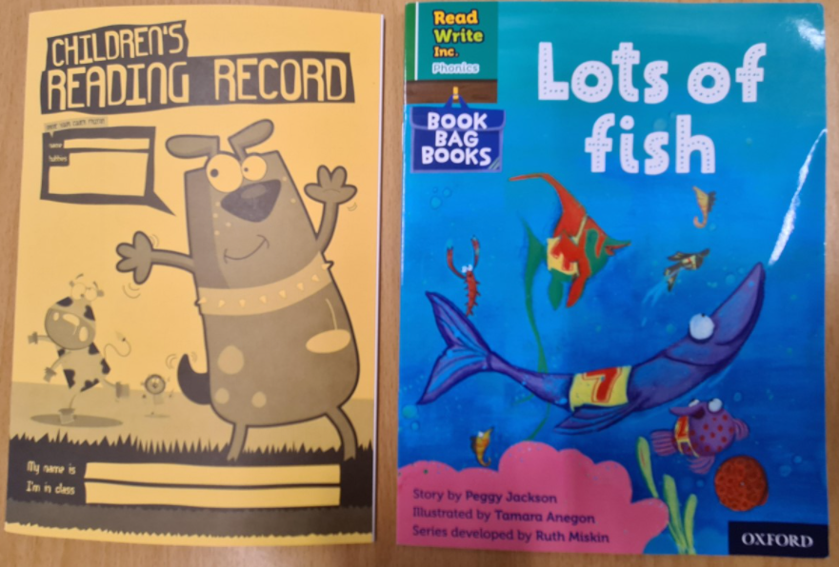
Reading
The expectation is for children to read for at least 10 minutes each day.
Please sign their reading journal when you have listened to your child read each day.
Children’s reading books will be checked and changed daily. All children are expected to bring their book bag and reading diary with them into school every day as it is part of their uniform.
It’s incredibly important that you listen to your children read every night to help us develop your child’s reading ability.
Children will also bring home a bedtime story for you to read to your child. This will be changed each day. This does not need to be recorded in reading diaries.

Slide 9



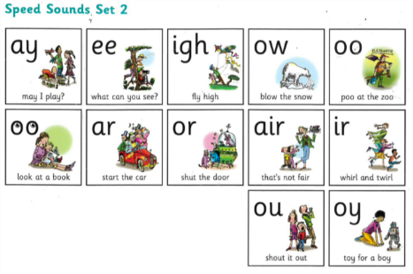

Phonics is a way of teaching children the skills of reading and writing.
How we teach phonics in school:
Phonics is taught every day.
Phonics is differentiated in each class and children are grouped based on their phonics needs.
Phonics is reinforced throughout all lessons and learning, to embed the skills and knowledge.
Notes:
Your children are at their age where they are beginning their reading journey.
As a school we are extremely passionate about reading and we embed those reading skills through a phonics scheme – RWI.

Slide 10
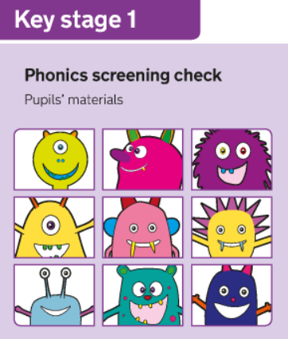
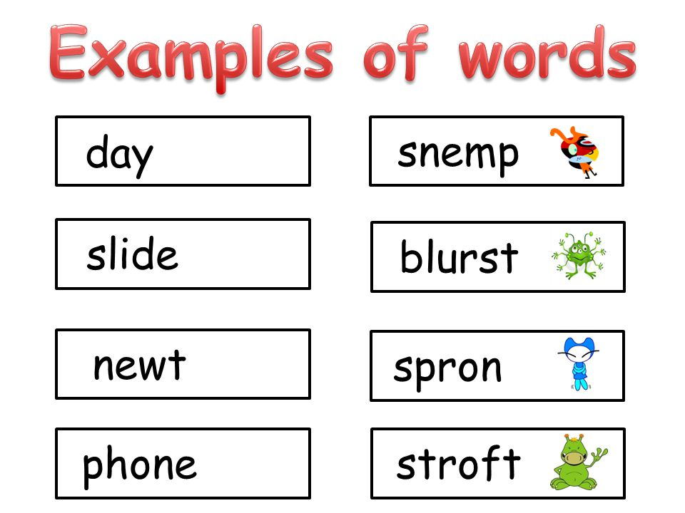
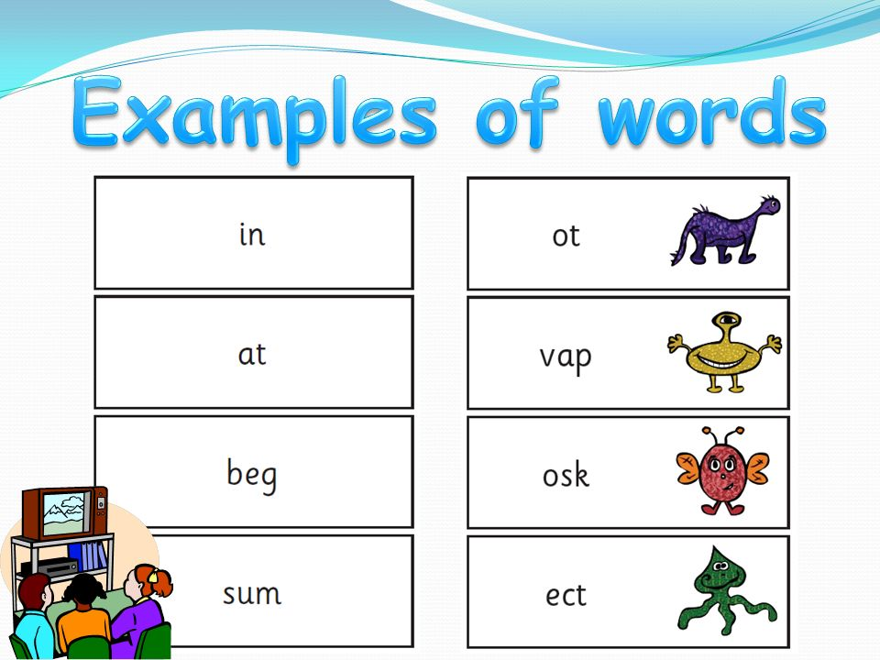
Phonics Screening
At the end of year 1 we have a phonics screening check to asses the children’s phonics ability.
Children are asked to read 40 real and nonsense words.
This is used as an assessment tool to inform teachers planning.
Children are assessed individually by a teacher. They do not know they are being assessed and are told that they are playing a game. (Please support school with this- children do not need to know.)
If your child doesn’t meet the pass rate they will retake the check in year 2.
Parents will be informed of the results alongside the end of year report.
Notes:
It is statutory through the government – like SATS.

Slide 11

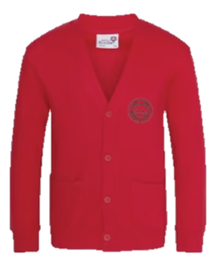


Uniform
Winter Uniform
White collared shirt
Green tie (available through Parent Pay)
Red jumper or cardigan
Girls – Grey school skirt
Boys – Grey school trousers
Black school shoes. (No Converse)
Summer Uniform
Girls
Red gingham summer dress
Red cardigan
White socks
Black school shoes
Boys
Red polo
Red jumper
Grey school shorts
Dark socks
Black school shoes
Children are expected to bring their book bags every day as part of their uniform.
Trainers should only be worn on PE days.
Smart watches with cameras or voice recording functions are not permitted.

Slide 12

P.E
Year 1 P.E days are Tuesday and Thursday. Children to arrive at school in their PE kit.
A reminder that P.E kit consists of red polo shirt, black jogging bottoms and trainers. Children must come in wearing their school jumper/cardigan.
In addition to their school jumper /cardigan children may come to school with a plain black sweatshirt/hoodie on top of their school jumper/cardigan. Wearing a black hoodie should not replace a school red cardigan/jumper.
In school they take their black hoodie off with their coat and keep it for the PE lesson.
For shoes children must wear appropriate trainers.

Slide 13
Jewellery
The wearing of any jewellery is not encouraged, watches are the only exception. We only allow analogue watches that support children to learn to tell the time - no digital/smart watches are permitted.
Children must not wear rings, chains, necklaces or earrings that hang below the ear e.g. sleepers. If parents still wish children to wear earrings, despite the risks of injury, only the small plain tiny stud type are allowed (maximum number of one per ear in the centre of the lobe). Staff cannot be held responsible for looking after items of jewellery such as watches or studs.
Children are also expected to take their own earrings out for P.E lessons as required. Children must NOT wear earrings of any type for swimming.
Therefore, we discourage any jewellery on P.E days.
Notes:
Jewellery is not encouraged at St Anne’s – except for small studded earrings.
Any earrings that hang below the ear lobe will be asked to be taken out.
If your child would like to wear a watch then this must be an analogue watch, not a smart watch.
I

Slide 14
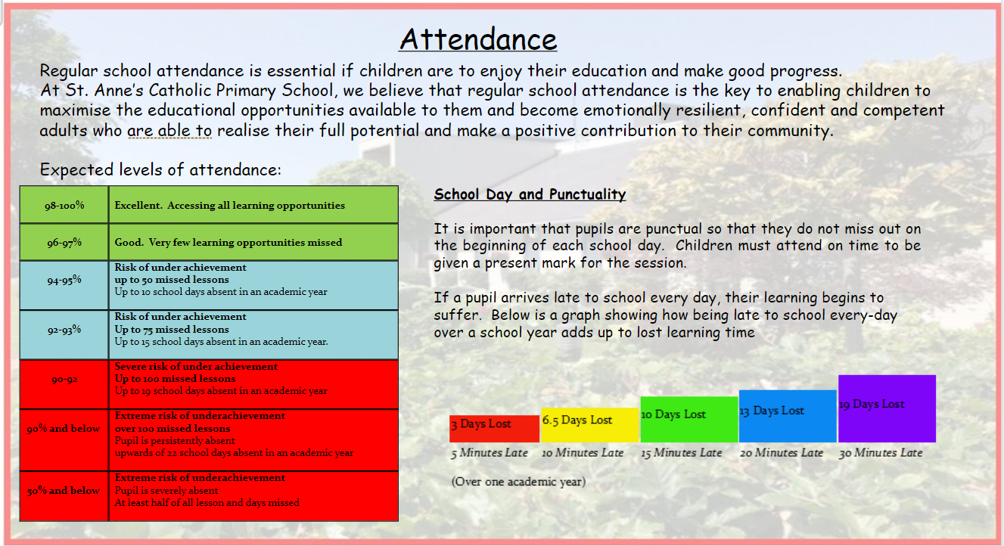
Notes:
As a school we aim for 100% attendance.
On the left you can see a grid with outlines the effects absences can have on your child's education.
Read and point out the school day – punctuality area.

Slide 15
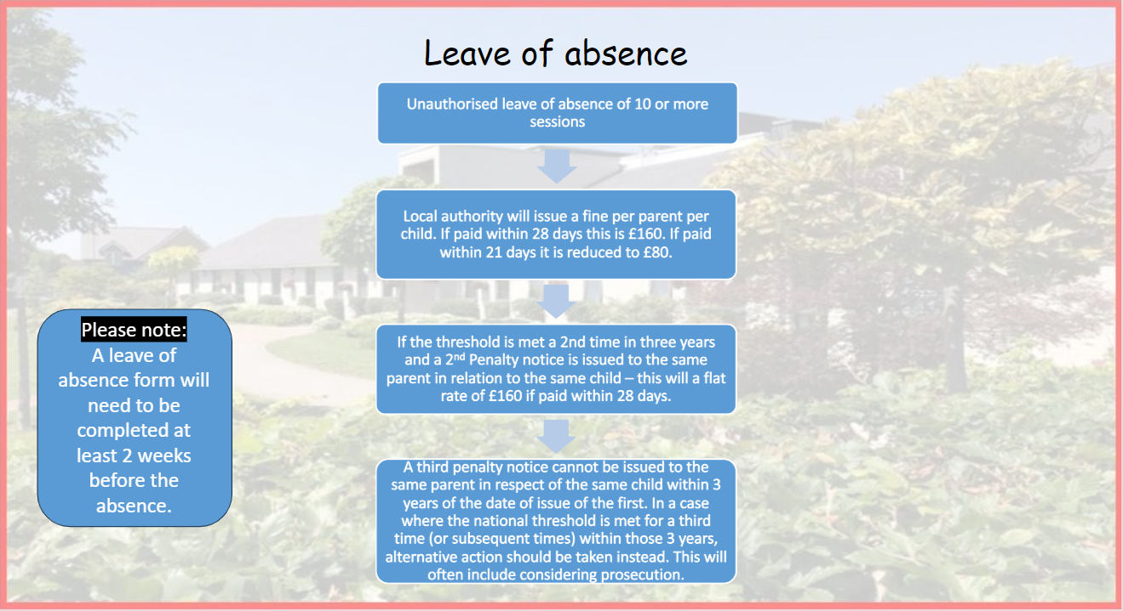
Notes:
Read from slides

Slide 16
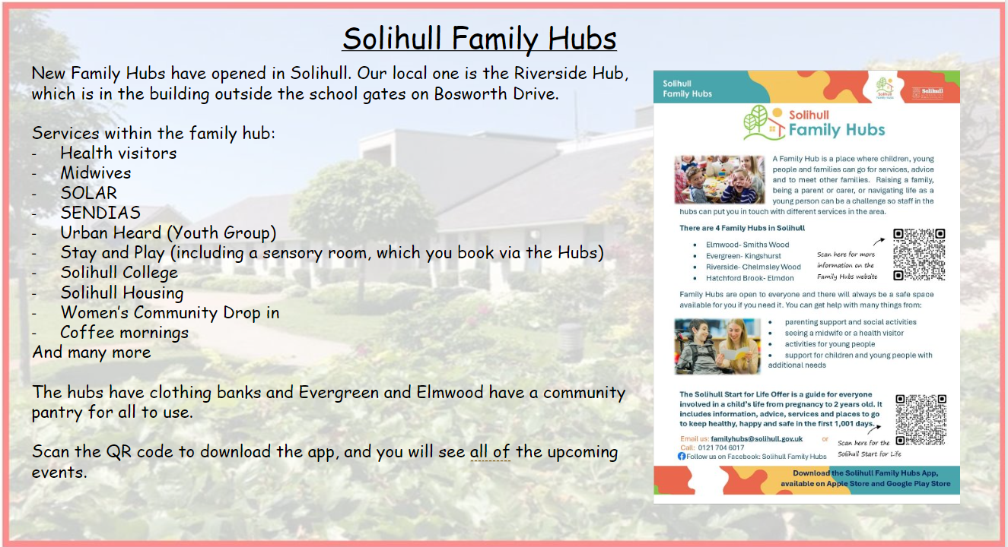

Slide 17

School Dinners
To order your child’s dinner, please order this via Parentpay.
Your ParentPay account will need to be in credit as all meals have to be paid for in advance.
There is more guidance on our website for ordering your child’s dinners.
There is also a family information pack, produced by Aspens for you all to look at.
Children are provided with a varied, hot and nutritious dinner is available every day, including a jacket potato or pasta pot or sandwiches.
If you are not able to access your ParentPay account, please contact the school office via Parent mail.
Please apply for Free School Meals if you think you may be entitled to these via Solihull Council.

Slide 18
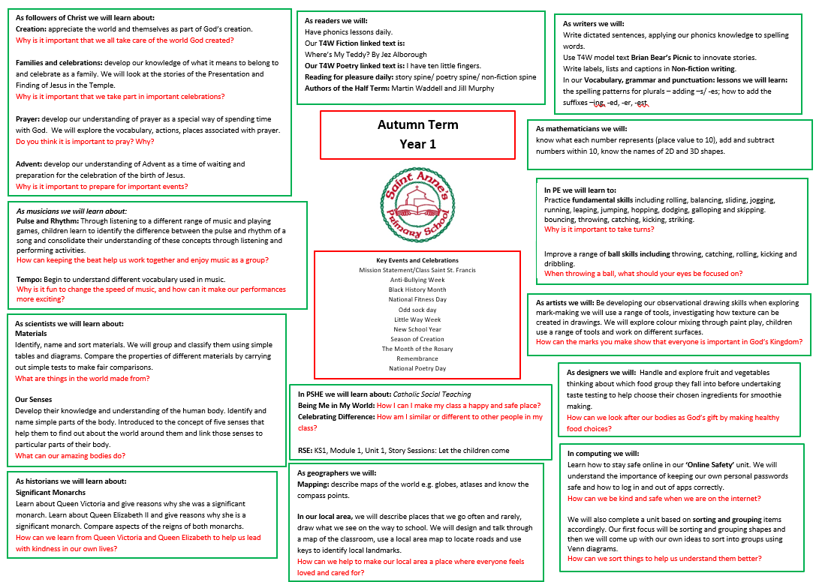
Each term you will receive a curriculum overview so you understand what your child will be learning in school.
Notes:
The writing in black is the content of learning.
The writing in red are the big questions that children will answer at the end of a unit.
We always encourage children's parents to talk about their child's learning with them and this is a helpful document to support you in doing this.
These will be emailed out to you each term (so autumn, spring and summer).

Slide 19
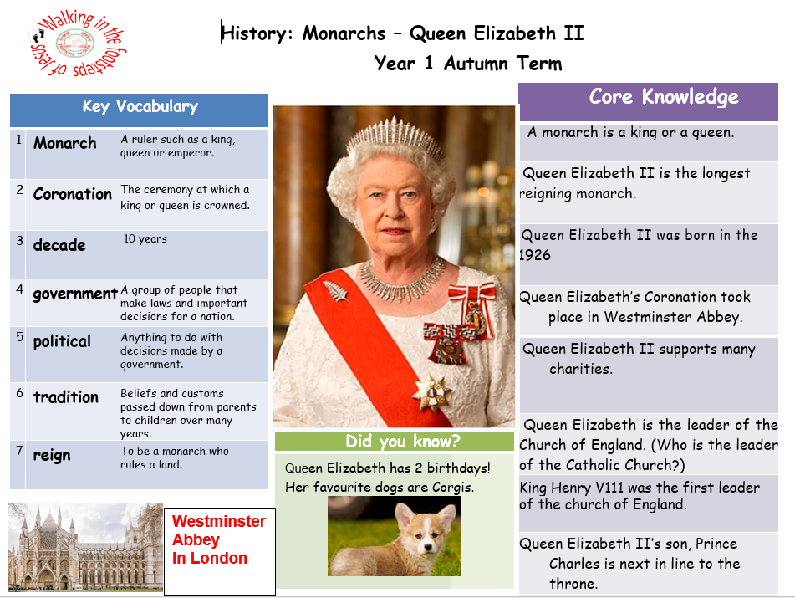

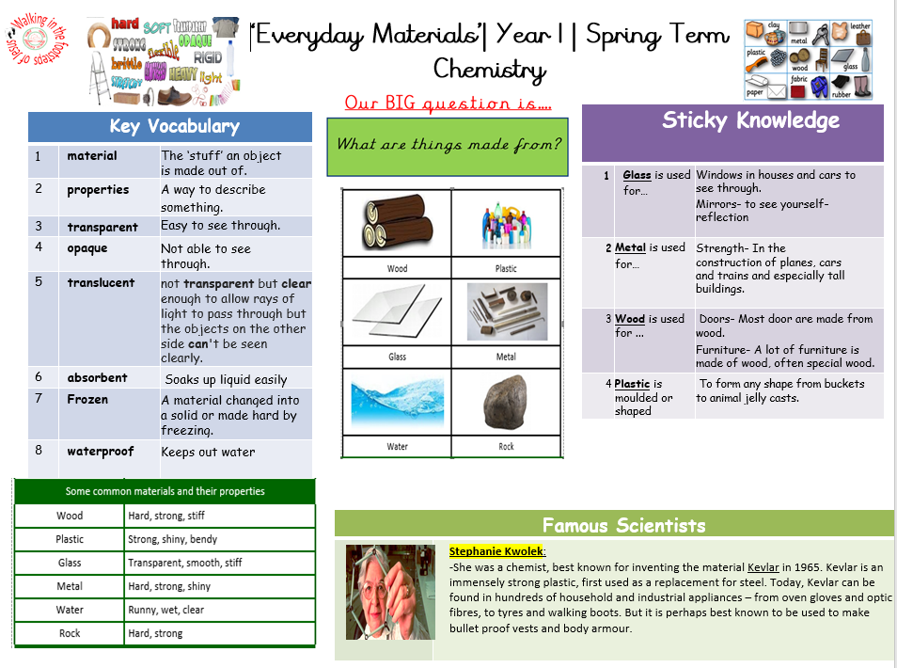

Knowledge Organisers
Each half term your child will bring home an overview of the curriculum for the upcoming weeks paired with the appropriate Knowledge Organisers.
Please have a look at these with your children and talk about some of the language and things we will be looking at in preparation. Knowledge organisers are also a fantastic resource for consolidating learning at home.

Slide 20
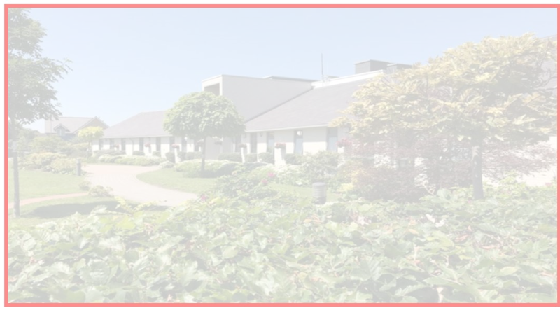


Building the Kingdom
Building the Kingdom is a faith-based initiative that weaves Catholic values throughout our curriculum. By engaging with big questions, children are encouraged to explore themes of faith, justice, and their role in the world. This approach supports our mission to guide young people into becoming compassionate, responsible individuals who live the Gospel and understand their place in God’s plan.
Notes:
Building the Kingdom is a Catholic initiative that We follow at St Anne’s
Building the Kingdom means helping children put our Catholic values into action every day. Through lessons, big questions and real-life experiences, children learn to love and care for others, make good choices, look after God’s world and live out the teachings of Jesus. We are helping to put their faith into action.
As an example we ask children to be stewards of God’s creation – to learn to care for the world around them. As a school to live this out by having litter pickers who litter pick in the school grounds but also our local area. We are putting ours and their faith into action.

Slide 21

Relationships & Health Education
Relationships and Health Education (RHE) is a statutory part of the primary curriculum and must be taught in all schools.
• It forms an important part of our safeguarding education, helping children develop the knowledge, language and skills they need to stay safe, build positive relationships, understand healthy lifestyles and support their emotional wellbeing.
• As part of ongoing updates to our curriculum, changes to our RHE programme came into effect this September. These changes ensure our teaching continues to meet statutory requirements and reflects the needs of children growing up in today's world.
• All RHE content is taught in an age-appropriate and sensitive way and is designed to support children at their stage of development.
• We value working closely with parents and carers and keeping you informed of any important updates or changes to the curriculum.
Notes:
Relationships and Health Education (RHE) helps children learn how to stay safe,
look after their health and wellbeing,
understand their feelings and build positive,
respectful relationships with others.
It is a statutory part of the curriculum and is taught in an age-appropriate and sensitive way, with parents and carers kept informed of important updates.

Slide 22
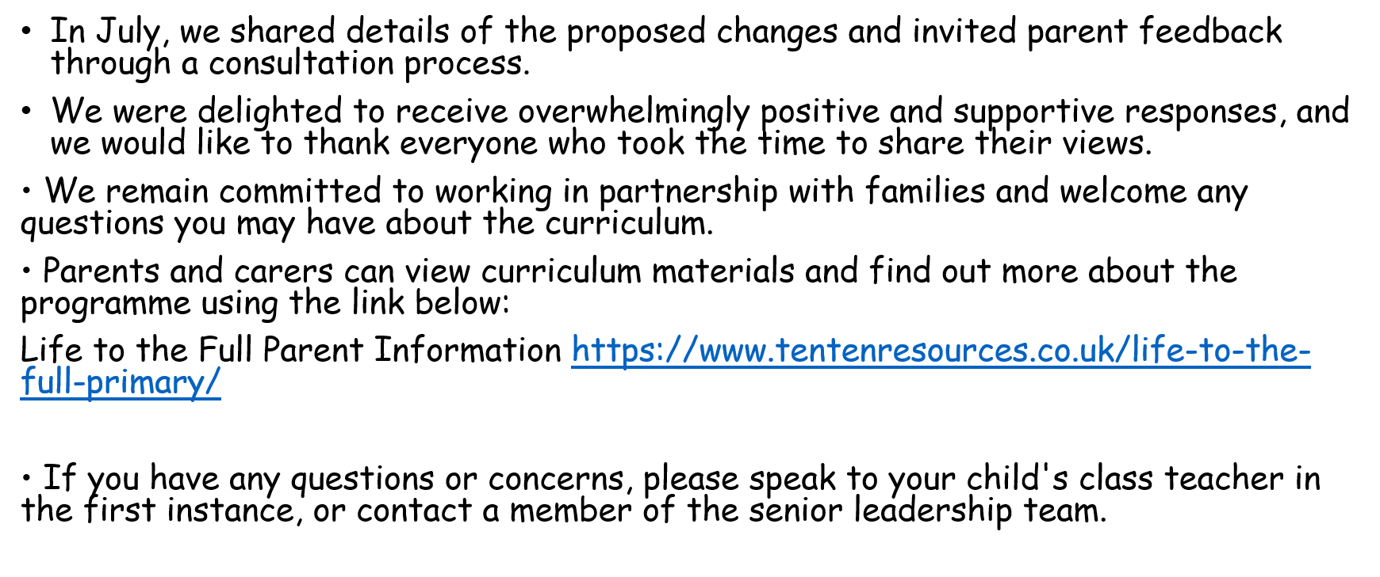

Slide 23
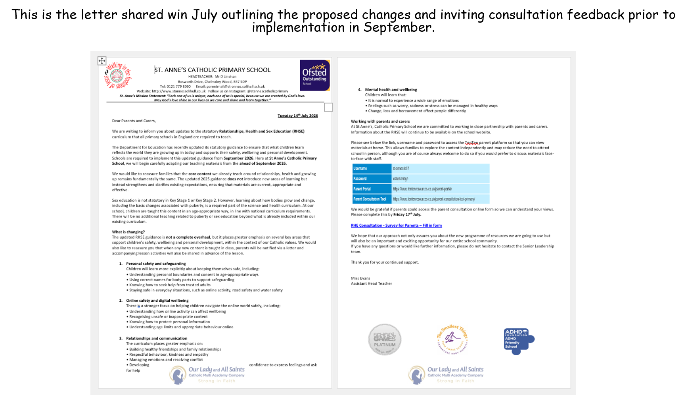

Slide 24

Online Safety
We support parents and families, and aim to work together with you to keep children safe online
We can advise you on:
How to set up parental controls
Talking to your child about staying safe online
Individual guidance for the sites, apps and games that
your child uses
Important to understand and consider the parental responsibilities linked to e-safety with the support of school.
Online Safety tips are shared each week via our Newsletter.
https://www.internetmatters.org/wp-content/uploads/2015/05/ncro3p-Internet-Matters_E-safety_Primary_1.pdf
https://www.nspcc.org.uk/preventing-abuse/keeping-children- safe/online-safety/
Notes:
As we know children are growing up in the ‘digital age’.
We are here to support you and we aim to work together to keep children safe online.
We teach online safety every week at the beginning of your childs computing lessons and we also thread this throughout other areas of the curriculum too.

Slide 25
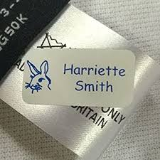


Please ensure all items of your child’s uniform have their names in them.
Please send them to school with a named water bottle every day.
A medical form is needed for any new creams/gels/soaps that have been prescribed by a doctor. Please ask us for one of these.
We hope all of the children have a fantastic year in Year 1!
And Finally …

Slide 26
If you have any questions please phone the school office or send your class teacher an email.
parentmail@st-annes.solihull.sch.uk
In the event of an urgent response,
please contact the school office 0121 779 8060
We will not hesitate to help!
Thank you for all your support and cooperation!

