Slide 1
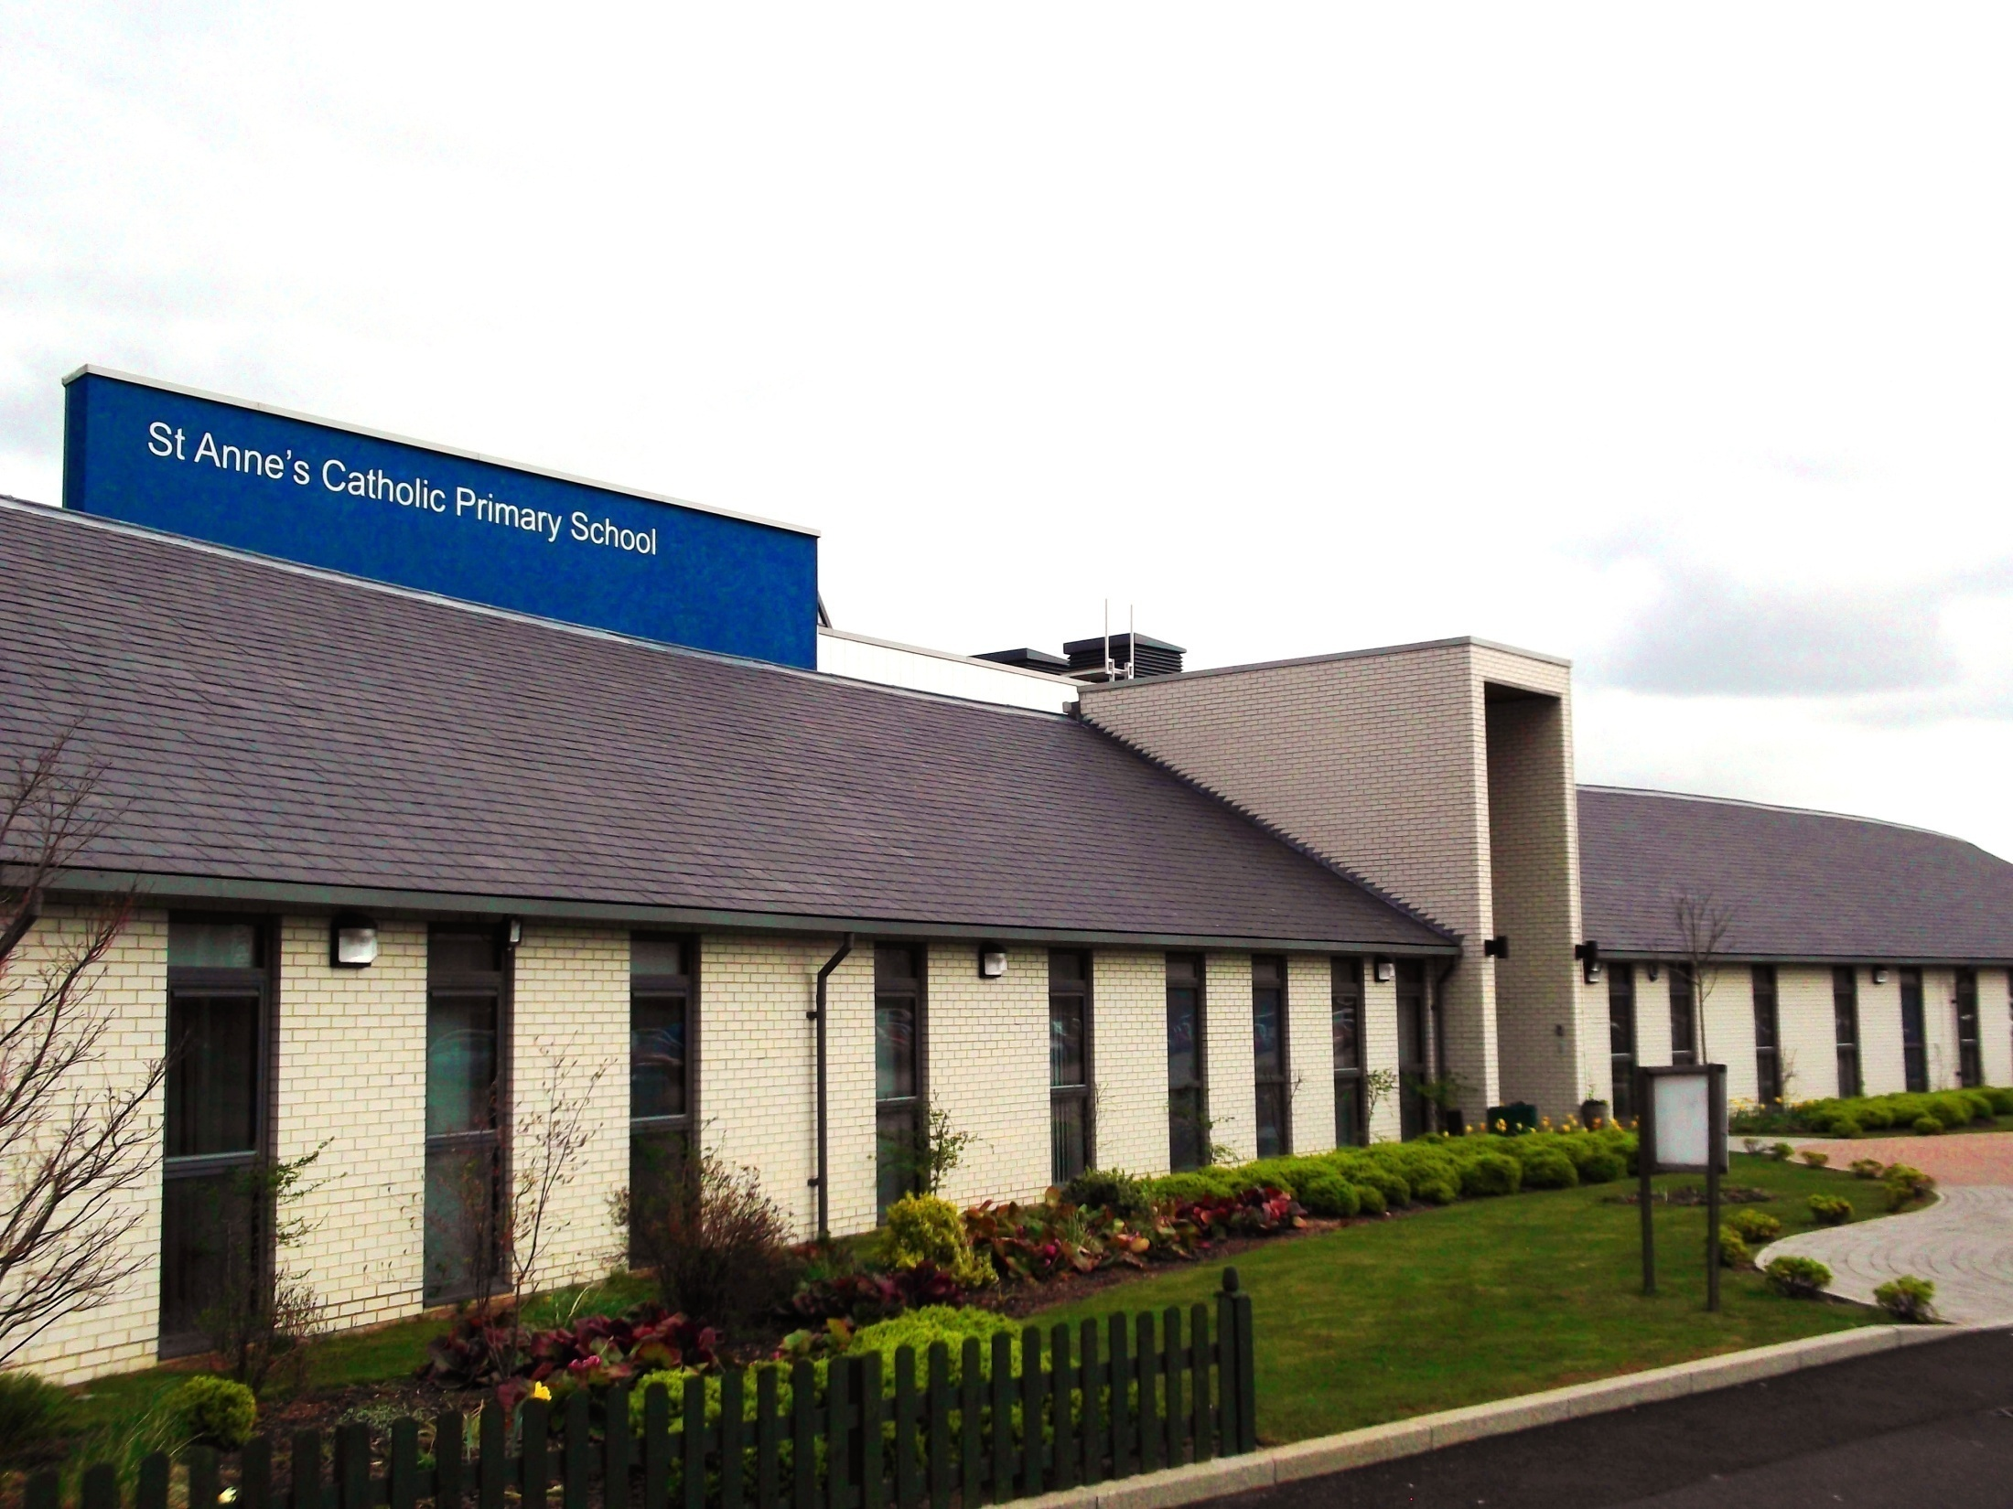

Year 6 2026-2027
Parent Information Presentation

Slide 2

Prayer to St.Anne
Saint Anne
Since Mary was your daughter
and Jesus your grandson,
look lovingly upon our families
in the same way that you looked upon the
Holy Family in Nazareth,
and intercede for us in heaven
where we all hope to meet one day
as members of the one, splendid family of God, our sins forgiven, our problems solved and our hearts filled with love
Amen

Slide 3


Catholic Life
As a Catholic School we practise our faith every day.
All children take part in a Celebration of the Word each day.
Children also take part in whole school assemblies and go to Church.
Children say daily prayers. All children will receive a prayer booklet at the beginning of the new academic year linked to traditional prayers the children will focus on in their year group. Please practise these prayers with your children at home.

Slide 4

Confirmation
The date of Confirmation is Friday 12th March 2027.
You should have received a letter detailing further information about the programme from Father Sean.
If you have any queries, please contact the parish or see parish bulletin.

Slide 5

Just a Reminder …
Attendance
Regular school attendance is essential if children are to enjoy their education and make good progress.
At St. Anne’s Catholic Primary School, we believe that regular school attendance is the key to enabling children to maximise the educational opportunities available to them and become emotionally resilient, confident and competent adults who are able to realise their full potential and make a positive contribution to their community.
Expected levels of attendance:
98-100% | Excellent. Accessing all learning opportunities
96-97% | Good. Very few learning opportunities missed
94-95% | Risk of under achievement up to 50 missed lessons Up to 10 school days absent in an academic year
92-93% | Risk of under achievement Up to 75 missed lessons Up to 15 school days absent in an academic year.
90-92 | Severe risk of under achievement Up to 100 missed lessons Up to 19 school days absent in an academic year
90% and below | Extreme risk of underachievement over 100 missed lessons Pupil is persistently absent upwards of 22 school days absent in an academic year
50% and below | Extreme risk of underachievement Pupil is severely absent At least half of all lesson and days missed
School Day and Punctuality
It is important that pupils are punctual so that they do not miss out on the beginning of each school day. Children must attend on time to be given a present mark for the session.
If a pupil arrives late to school every day, their learning begins to suffer. Below is a graph showing how being late to school every-day over a school year adds up to lost learning time

Slide 6

Lots of changes lie ahead…
Growth - both physical and academic
Socially – opportunities to develop
Spiritually – becoming closer to God

Slide 7

Being a Year 6 Leader
Your child is now a Leader of the school and officially a Year 6 Leader!
This is a hugely important part of life as a Year 6 pupil
We are all here to help the children learn about leadership and act out our Mission Statement as responsible Year 6 Leaders
We expect the children to act and behave in a way that sets a positive example to others in the school, particularly our younger children
Behaviour
Uniform standards including haircuts, jewellery
Organisation
Commitment
Independence
Initiative
Resilience.

Slide 8

If you follow the Year 6 leadership example…
Leaders badges
Saints Team points and raffle tickets
Lots of positive praise and encouragement
Head Teacher and Effort Certificates
Values and Virtues Certificates
Treats and rewards linked to whole class successes
Satisfaction and pride in the work the children have produced.
Fulfilment of high expectations: not only from staff, but for themselves!
We will be celebrating our new Leaders at Mass on the Tuesday 22nd September. You are all welcome to celebrate Mass with us at 9.15.

Slide 9
How can we work together?
Working in partnership together to ensure best outcomes for your child
Support with homework, spellings, times-tables
Reading (checking reading records daily, signing them and reading with your child)
Online safety (parental responsibility)
Helping your child prepare for school and encouraging a level of independence

Slide 10
Booster
Booster will take place every Monday after school
until 4.15pm
This is an opportunity for the staff in Year 6 to help support your child further in preparation for SATs and to further develop their confidence in the core subjects.
Booster begins on Monday 7th September

Slide 11


Reading
Children’s reading records and books (which need to be changed) are to be brought into school every day, to be checked by their teacher.
It’s incredibly important that you listen to your children read every day to help us develop your child’s reading ability.
The expectation is for children to
read for at least 10 minutes each day.
Please sign their reading record
when you have listened to
your child read each day.

Slide 12

Homework
Homework
Your child will receive Maths and English homework weekly
Maths – consolidating maths knowledge, arithmetic
English – spelling, grammar, reading
Additional Curriculum Projects
There will be opportunities for children to showcase their knowledge in curriculum projects.

Slide 13
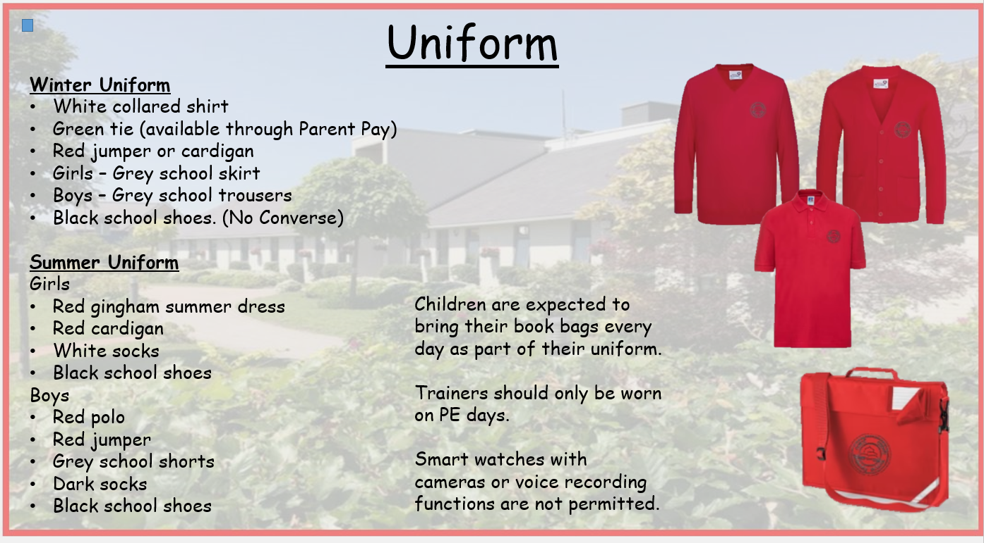
Just a Reminder …
This includes not wearing makeup or having false nails/nail polish.

Slide 14
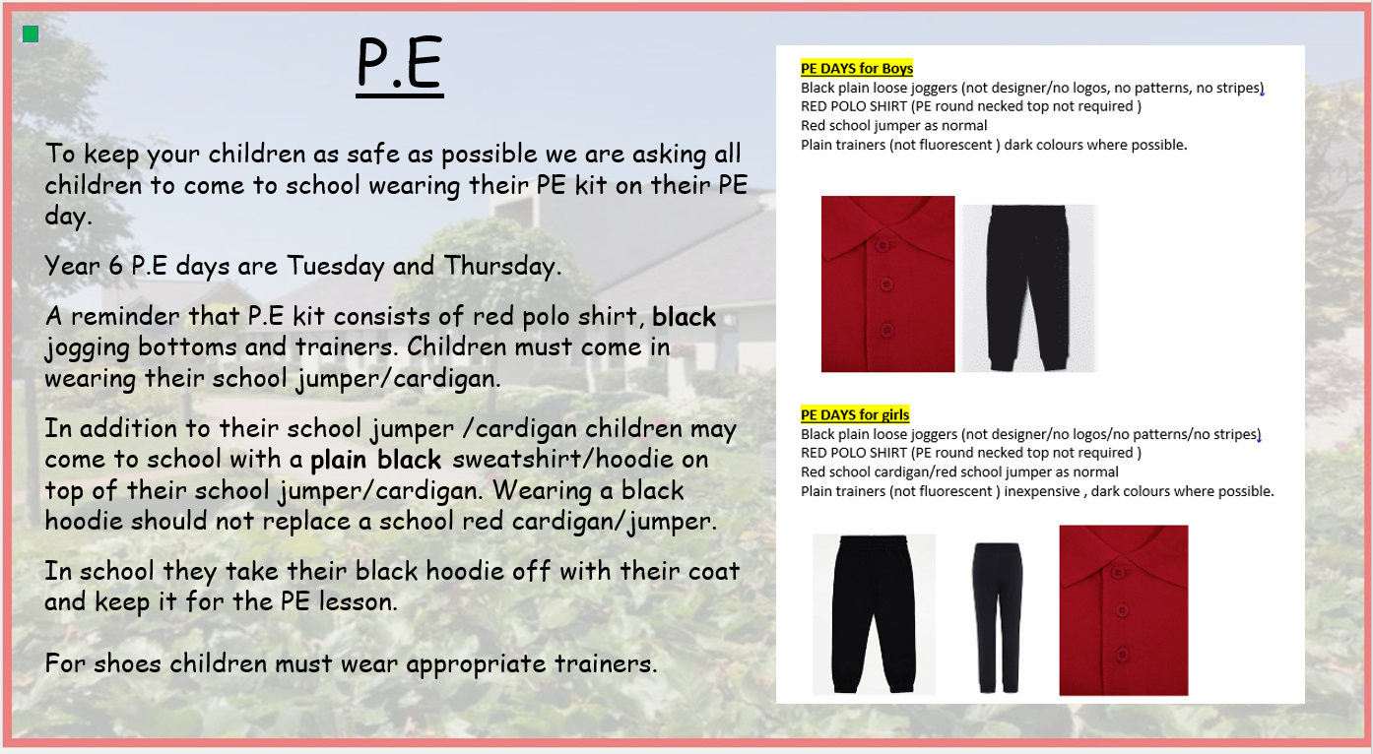
Just a Reminder …

Slide 15
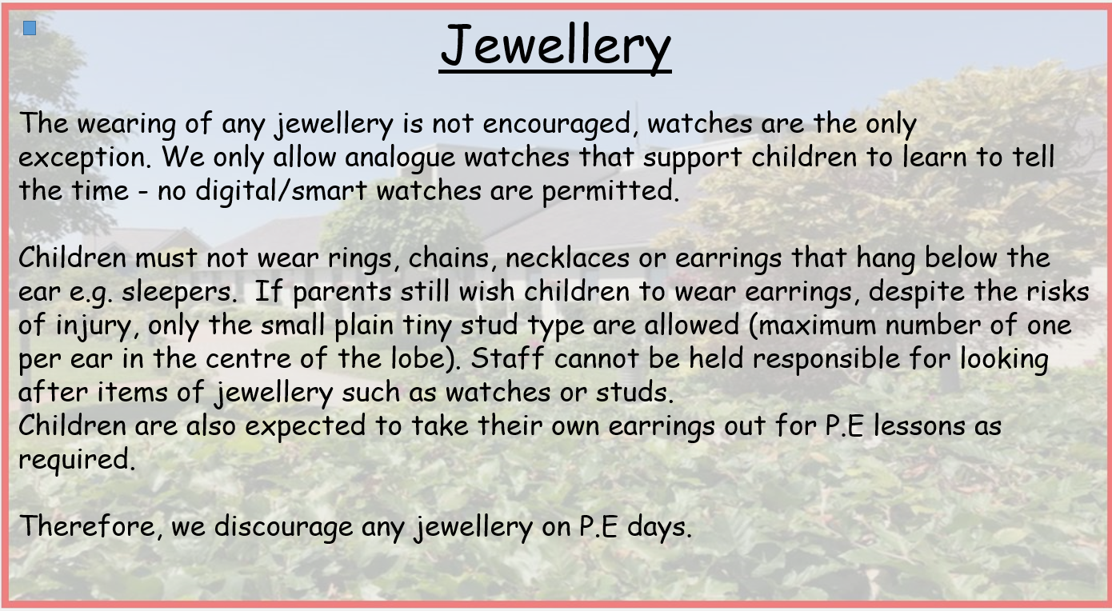
Just a Reminder …

Slide 16

Online Safety
We support parents and families and aim to work together with you to keep children safe online
Set up parental controls
Talking to your child about staying safe online
Individual guidance for the sites, apps and games that your child uses – please look at the Age Guidance for the social media websites that your child is accessing
Important to understand and consider the parental responsibilities linked to online safety with the support of school
https://www.internetmatters.org/wp-content/uploads/2015/05/ncro3p-Internet-Matters_E-safety_Primary_1.pdf
https://www.nspcc.org.uk/preventing-abuse/keeping-children- safe/online-safety/

Slide 17
Just a Reminder …
Mobile Phones
In line with our school policy, Mobile phones are not permitted at school
Only in exceptional circumstances can a mobile phone be permitted.
In this case, please speak to a member of staff in year 6 and complete the necessary paperwork.

Slide 18
End of Key Stage 2
Assessments.
Teacher Assessments
National Tests (SATS):
WC Monday 10th May 2027
Practice tests
Full attendance is vital during the year.
Full participation in lessons
No holidays are permitted.

Slide 19
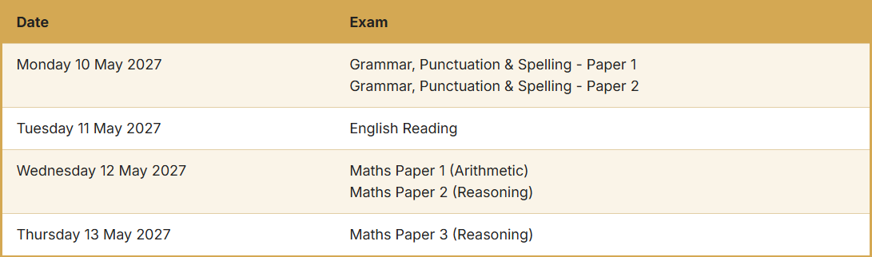
SATs (Statutory Assessment Tests)

Slide 20
Alton Castle
Kenelm Youth Trust http://www.kenelmyouthtrust.org.uk/altoncastle.html
Closer to the time, we will have a further meeting to discuss the logistics and expectations of the trip.
Dates are: 24th- 26th May 2027

Slide 21
Admissions to Secondary School.
The deadline to return the electronic form to
Solihull Council is October 31st
If applying for JHN or any other Catholic School, it is your responsibility to provide that school with your child’s Baptism Certificate with your application
You will receive an E-mail to notify you of the
Secondary School place in March.
Please note that this process all takes place online,
no postal option is available.

Slide 22
Admissions
to Secondary School….
We strongly recommend that you:
1. Make all choices on the form
(don’t select only 1 school)
2. Accept the place that is offered to you
3. If the place that is offered to you is not your
preferred choice, we recommend that you still
accept the place that you are offered
4. You then request to be placed on the waiting list for
your preferred choice.

Slide 23
Couple of reminders…
Please ensure all of your child’s uniform is named- especially jumpers. As you can imagine there are 30 jumpers that are all identical!
Please send them to school with a named water bottle every day and also their reading bag/equivalent.
If your child has any new medical issues, or any changes to those already existing, please let your class teacher know via the office.
We hope all of the children have a fantastic year in Year 6!

Slide 24
If you have any questions please phone the school office or send your class teacher an email.
parentmail@st-annes.solihull.sch.uk
In the event of an urgent response,
please contact the school office 0121 779 8060
We will not hesitate to help!
Thank you for all your support and cooperation!
Please read all texts and emails from the school regarding important information
Read our weekly newsletters for key dates and information
Follow us on Instagram @stannescatholicprimary

